Slide 1
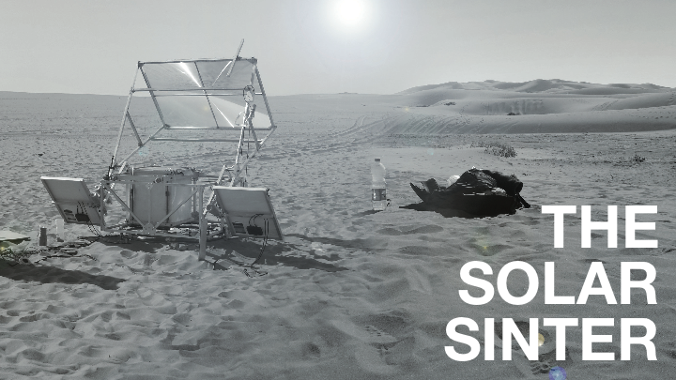

Slide 2
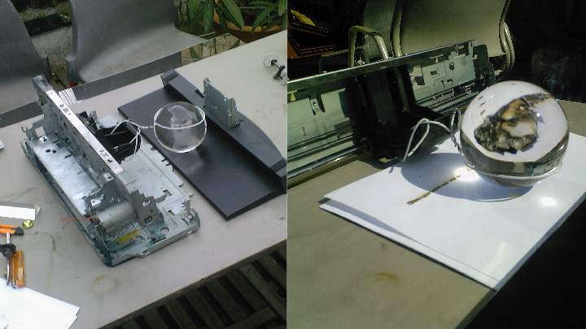

Slide 3
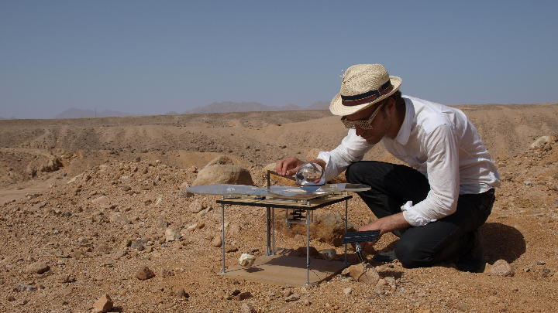

Slide 4
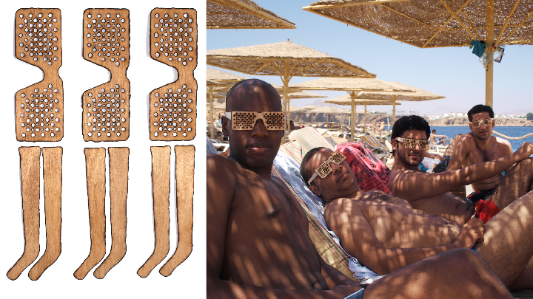

Slide 5
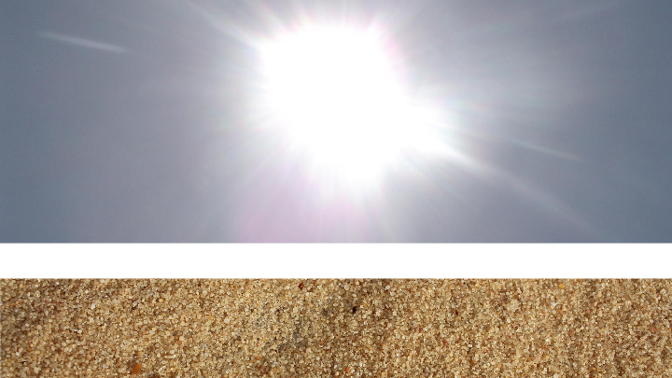

Slide 6
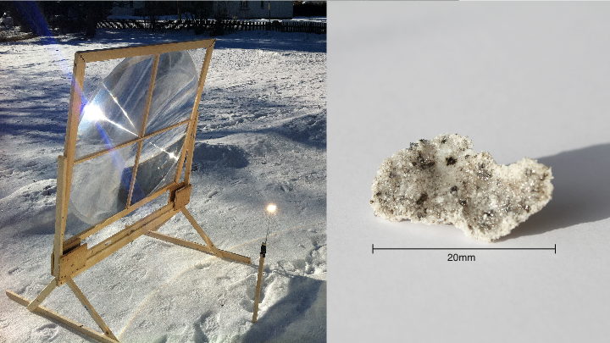

Slide 7
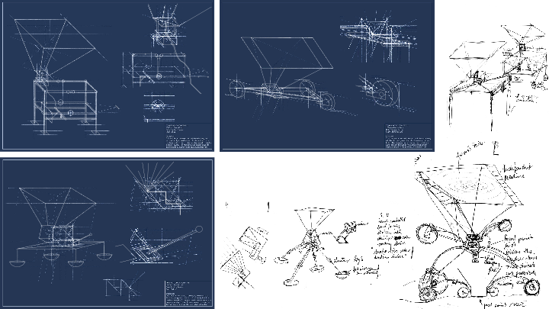

Slide 8
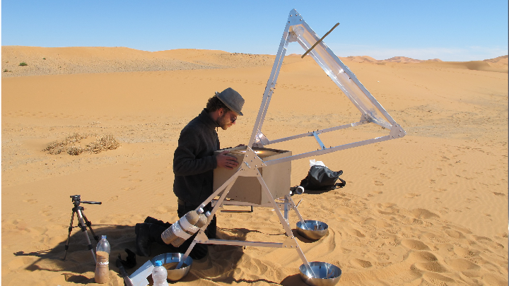

Slide 9
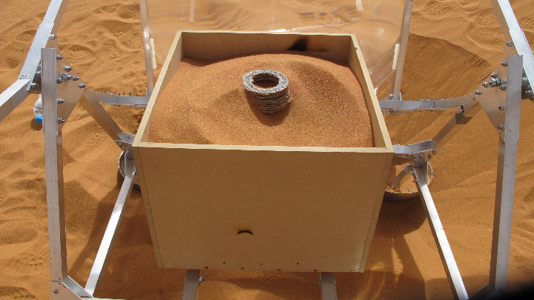

Slide 10
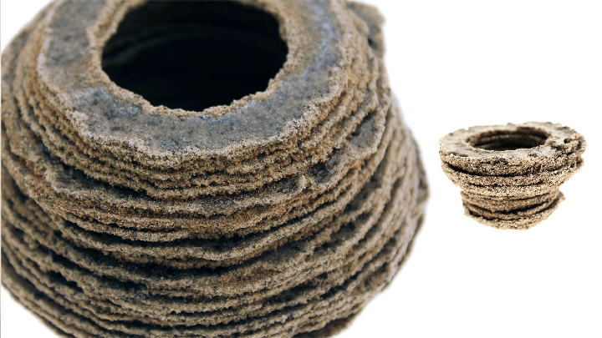

Slide 11
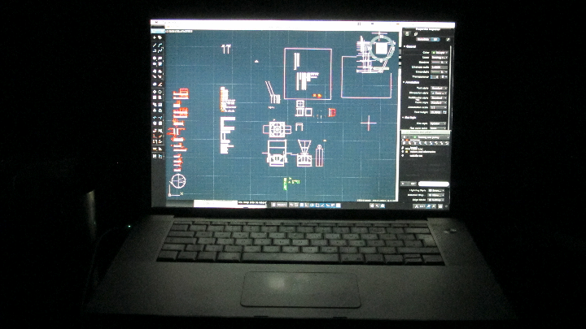

Slide 12
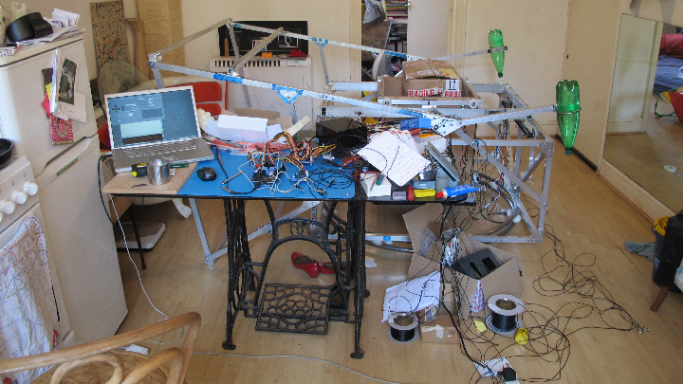

Slide 13
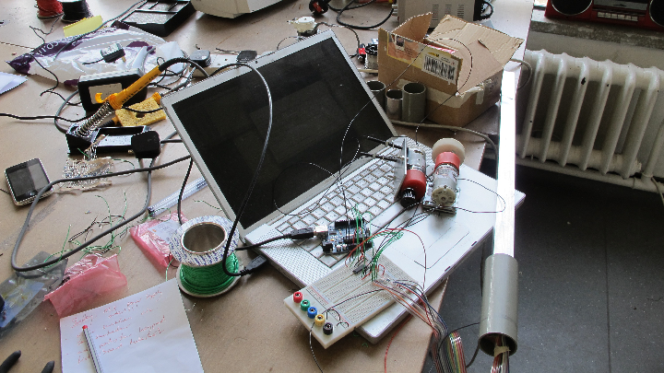

Slide 14
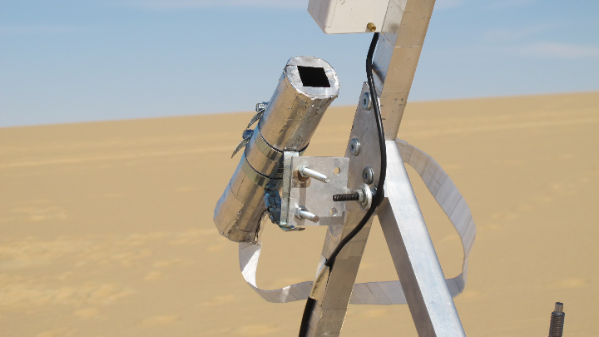

Slide 15
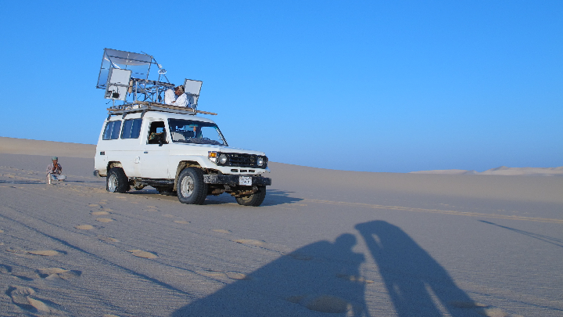

Slide 16
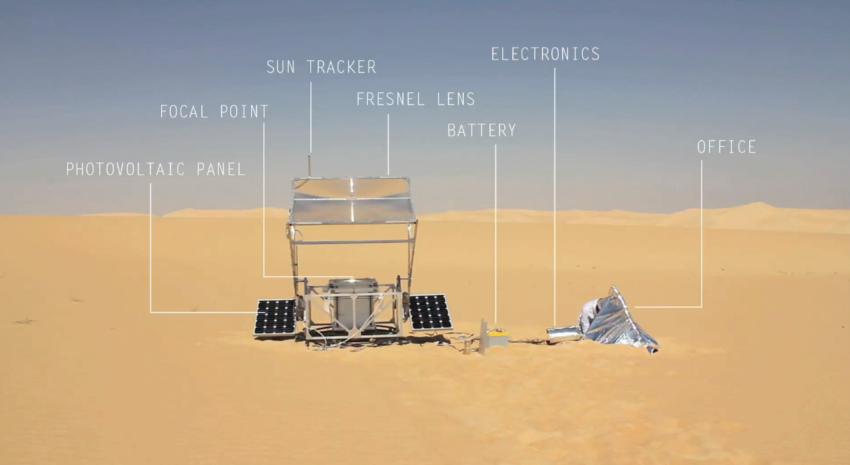
Notes:
A large Fresnel lens (1.4 x 1.0 metre) is positioned so that it faces the sun at all times via an electronic sun-tracking device, which moves the lens in vertical and horizontal direction and rotates the entire machine about its base throughout the day. The lens is positioned with its focal point directed at the centre of the machine and at the height of the top of the sand box where the objects will be built up layer by layer. Stepper motors drive two aluminium frames that move the sand box in the X and Y axes. Within the box is a platform that can move the vat of sand along the vertical Z axis, lowering the box a set amount at the end of each layer cycle to allow fresh sand to be loaded and levelled at the focal point.
Two photovoltaic panels provide electricity to charge a battery, which in turn drives the motors and electronics of the machine. The photovoltaic panels also act as a counterweight for the lens aided by additional weights made from bottles filled with sand. And of course the office where the computer is hiding from the sun.
The next clip I will show you is a close-up shot of the sand grains melting in the focal point of the lens in actual speed at 1mm per second.

Slide 17
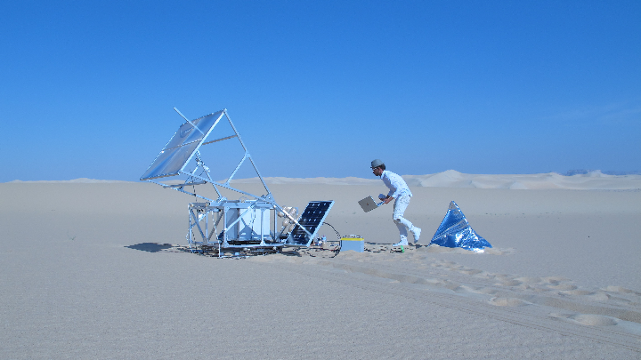

Slide 18
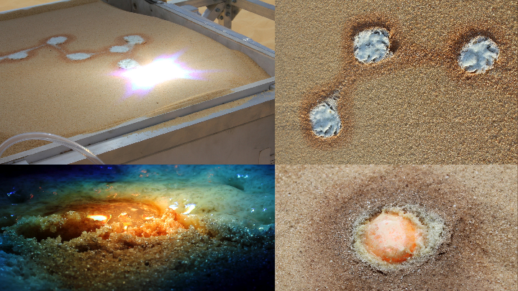

Slide 19
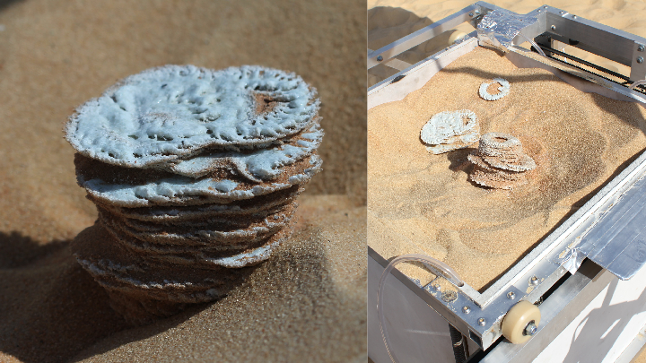

Slide 20
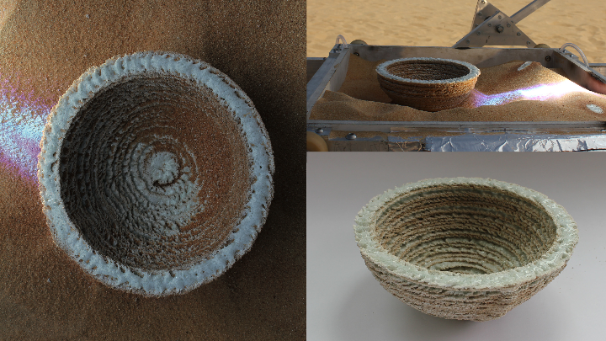

Slide 21
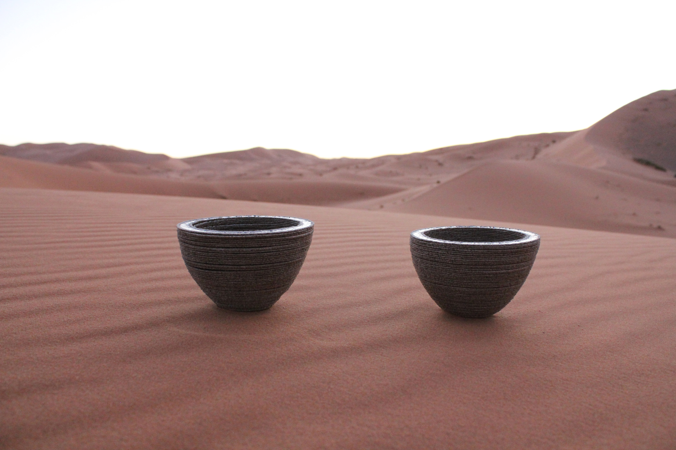

Slide 22
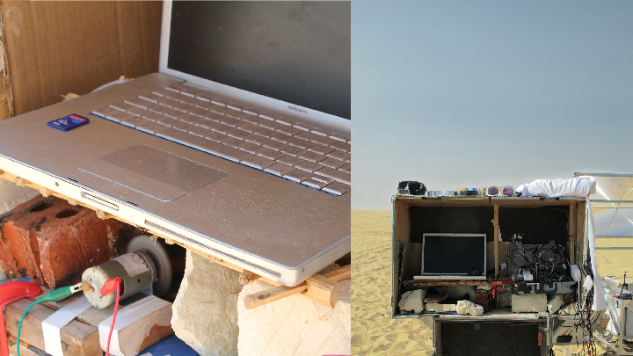

Slide 23
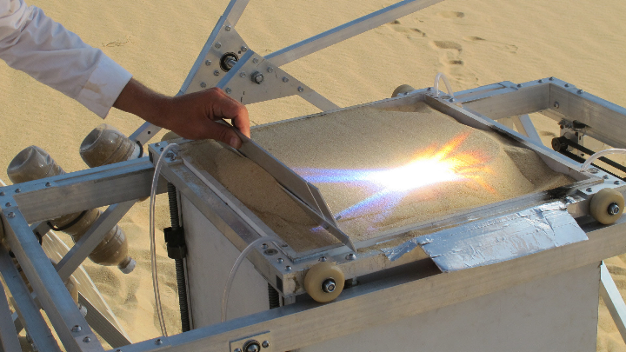

Slide 24
Solar Sinter Film (2min)

Slide 25
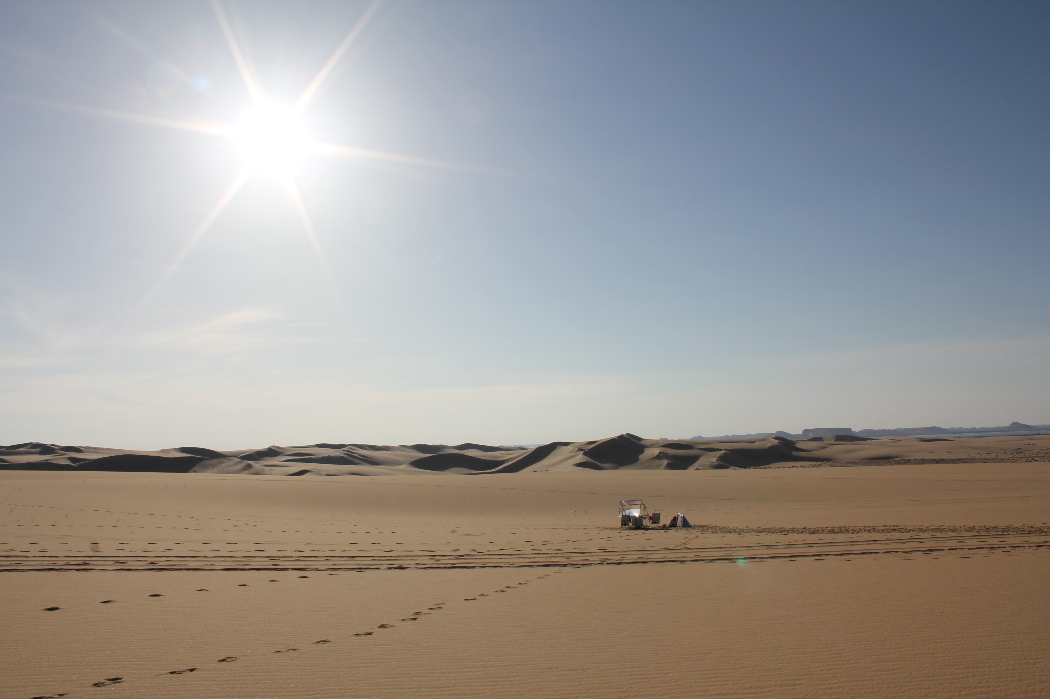
Notes:
– the deserts of the world.
Sunlight we would all agree probably is the most potent natural energy resource we have. Plants, animals and humans thrive in sunlight and today even power stations use sunlight, starting to provide the electricity to power the cities of this world.
The material is sand in the form of silica, which is a fantastic raw material to produce glass.
So the Solar Sinter project explores the potential of ‘desert manufacturing’.

Slide 26
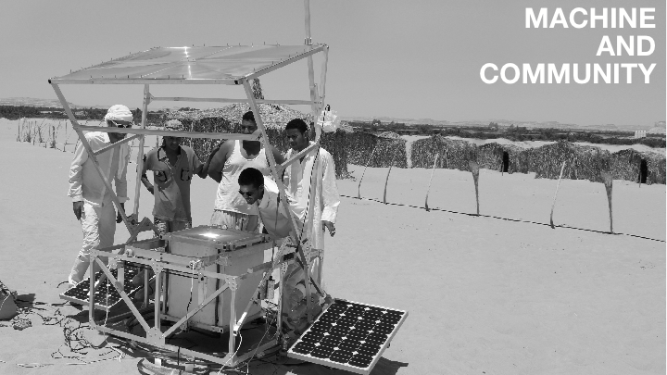

Slide 27
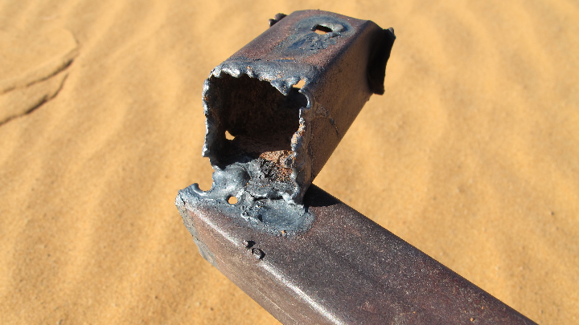

Slide 28
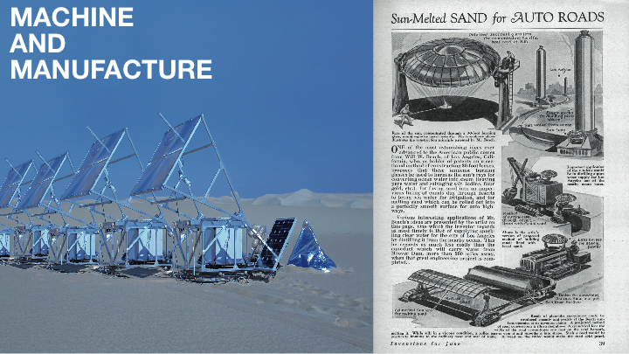

Slide 29
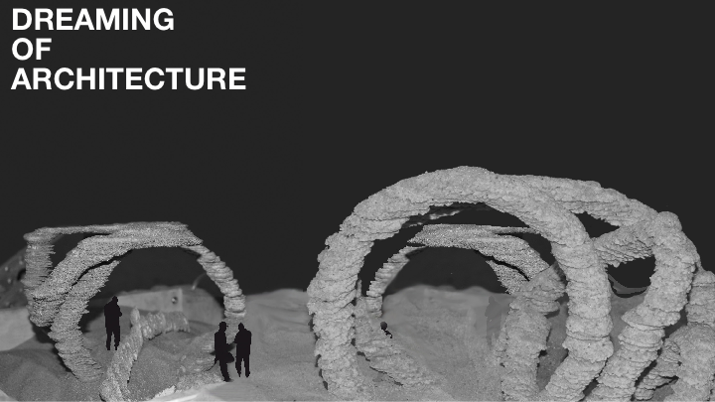

Slide 30
