Slide 1
Pandora’s Box and Advanced Manufacturing: Opening the lid, carefully
The 2012 Fab Lab conference and public academic symposium
August 22-28.
College of Creative Arts at Massey University
Wellington, New Zealand
In conjunction with the Centre for Bits and Atoms at MIT, The Fab Lab Network and the Affect Research Centre
Michael Hopmeier
President
Unconventional Concepts, Inc.

Slide 2
Disclaimer
The views expressed in this paper are those of the author and do not reflect the official policy or position of the US government.

Slide 3
Who Is Hopmeier
Former Mechanical Engineer
Contractor/Consultant to government and industry
Work with numerous countries, agencies and organizations
Focus on “unconventional” problems, tasks and issues
Primarily related to national security

Slide 4
Why am I here
To present the technical challenge of reducing or mitigating the threat from advanced manufacturing and digital materials, while
not impeding their development and progress.

Slide 5
Any sufficiently advanced technology is Indistinguishable from magic.
Sir Arthur Charles Clarke, CBE, FRAS
(16 December 1917 – 19 March 2008)
Science Fiction Author, Inventor, Futurist
Author of “2001: A Space Odyssey
Hope, which whispered from Pandora's box after all the other plagues and sorrows had escaped, is the best and last of all things.
Ian Caldwell and Dustin Thomason, The Rule of Four
2004
If we had a reliable way to label our toys good and bad, it would be easy to regulate technology wisely. But we can rarely see far enough ahead to know which road leads to damnation. Whoever concerns himself with big technology, either to push it forward or to stop it, is gambling in human lives.
FREEMAN DYSON, Disturbing the Universe, 1979. (Columbia)

Slide 6
Lessons from History…?

Slide 7
Copiers
1963: Xerox 813
First desk top plain paper copier
1968: 3M commercial color printer
1969: Xerox invents laser printer
Modified copier
1973: Cannon introduces electrostatic copier
1975-1985: primary marketing battle for supremacy in copier technology and market
Notes:
Wikipedia, multiple entrys

Slide 8
Major Technology Break Through
1100 PM, March 14th, 1976:
An MIT Mechanical Engineering Intern at Xerox recognizes the highest, best use for this emerging, revolutionary technology

Slide 9
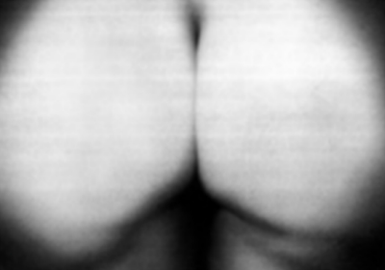
He is honored, and widely credited, as the inspiration for including pictures on Facebook…

Slide 10
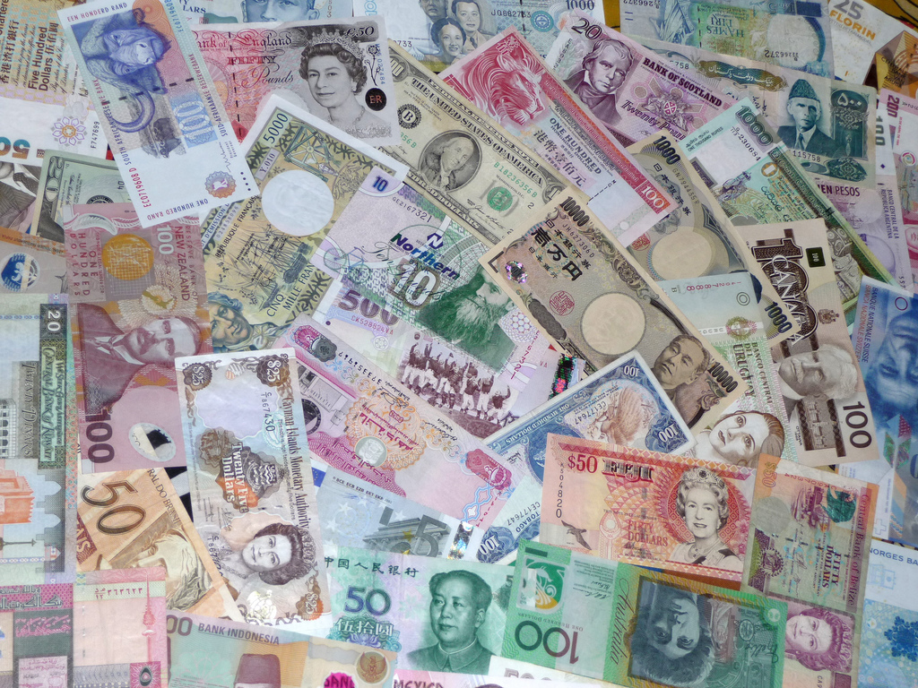
Modern Counterfeiting
“P-notes” or printer notes
First recognized by law enforcement in mid-90’s
Evolved into a major problem
1995: 37 arrests for P-notes
2000: 4500 arrests (NOT total number engaged in practice)
Accounted for 40% of seized currency!
Notes:
http://www.answers.com/topic/counterfeit-currency-technology-and-the-manufacture

Slide 11
Anti-counterfeiting Technology
1996: First major US currency redesign in 70 years
2004: further major revisions
Technologies included:
Optically Variable Ink
Special colors
Watermarks
Embedded threads
See-through features
Microprinting
Holograms
Etc.
All can/have been defeated, to greater or lesser degrees
Notes:
http://www.answers.com/topic/counterfeit-currency-technology-and-the-manufacture

Slide 12
Laser Printers, Forensics, and Steganography
First introduced in the 1990’s as a way of mollifying government concerns related to potential nefarious use
Companies included Xerox, Brother, Canon, Dell, Epson, HP, IBM, Konica Minolta, Kyocera, Lanier, Lexmark, Ricoh, Toshiba
Tiny yellow dots and other means are printed on each page identifying manufacturer, model number, serial number and time/date of printing
2005: Electronic Frontier Foundation broke and published code for Xerox, making public widely aware of practice
Notes:
http://en.wikipedia.org/wiki/Printer_steganography

Slide 13
Why do we care?
Forensics and attribution
Prior to laser printers, typewriters were generally easily identifiable and traceable as a means of assisting law enforcement
Wide availability of laser printing negated this as an investigative technique

Slide 14
Examples of potential nefarious uses

Slide 15
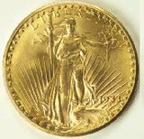
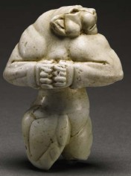
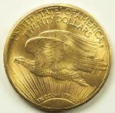
Counterfeiting Money... Why bother?
The Guennol Lioness
Limestone, c.3000 b.c.
$57,200,000 –
Sotheby's NY, December 5th 2007.
1933 Gold Double Eagle
$7.5 million in 2002
Notes:
http://coins.about.com/od/famousrarecoinprofiles/p/1933_Gold_Eagle.htm
http://www.theartwolf.com/articles/10-most-expensive-antiquities.htm
https://portal.navfac.navy.mil/portal/page/portal/navfac/navfac_ww_pp/navfac_nfesc_pp/locks/hisecpadlocks/tab_hsp_prod

Slide 16
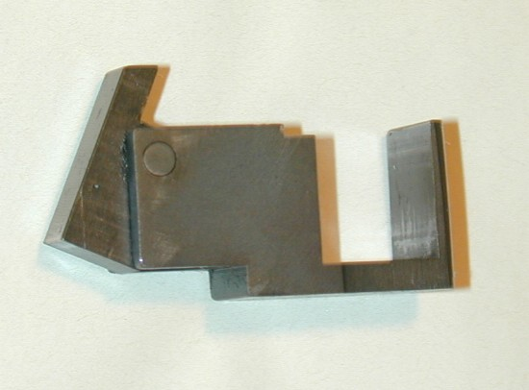
AR-15 Auto-Sear
Added to semi-automatic assault rifles to make them fully automatic
Require a reasonably high level of skill and resources to manufacture
Precision machined from high strength steel
SUPPOSED to be regulated and monitored by the government

Slide 17
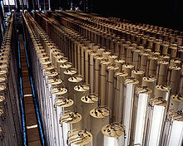
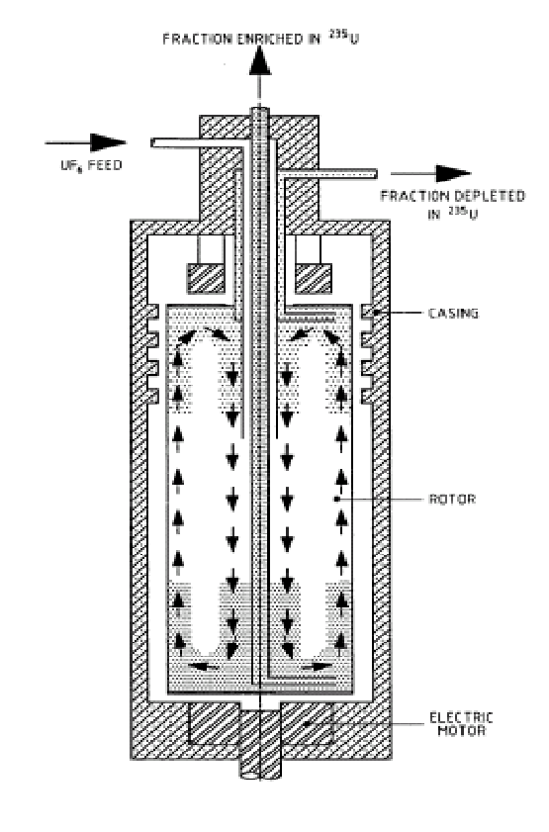
U-235 Centrifuge Precursor for Nuclear Weapons
“The recent development of inexpensive, high-precision computer-controlled machining equipment has made things somewhat easier. This is why more countries are learning to enrich uranium in recent years.” http://science.howstuffworks.com/uranium-centrifuge.htm
Notes:
http://en.wikipedia.org/wiki/Gas_centrifuge

Slide 18
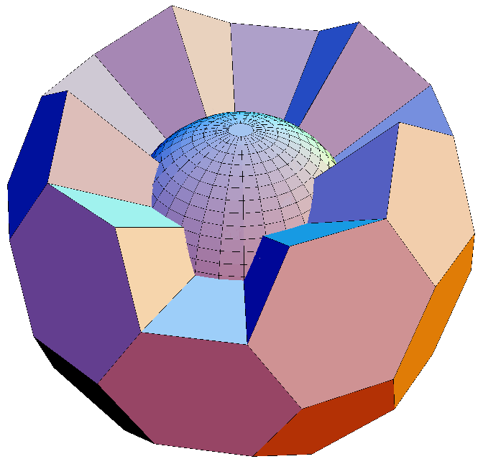
Nuclear Weapons
Explosive Lens
Highly precise array of components, carefully fitted together, manufactured from various explosive materials, that focus blast energy in a very precise manner to initiate a nuclear explosive.
Made from extremely complex shapes machined to very precise tolerances with accuracies of greater then
1 in 100,000
Notes:
http://en.wikipedia.org/wiki/Explosive_lens
http://nuclearweaponarchive.org/Nwfaq/Nfaq8.html

Slide 19
Very Cool Application

Slide 20
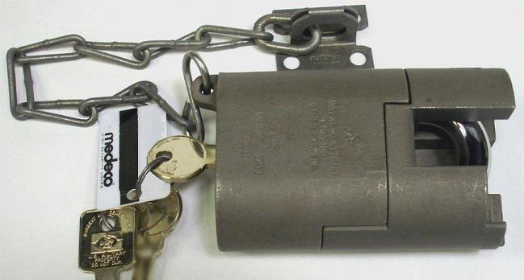
Not so cool application…
S&G 951 High Security Padlock
Protects… at a value of ???

Slide 21
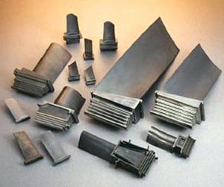
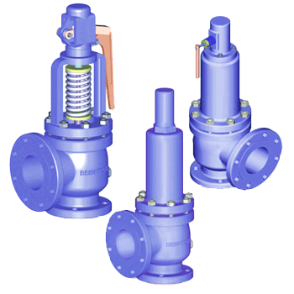
Counterfeiting Parts
Gas Turbine Blades
Failure can mean catastrophic destruction and “rapid disassembly”
High Pressure relief valves
Failure can mean rupture and explosion of pressure vessels
Notes:
http://www.turbocare.com/gas_turbine_blades_buckets.html
http://www.brightechvalves.com/sf_sf50.htm
http://thehill.com/news-by-subject/defense-homeland-security/192405-counterfeit-parts-from-china-a-clear-and-present-danger-to-us-troops-senators-say
http://vibeghana.com/2012/03/16/use-of-counterfeit-parts-dangerous-to-drivers-and-passengers/
http://www.authenticsfoundation.org/index.php?option=com_content&view=article&id=75

Slide 22
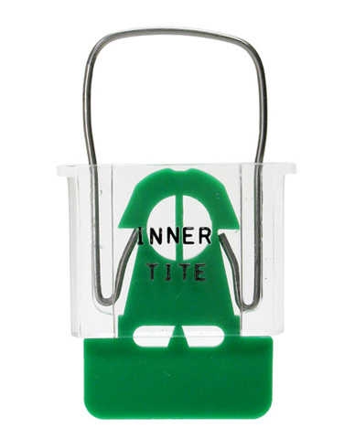
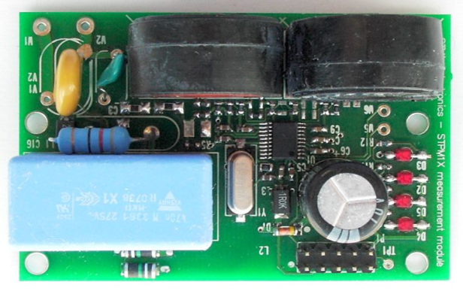
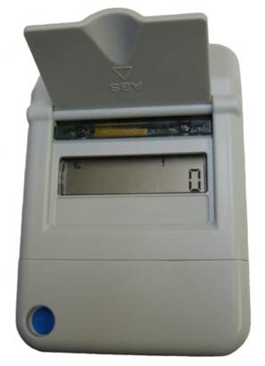
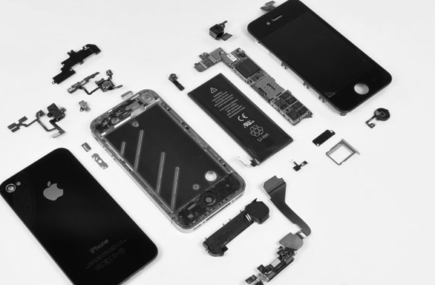
Bypassing Tamper Indicators
Hardware Tampering Detectors
Water gauge Indicator
Warranty Voiding Indicators
Electrical Tamper Indicator
Tamper-proof Screws in Apple Products

Slide 23
Why Do We Care?
Mass death
Uncontrolled Proliferation of advanced weapons technology
Fraud, corruption, underground economies
Individual injury, destruction, and death from fake parts
Loss of intellectual property value and rights

Slide 24
Why am I even bringing this up?

Slide 25
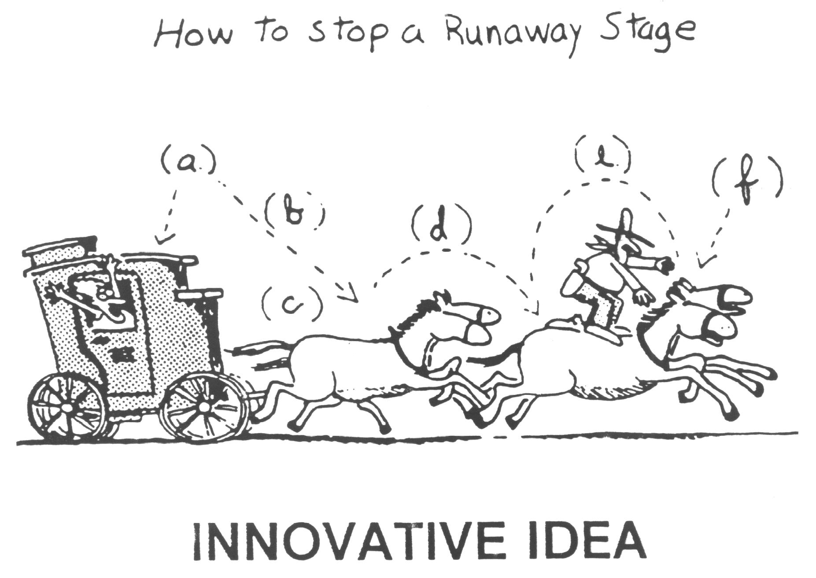
Controlling Nefarious Use What we want to DO…

Slide 26
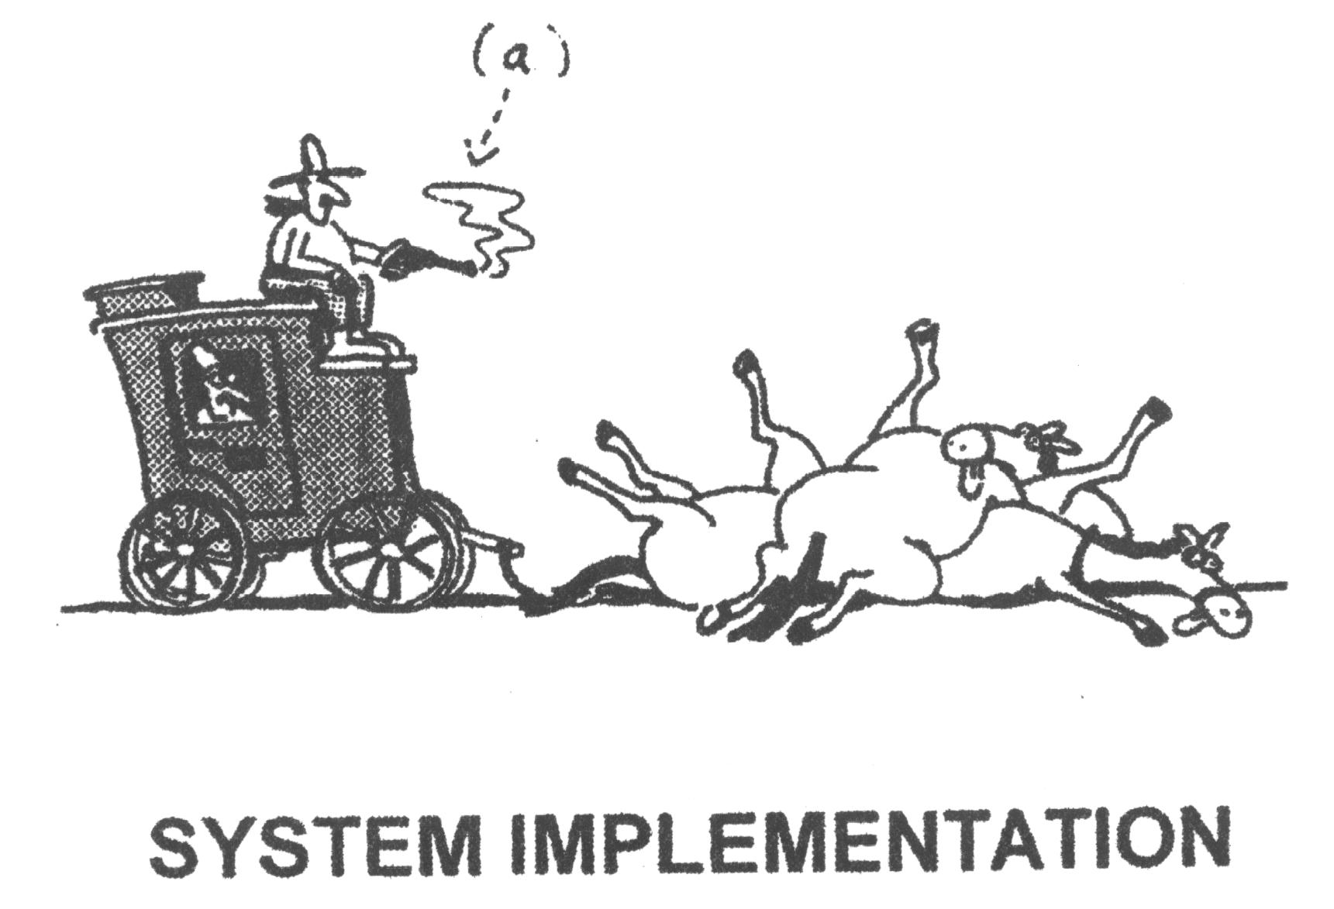
Controlling Nefarious Use What we’d like to AVOID…

Slide 27
Challenge
How can we address this BEFORE it becomes an issue…?
Technical challenges
Cultural issues
Banning the technology will NOT work
It would almost certainly be tried
It will absolutely fail at multiple levels
Can we educate policy makers?
Can we provide solutions other than through trial, error, and failure?

Slide 28
Narrow window to act
Like the internet, decisions made early on can affect it systemically forever
What decisions can we make today to avoid disaster tomorrow?
We have a very narrow time window (perhaps 18 months) to act before discussions evolve into potentially misguided decisions

Slide 29
Summary
Advanced Manufacturing is incredibly EXCITING
Like Pandora’s box, we are on the verge of letting loose a great benefit, or evil, upon the world
Can we control it, rather than being controlled by it?

Slide 30
Questions?
Michael Hopmeier
Unconventional Concepts, Inc.
hopmeier@unconventional-inc.com

