Slide 1
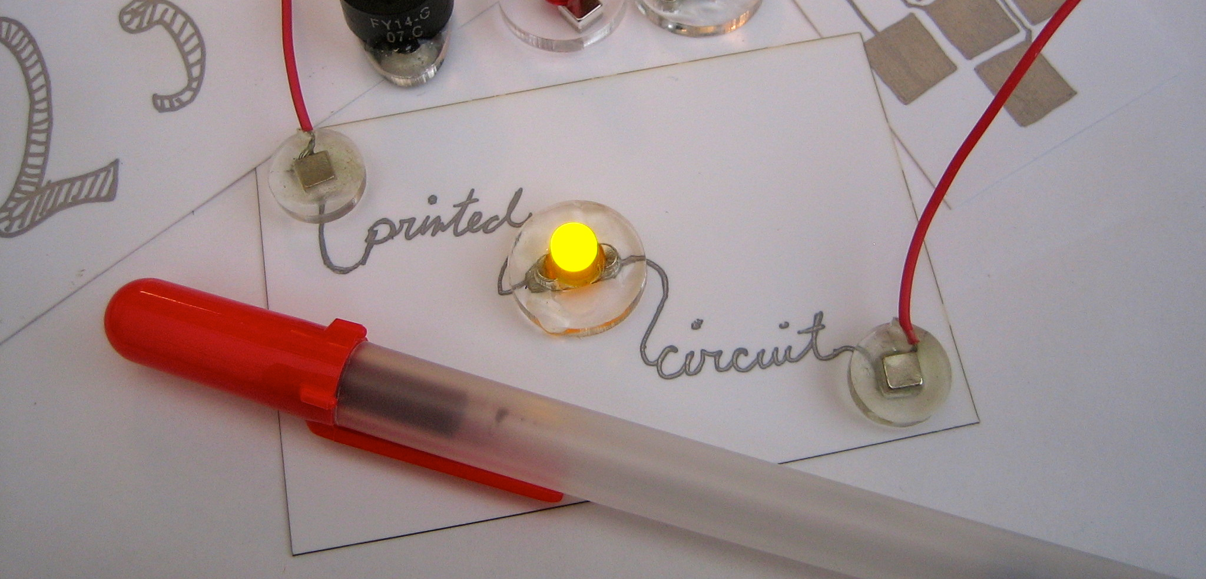

Pen-on-Paper Flexible Electronics
Analisa Russo
In collaboration with Jennifer Lewis
and Bok Yeop Ahn
Notes:
Add Illinois and MRL logos

Slide 2
Demo
Instructions: draw whatever you want on the card – just don’t short out the LED!

Slide 3
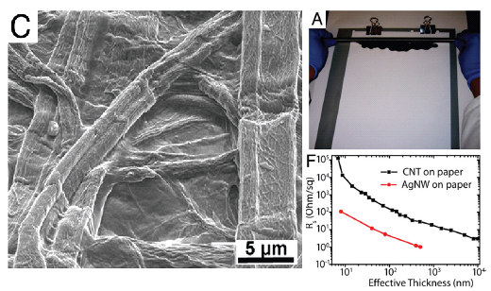
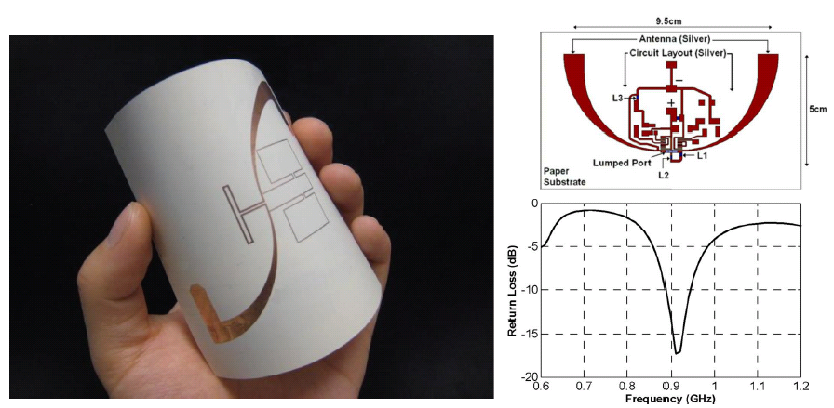
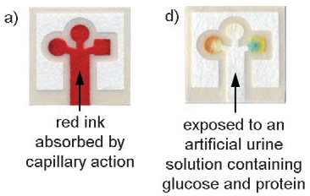
Paper-based electronics
High flexibility
Foldable thermochromic displays
High porosity
Energy storage materials
A.C. Siegel, et. al, Adv. Funct. Mater. 2010, 20, 28.
L. Hu, et. al, PNAS 2009, 106, 21490.
Biodegradable
Disposable RFID tags
Inexpensive
Paper-based microfluidics
V. Lakafosis, et. al, Proc. IEEE. 2010, 98, 1601.
A. C. Siegel, et. al, Lab on a Chip. 2009, 9, 2775.

Slide 4
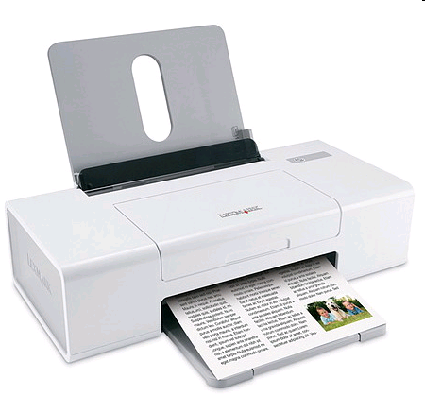
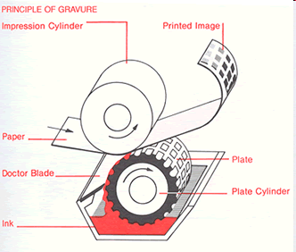
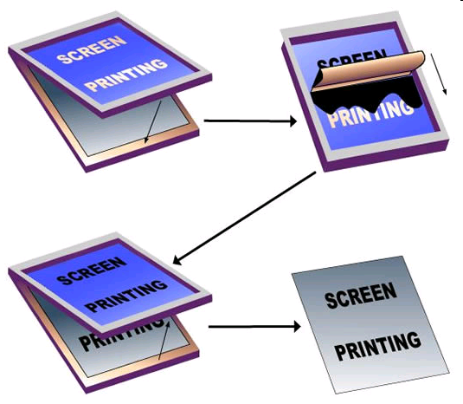
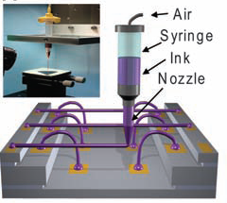
Ink-based manufacturing
Large-scale additive fabrication:
Inkjet printing
Gravure and roll-to-roll
Screen printing
Small-scale fabrication and prototyping:
Direct Ink Writing (DIW)
B.Y. Ahn, E.B. Duoss, Science. 323 (2009).
Notes:
What is missing from the toolbox? You probably noticed that paper is portable, lightweight, ubiquitous – but none of these techniques are.

Slide 5
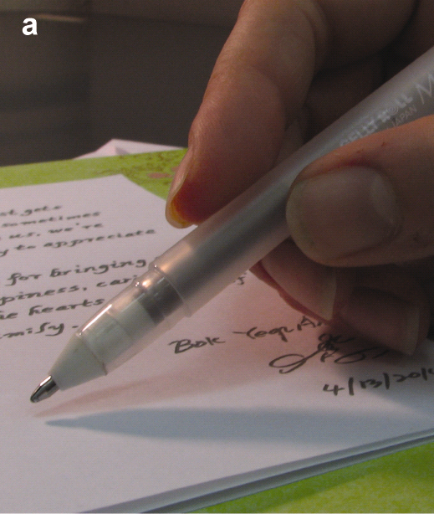
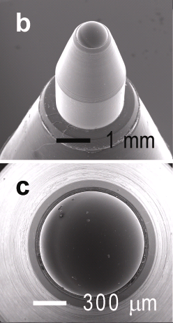
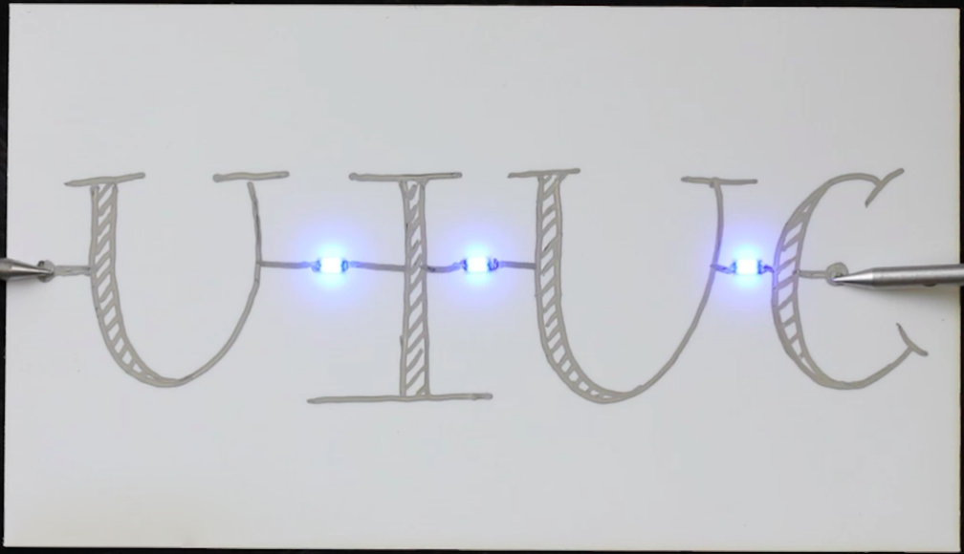
Rollerball pen writing of microelectrodes
Like paper, the rollerball pen is lightweight, portable, inexpensive.
It can be used to create devices “on-the-fly…”
…it is also an intuitive design tool
Notes:
What’s missing? A tool that is as ubiquitous and inexepnsive and portable as the paper substrate itself. What we found, after using the pen for some time, is that it is also an intuitive design tool.

Slide 6
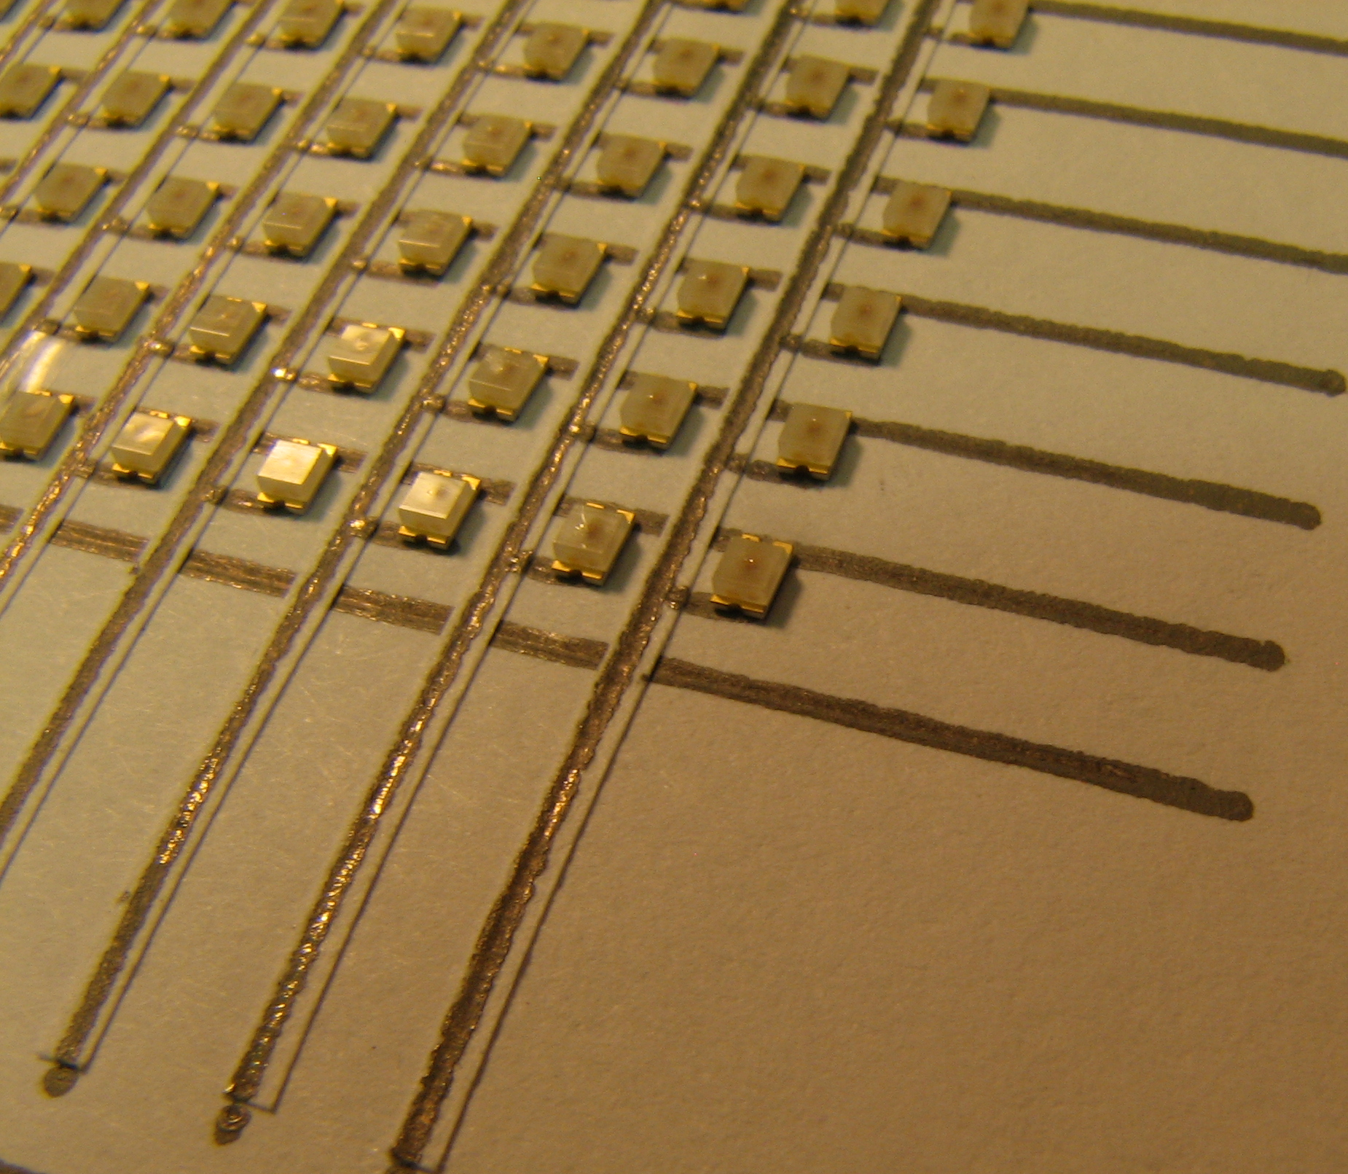
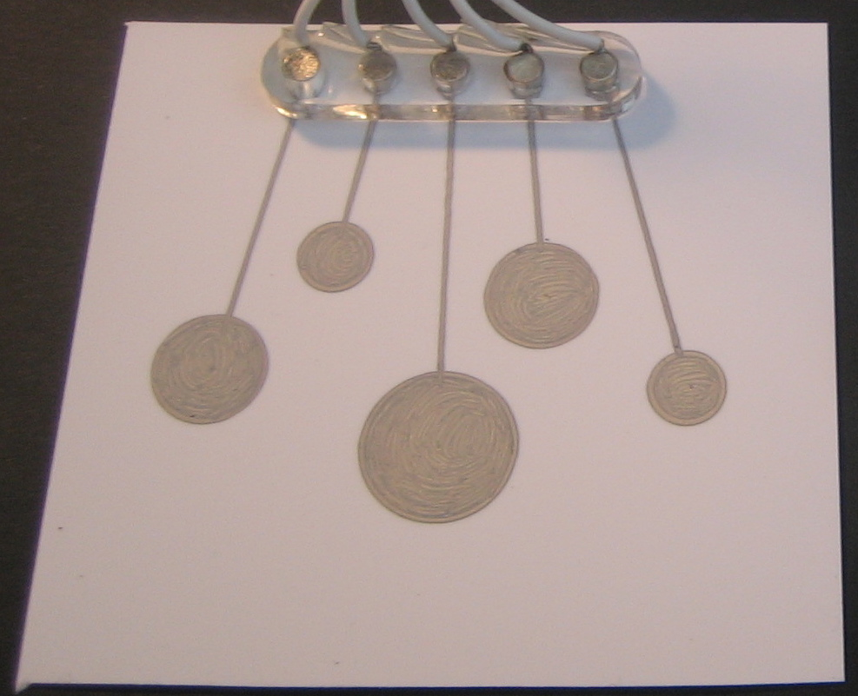
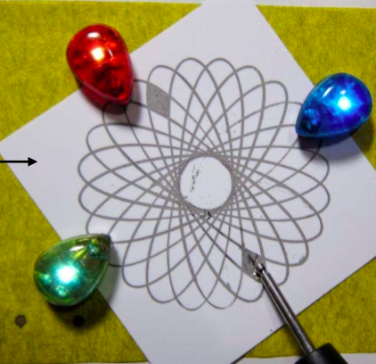
Rollerball pen writing of microelectrodes
Regular drafting tools can be used to create uniform shapes
4 mm
1 mm
4 mm
Ruler
Stencil
Spirograph
Notes:
For example, regular drafting tools can be used to create uniform shapes, without the need for setting up equpiment or writing a program.
As an aside – these are some magnetic components that we borrowed from Leah buechely’s group at the media lab: I’ll talk about these again later…

Slide 7
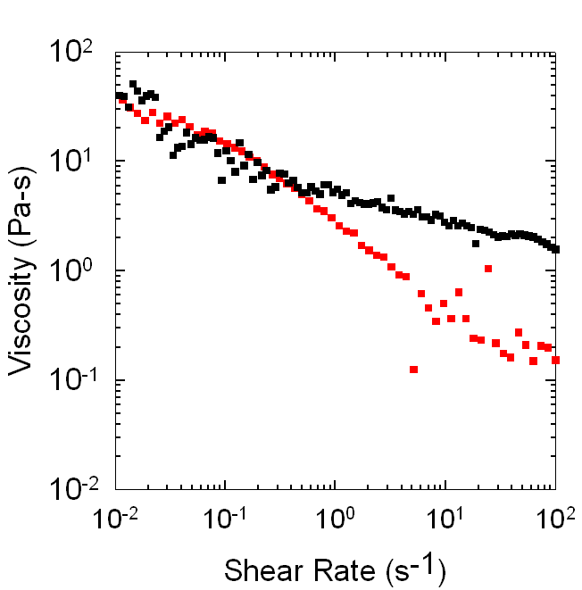
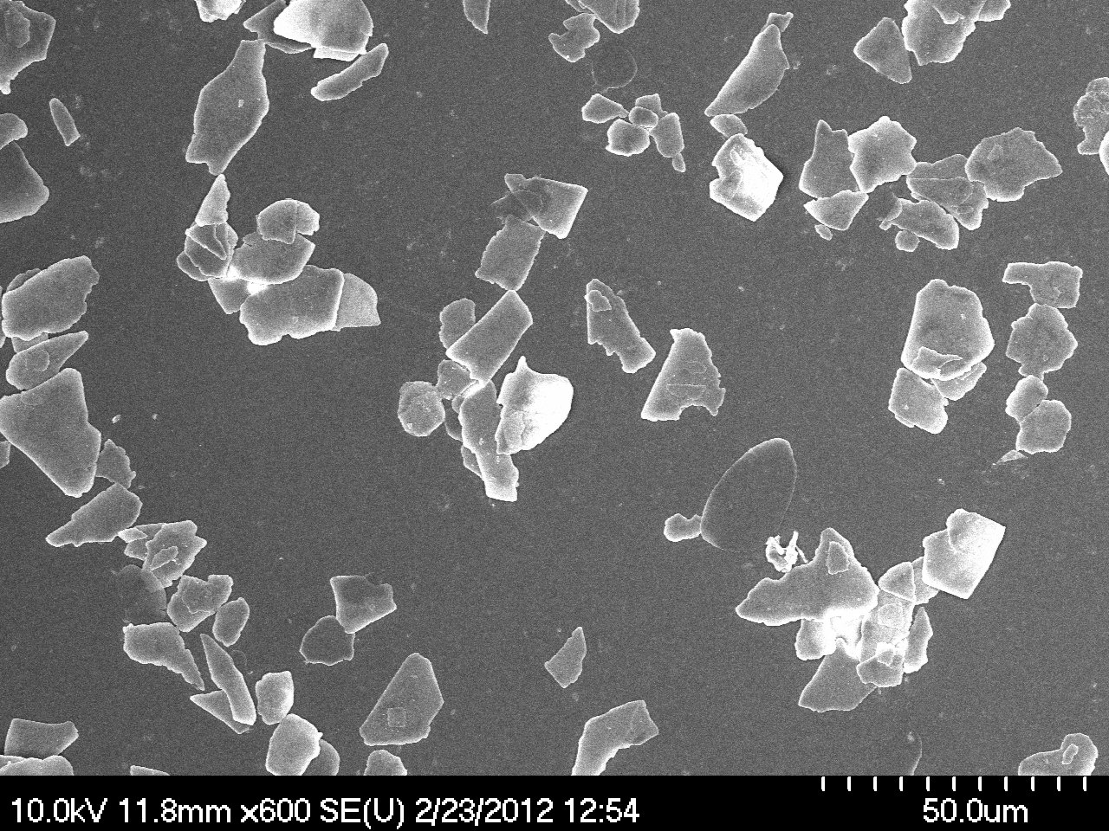
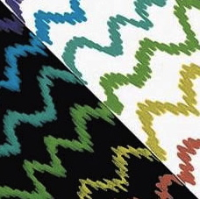
Rollerball pen ink: an advanced material
Our ink
Commercial ink
Large pigment particles: creates bold colors that are visible on dark paper
Shear thinning ink: flows through tip without leaking or skipping, enables suspension of large particles
Notes:
Our inspiration for ink design came from commercial rollerball pens – already a highly engineered fluid.
Compare to something we know: 10 Pa-s = melted chocolate, 0.1 Pa-s is

Slide 8
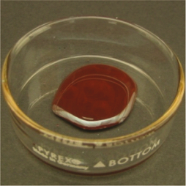
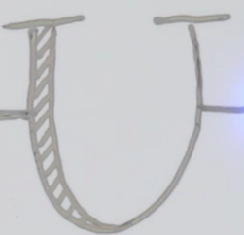
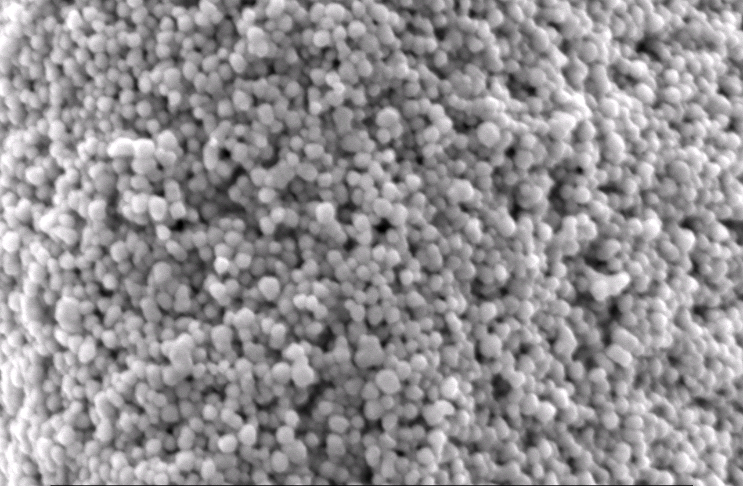
Conductive ink for rollerball pen
Ink is composed of water and a cellulose binder – replace large pigment particles with conductive silver…
…upon drying, the particles form a continuous conductive network.
drying
Notes:
Has all of the target design parameters to commercial rollerball ink, in addition to requiring high conductivity

Slide 9
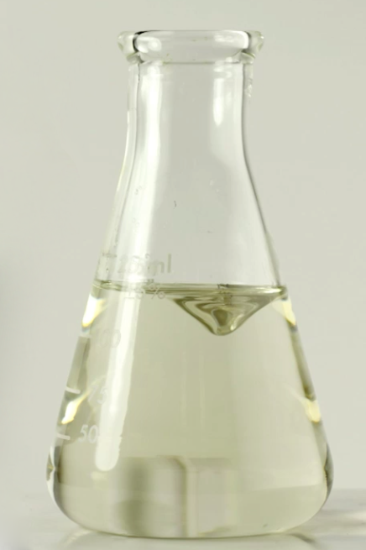
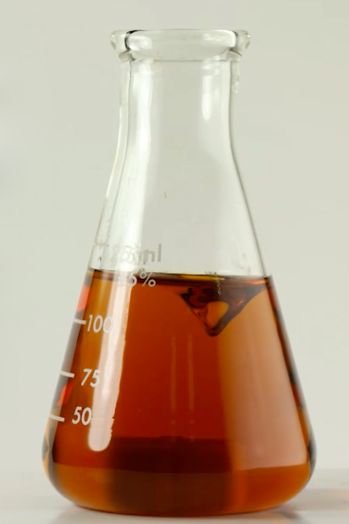
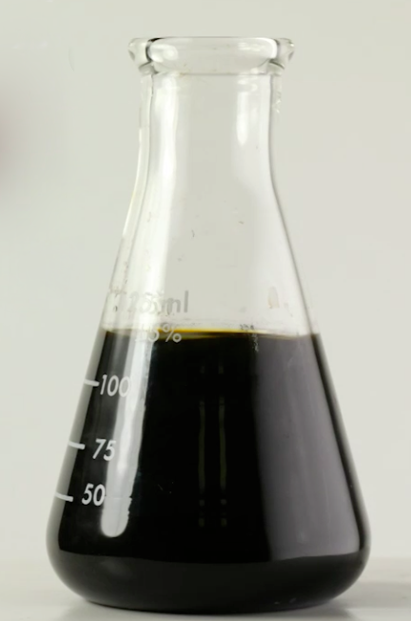
Ink synthesis
50 ml water
40 ml diethanolamine
1.95 g poly (acrylic acid)
20 g silver nitrate
5 hours
20 hours

Slide 10
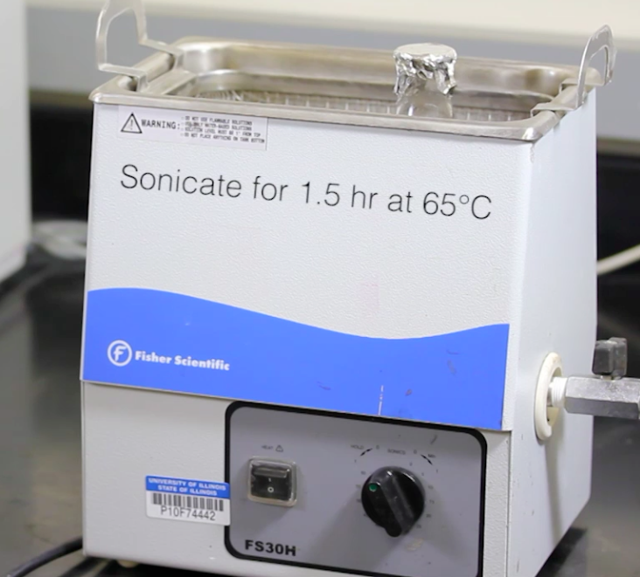
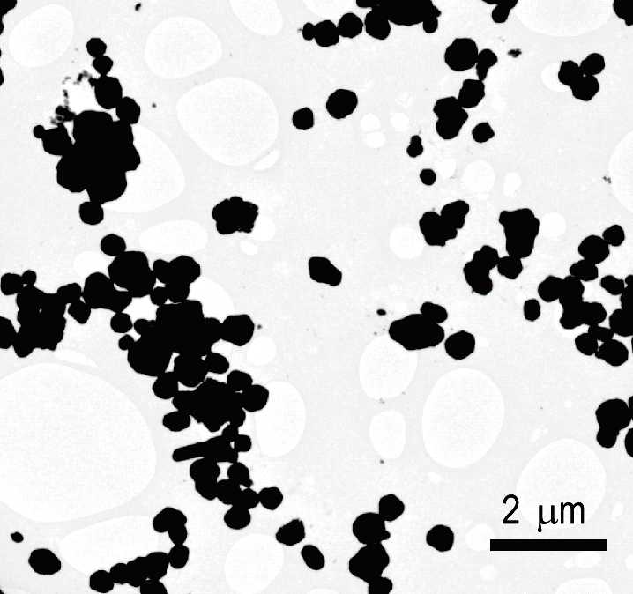
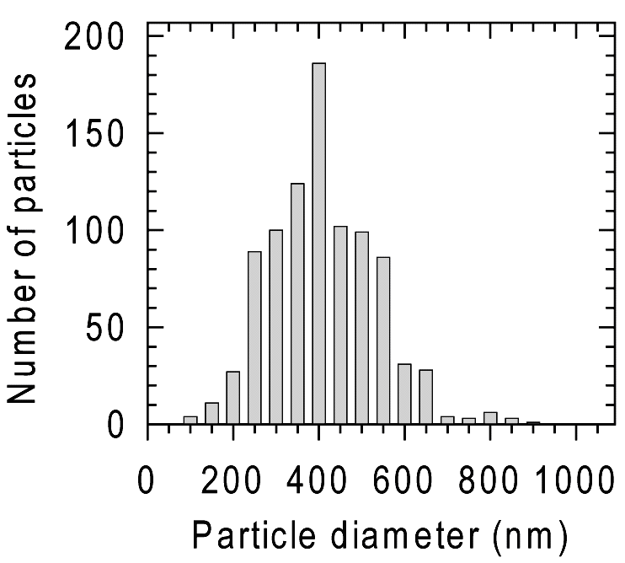
Ink synthesis
Grow particles to 400 nm diameter

Slide 11
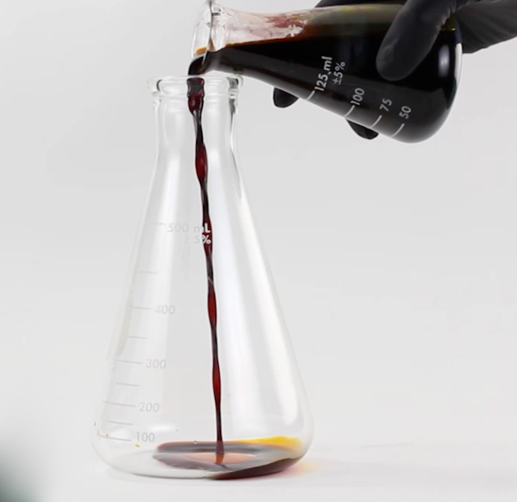
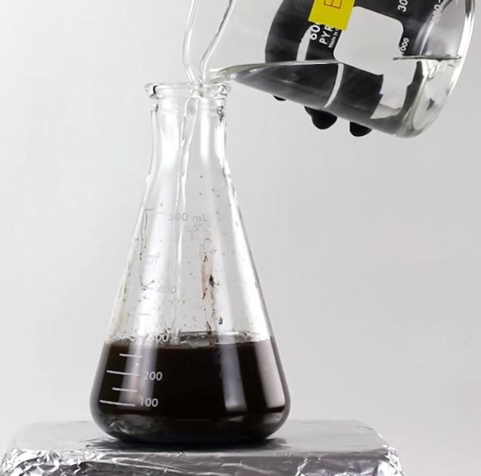
Ink synthesis
Transfer to larger beaker
Coagulate particles with ethanol

Slide 12
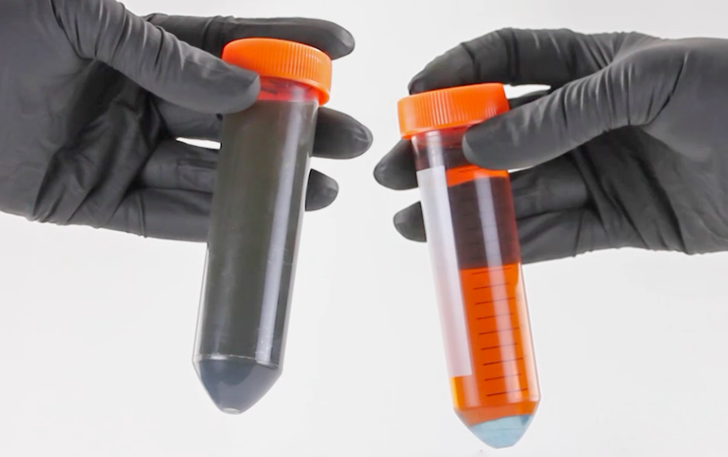
Ink synthesis
before
after
Centrifuge at 9000 rpm to collect particles

Slide 13
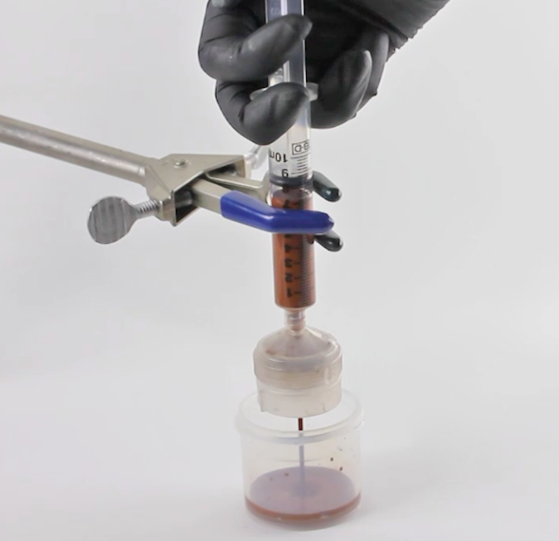
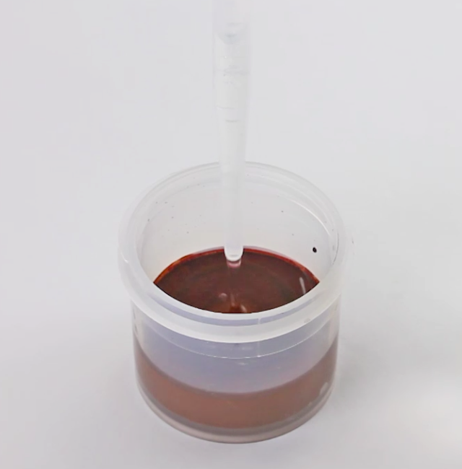
Ink synthesis
Filter ink through 10 micron pore filter
Add viscosifier:
Hydroxyethyl cellulose
HEC:Ag = 3:100 by weight

Slide 14
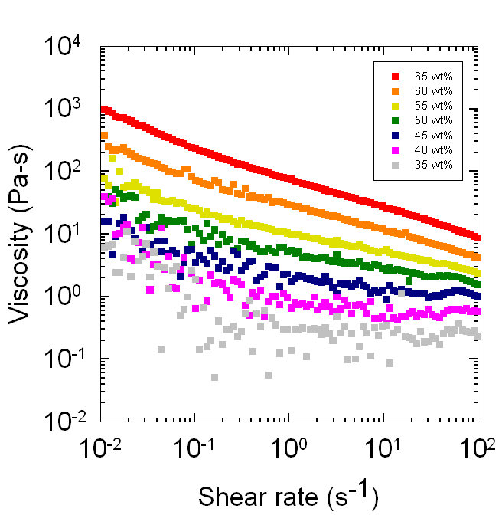
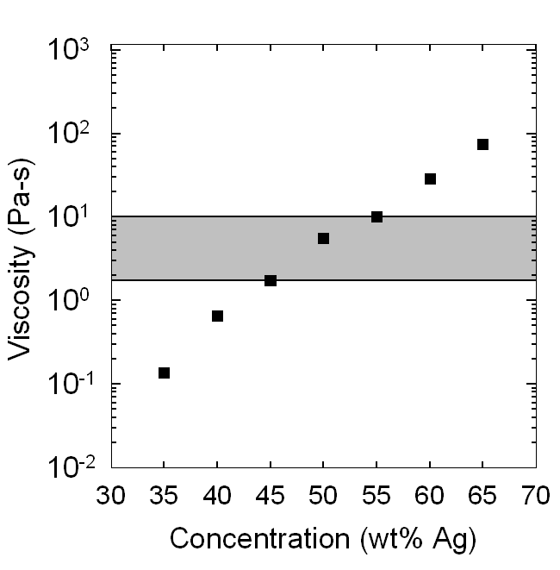
Tuning ink viscosity
Simply change water content to adjust viscosity
shear rate = 1 s⁻¹
clogging
leaking
A viscosity “writing window” exists where ink flows through tip without leaking or clogging
A. Russo, B.Y. Ahn, et. al, Adv. Mater. 2011

Slide 15
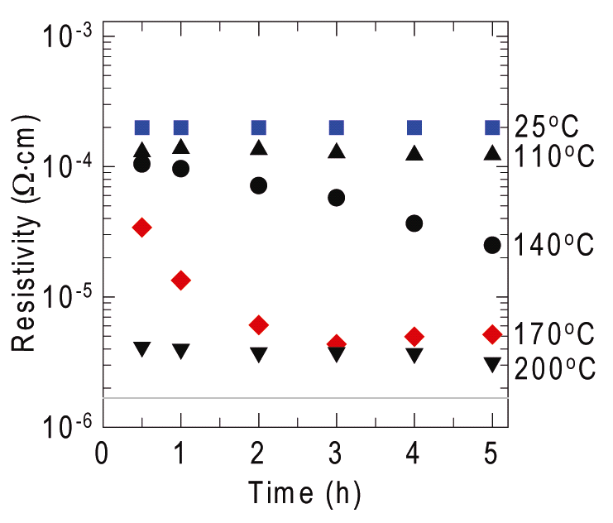
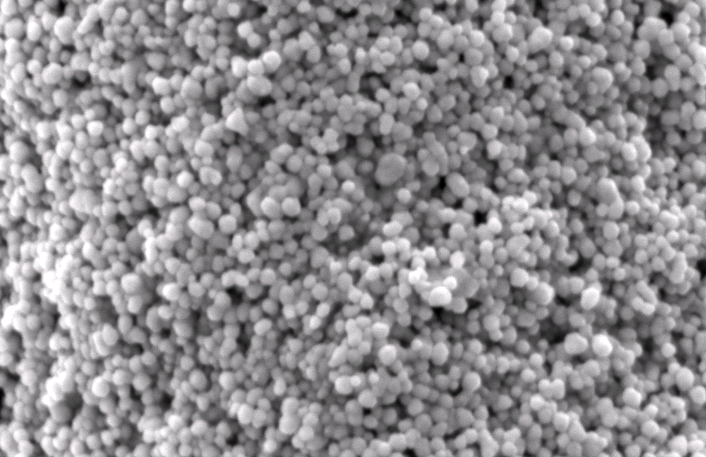
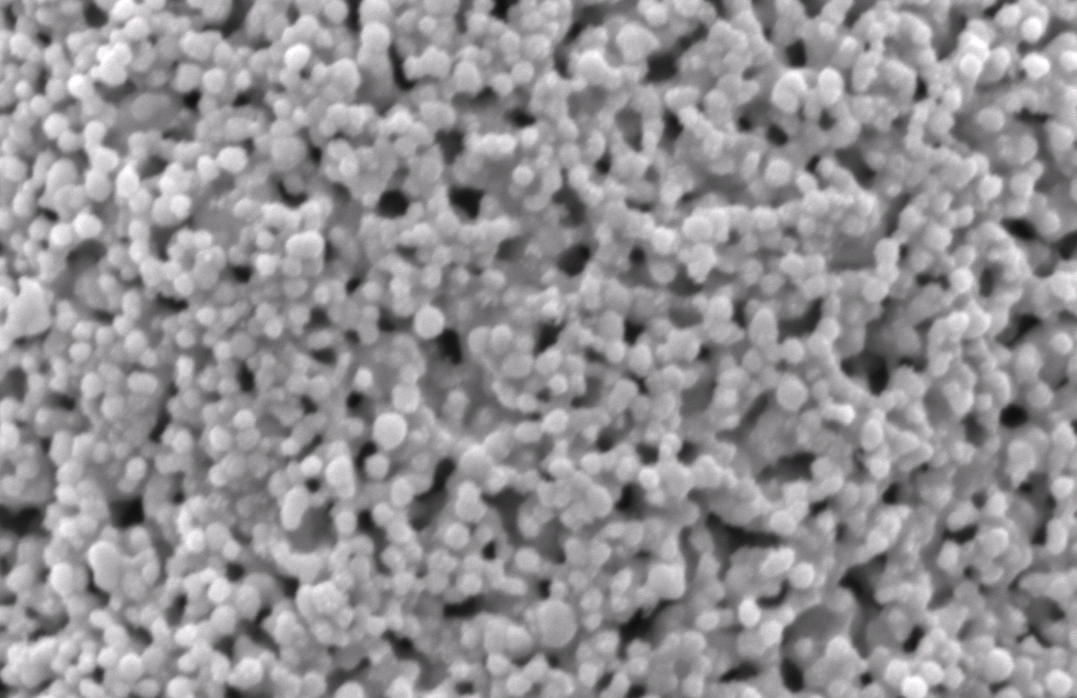
Printed ink microstructure and resistivity
Low resistivity after writing
50ºC, 2 hr
100°C
Cellulose burns out
250°C
bulk silver
Particle sintering
2 μm
Notes:
Resistivity is a material property that describes how well it an conduct electrons – can be measured directly.

Slide 16
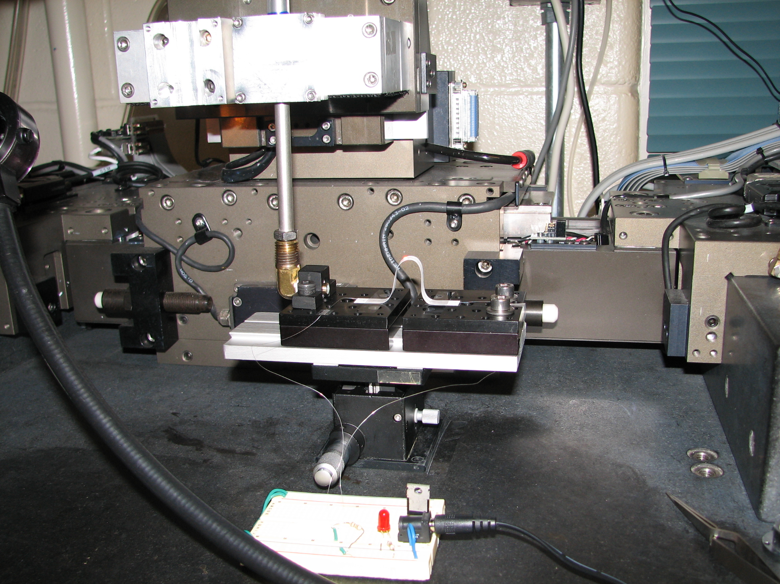
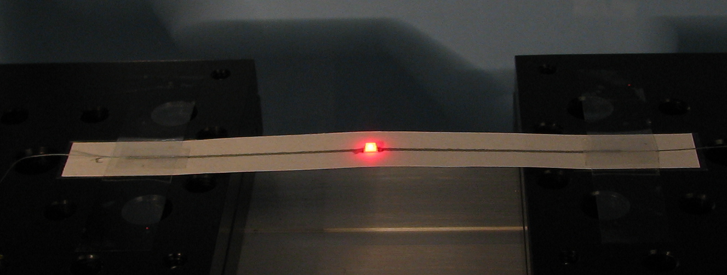
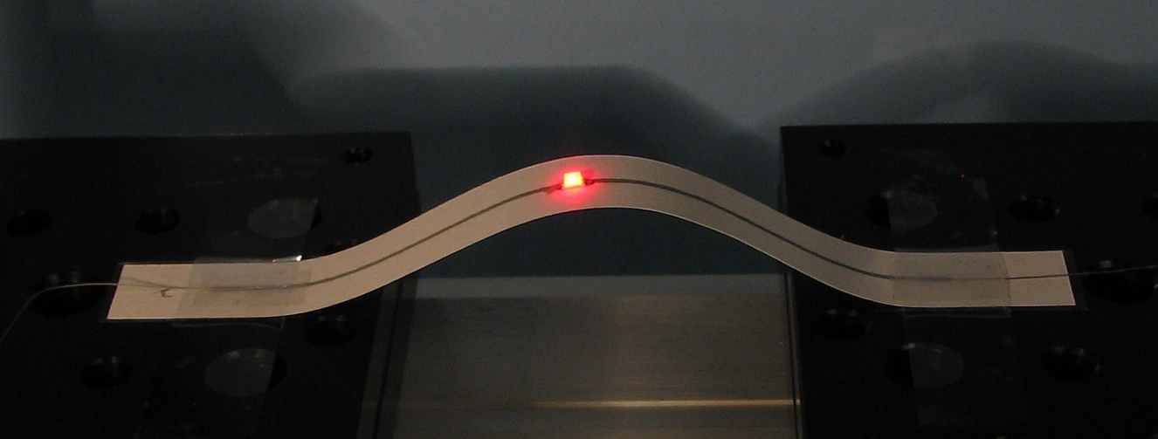
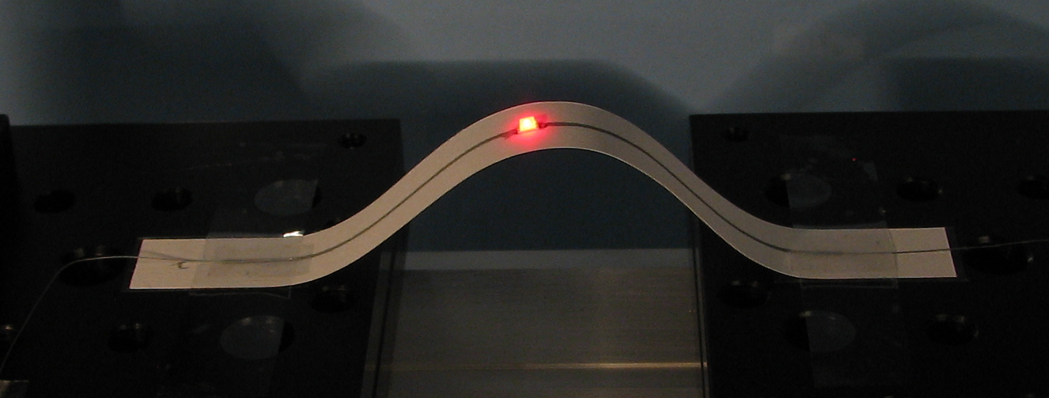
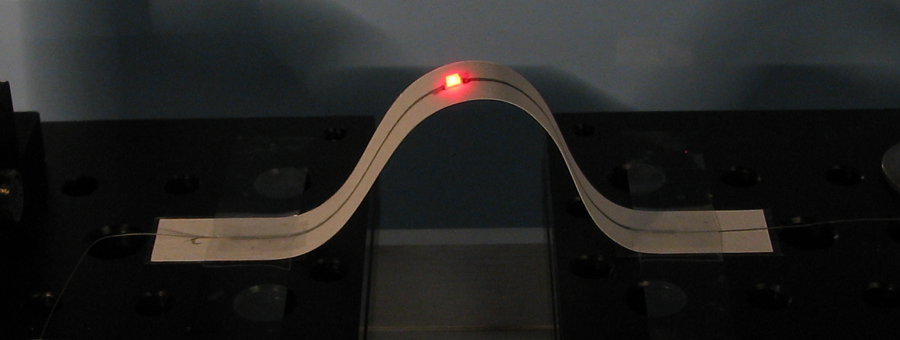
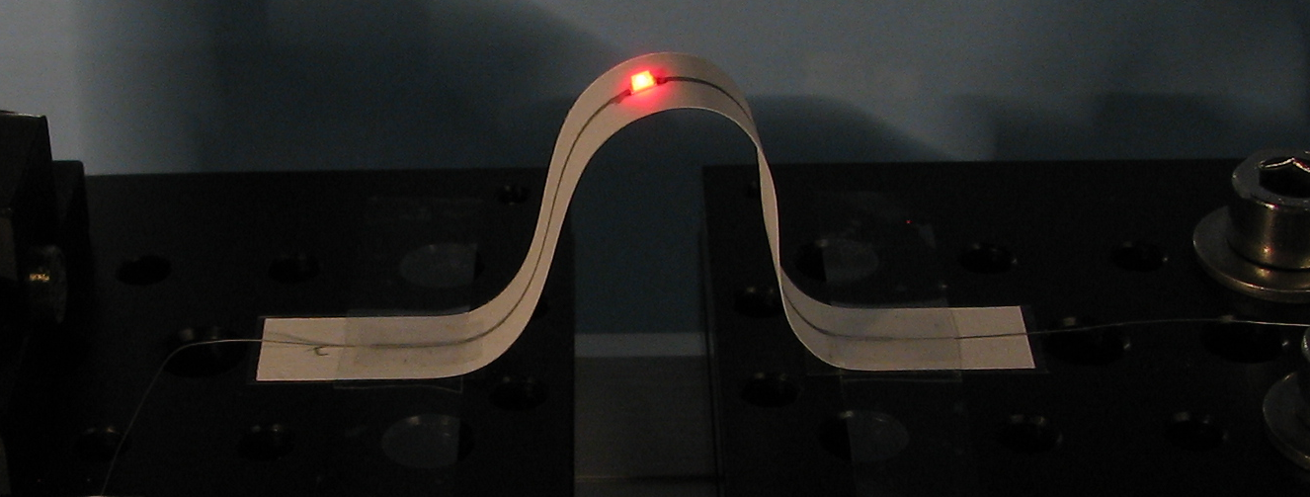
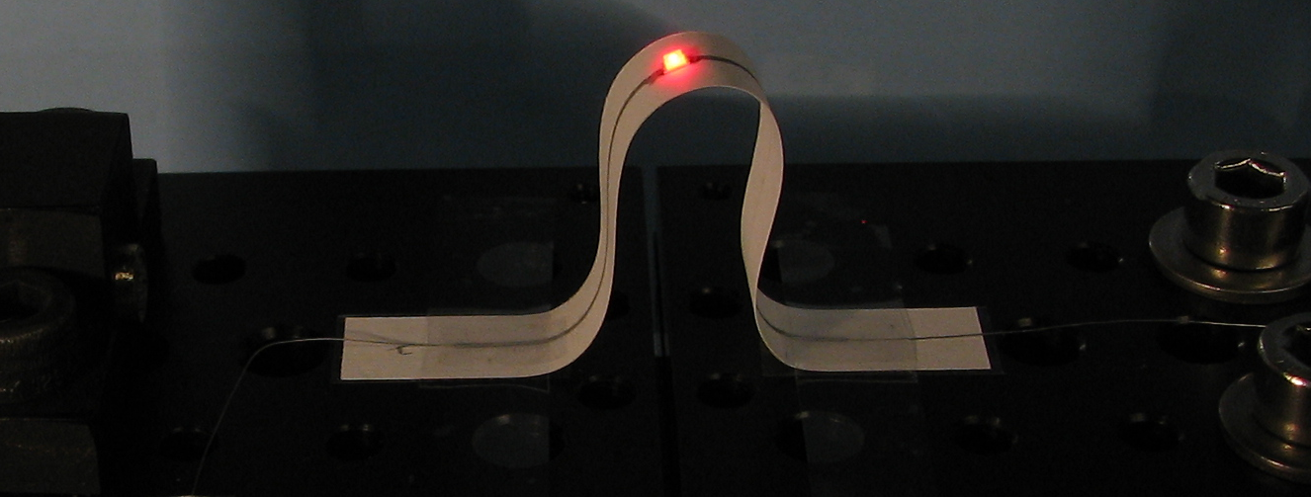
Flexible printed microelectrodes on paper
d = 40 mm
Robotic stage
d = 35 mm
d = 30 mm
d = 20 mm
Bending apparatus
d = 10 mm
LED kit
d = 0 mm
Radius of curvature = 5mm

Slide 17
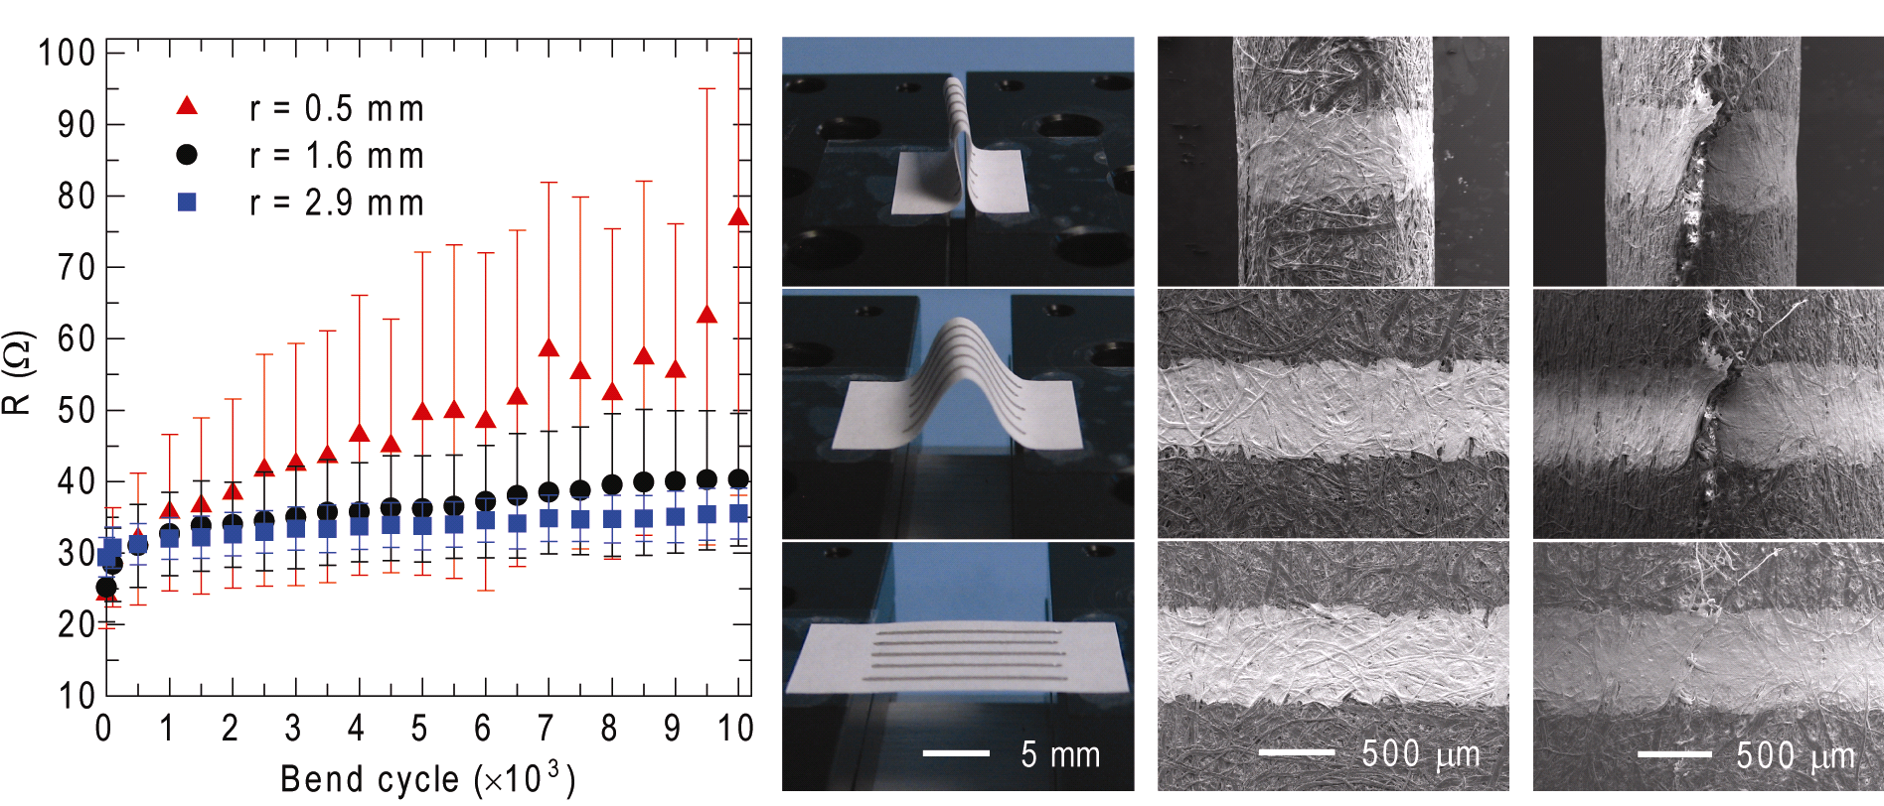
Flexible printed microelectrodes on paper
1.5 cm printed electrodes are bent repeatedly to three difrerent radii of curvature (slight bend, to almost creased)
Resistance is measured after when paper is in a flat orientation
1 bend cycle
10,000 cycles
A crease develops in paper after 10,000 bend cycles
A cold joint is formed in the flat state, restoring conductivity
A. Russo, B.Y. Ahn, et. al, submitted to Adv. Mater. 2011
Notes:
Conductive trace fails when the paper fails!

Slide 18
Applications

Slide 19
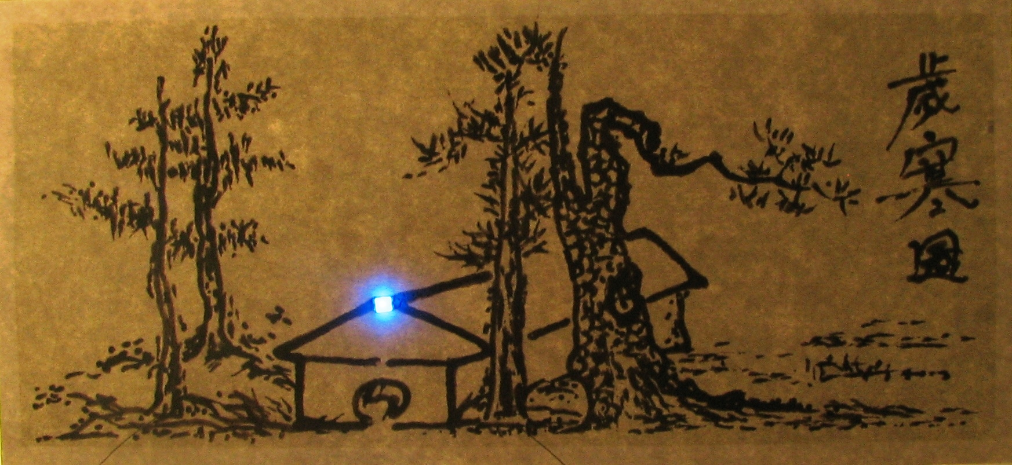
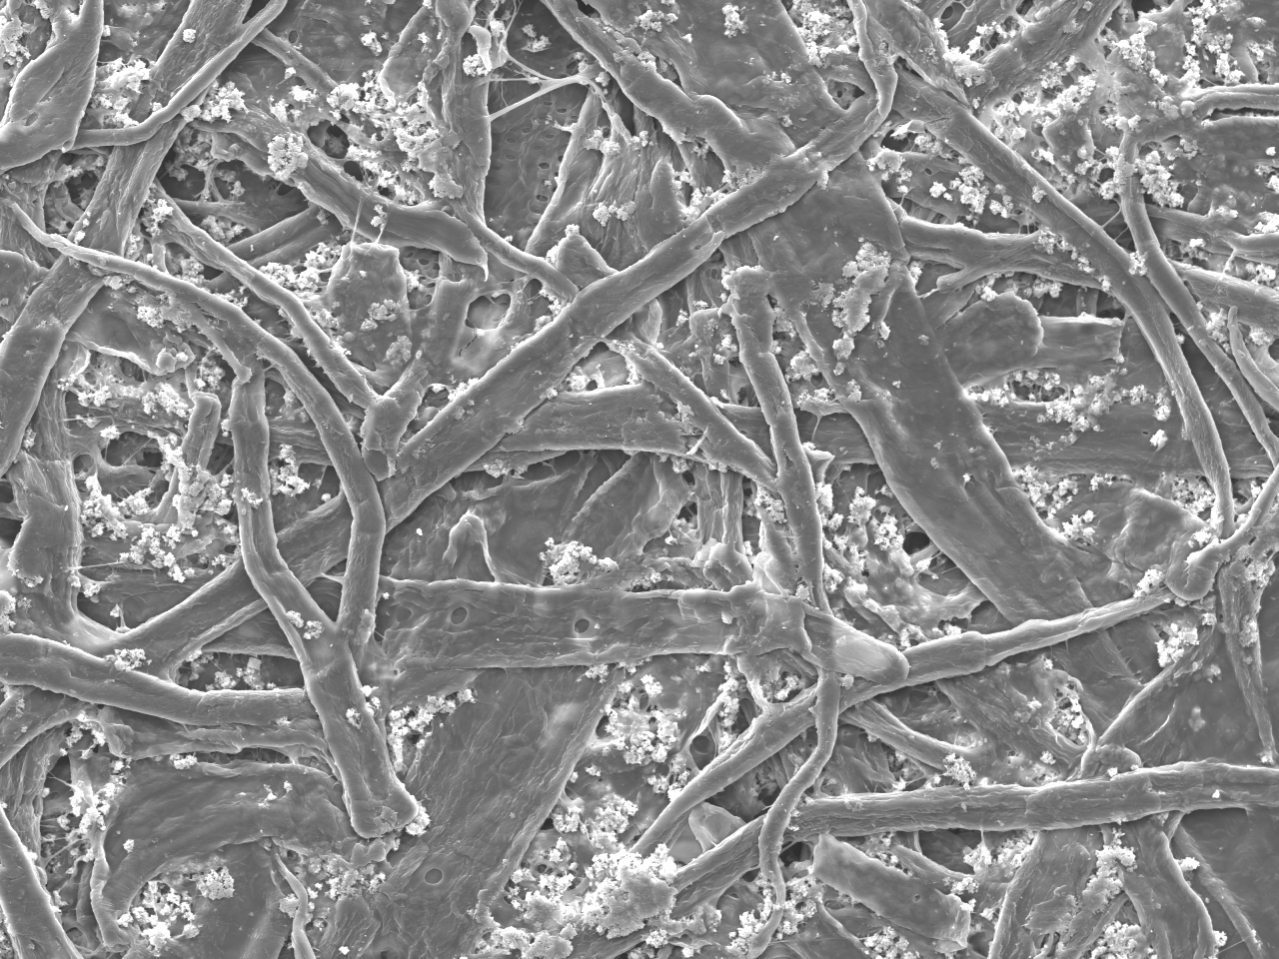
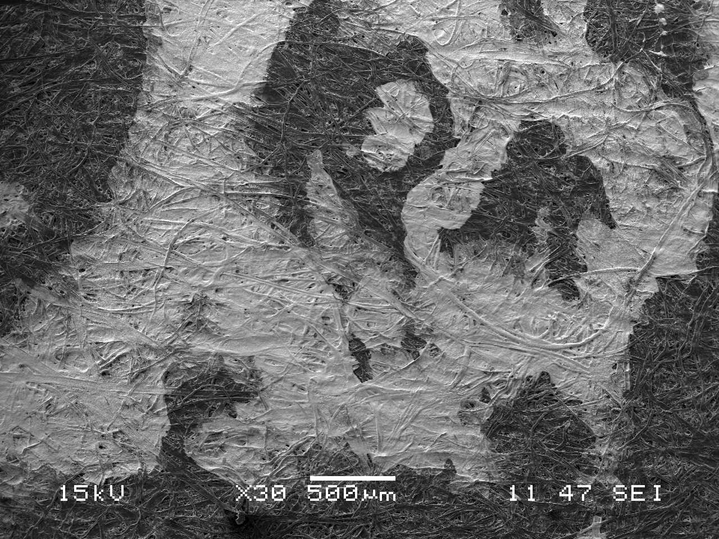
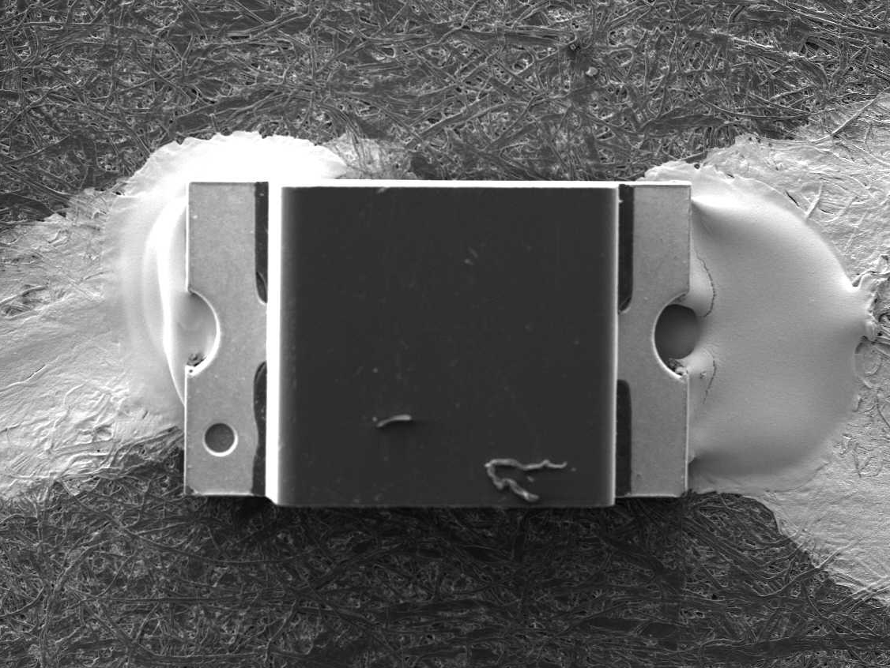
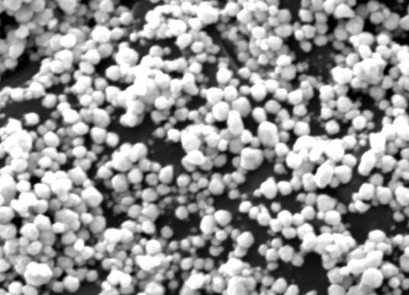
Electronic art
1 cm
2 um
50 μm
500 μm
Paper substrate
Conformal silver ink
LED attachment
Notes:
Famous korean painting Sae han do. One of our post-docs traced this. Good illustration of how this ink works. Surface mount LED attached with conductive epoxy

Slide 20
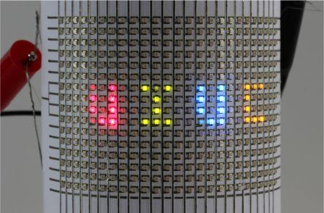

LED display
4 mm
1 mm
4 mm
Surface mount LED array, drawn by hand and dried at room temperature
(25×16) 400 LEDs, operated by a 9 V battery

Slide 21

Radio frequency antenna
A. Russo, B.Y. Ahn, et. al, Adv. Mater. 2011

Slide 22


Applications of pen-on-paper electronics
LED display
Conductive touch-pad
3D antenna
Electronic art
Notes:
Surface mount LED array, drawn by hand and dried at room temperature
(25×16) 400 LEDs, operated by a 9 V battery

Slide 23
Pen-on-paper for education:
Girls Learning about Materials “GLAM” summer camp

Slide 24




Resistors in series and in parallel

Slide 25




LED project

Slide 26
Fab Lab workshop
Champaign-Urbana community

Slide 27


Magnetic components
Teardrop project, MIT:
Our version:
Laser cut acrylic pads, press fit magnets and through-hole components
Throwies:

Slide 28





Practical circuits

Slide 29



Magnetic components 2.0
Triangle-shaped LED component indicates diode direction
through-hole components
Press-fit magnets
Laser-cut masonite
Notes:
Fab lab workshop was a nerdy crowd, so their feedback was to make the components look more like the symbols

Slide 30


Capacitive sensors and programmable devices
Magnets used to hook up devices to an Arduino board

Slide 31
Conclusions
We believe that the P-o-P electronics is a versatile approach to prototyping devices and is a valuable teaching tool.
Goals:
Continue to improve the interface between P-o-P electronics and existing DIY tools like the Arduino system
Develop an expanded palette of materials that can be used for P-o-P electronics (ionic conductors, insulators, magnetic inks)
Acknowledgements
Advisor: Jennifer A. Lewis
Collaborators: Bok Yeop Ahn, Brett Walker
Lewis Group Members
Funded by: DOE MRL

