Slide 1
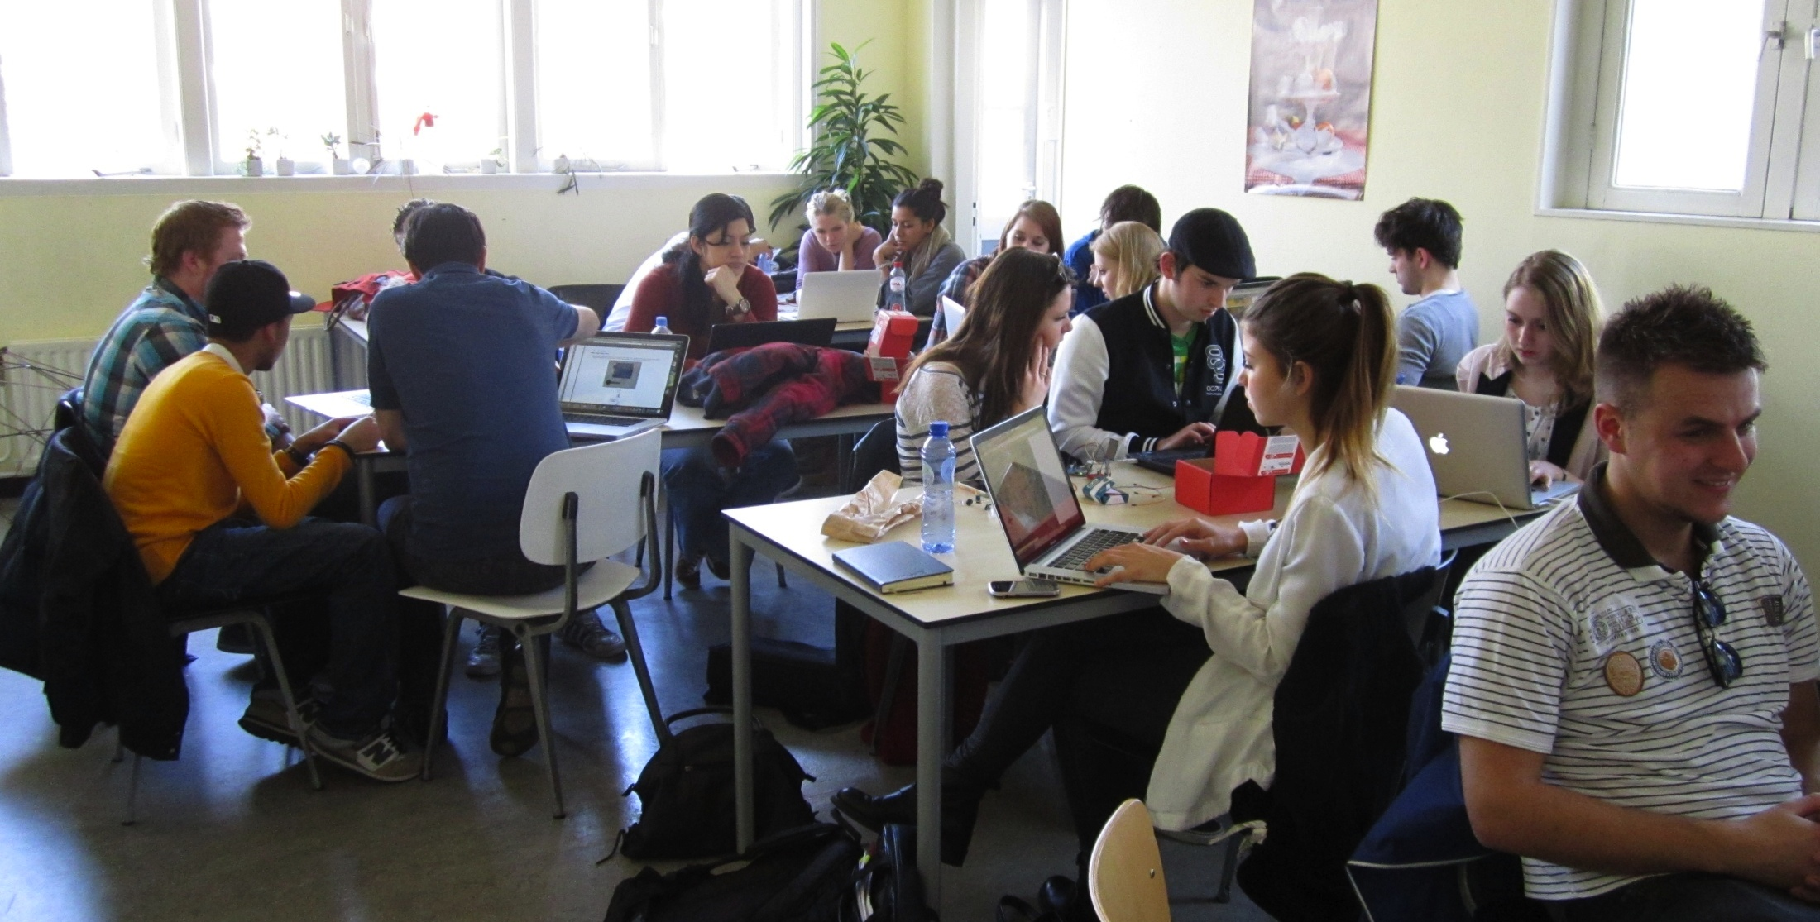
Stadslab – FabLab 010
2012
Arnold Roosch

Slide 2
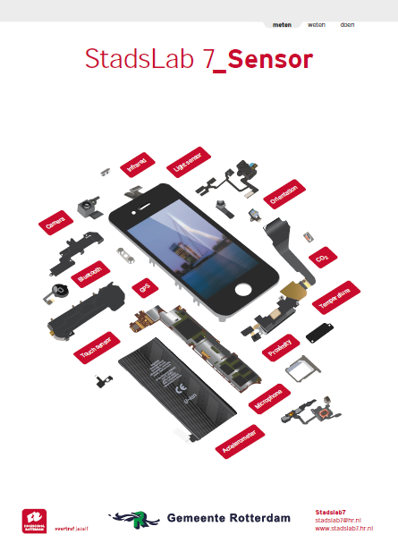
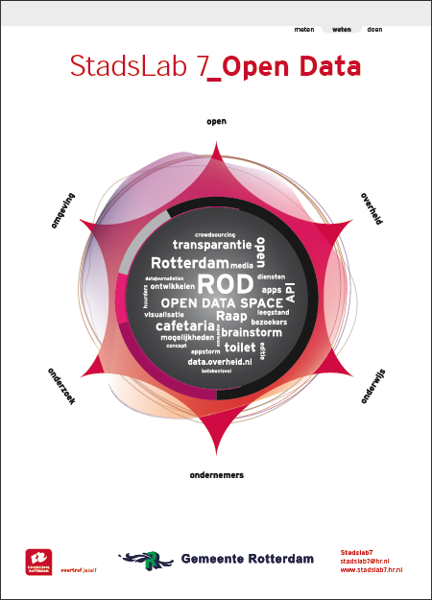
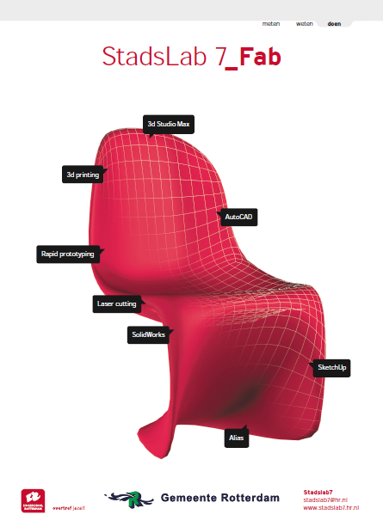
Three Labs
Measuring
Sensor Lab
Knowing Open Data Lab
Making Fab Lab

Slide 3
Stadslab @ Hogeschool Rotterdam
Notes:
Open Data promoted by City Councillor Korrie Louwes
Cooperation with the City of Rotterdam on Open Data
Project Rotterdam Open Data → Store & interfaces
Data combined with sensor technology and a fabrication lab in one physical space for experiments, open to everyone
Location sponsored by City of Rotterdam: Calandstraat 7
Fit with current trends: afffordable, prosumers, community building, the power of open, big data …

Slide 4
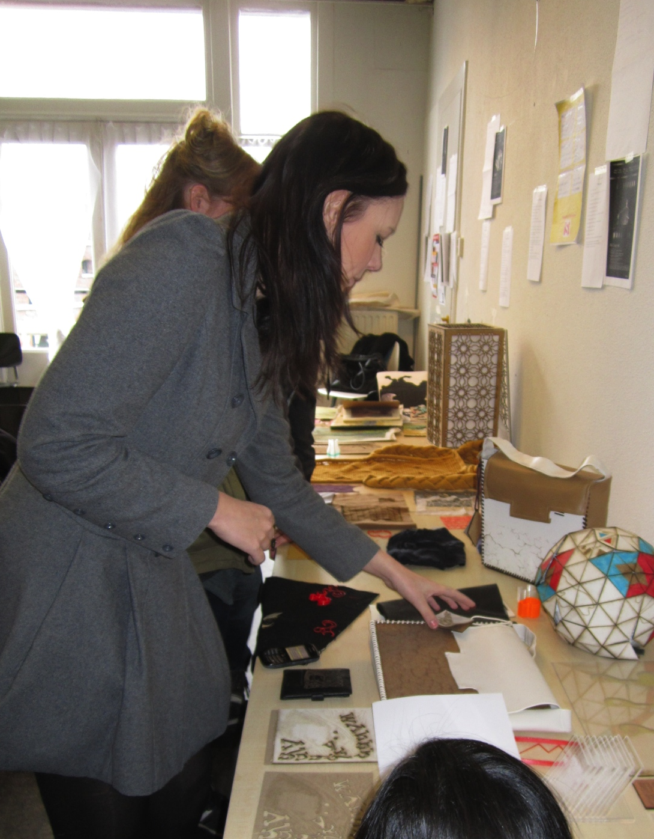
Educational Programs
Notes:
Stadslab is connected to the Rotterdam University of Applied Sciences, mostly through personnel from the department for Communication, Media and Information Technology (CMI)
(Technical) Information Technology
Media Technology
Communication & Multimedia Design
Communication (and Digital Media)
…and cooperation with Willem de Kooning Academy, Leisure Management, Building Engineering, etc.

Slide 5
Stadslab Uses
Notes:
Initiative by Hogeschool Rotterdam, City of Rotterdam, and creative business in Rotterdam
An inspirational place to meet and work for education, research, businesses and government: co-operation, experiments, co-creation, creativity, innovation around issues from and for Rotterdam
A physical place to connect practitioners with education and research
Easily accessible for SMEs

Slide 6
Examples
Notes:
Course modules
Research programmes
Workshops (mostly Fablab, some combined with Sensorlab)
Inspirational workshop (eg. Networks for women in business, Rotterdam media bureaus from CMI Advisory Board, Primary Education groups 8-10 years old)
Guided tours (eg. vocational education programmes, businesses)
Project meetings Rotterdam Open Data and public brainstorm gatherings “ROD voor z’n Raap”
Pilot City Development
Scrum workshops
Exhibitions

Slide 7
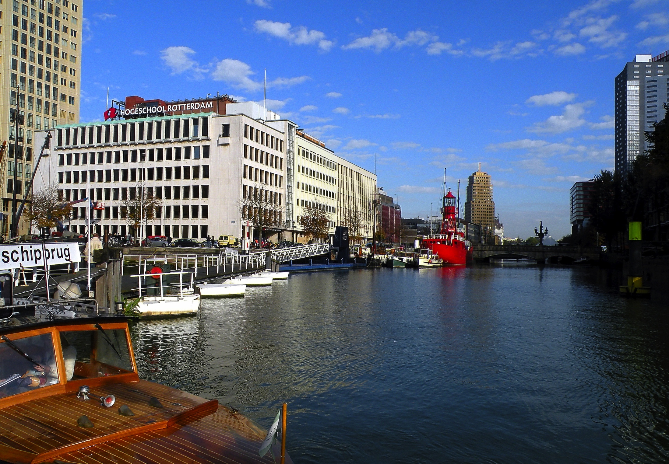
Lab moving to a new Location
Notes:
Sensorlab:
Arduino, Myrianed, Phidgets setjes
Xbox Kinect, smartphones
OBD II Car interface
Wireless mesh network
Fablab:
3D-printers
Lasercutters
Open Data lab:
Designing data store architecture (Data Store 2.0)
Studying methods for the analysis of open / big data
Various datasets of the City of Rotterdam
Education and experiments with met Open Data
Cases: 1km3, Car2Cloud, Rotterdam Unlimited
Developing concepts, apps, visualisations and applications for open data

