Slide 1
Museum of Science and Industry, Chicago, IL, USA
Rabiah Mayas, PhD, Director, Science and Integrated Strategies
Dan Meyer, Fab Lab Manager
Matt Chalker, Fab Lab Program Coordinator

Slide 2
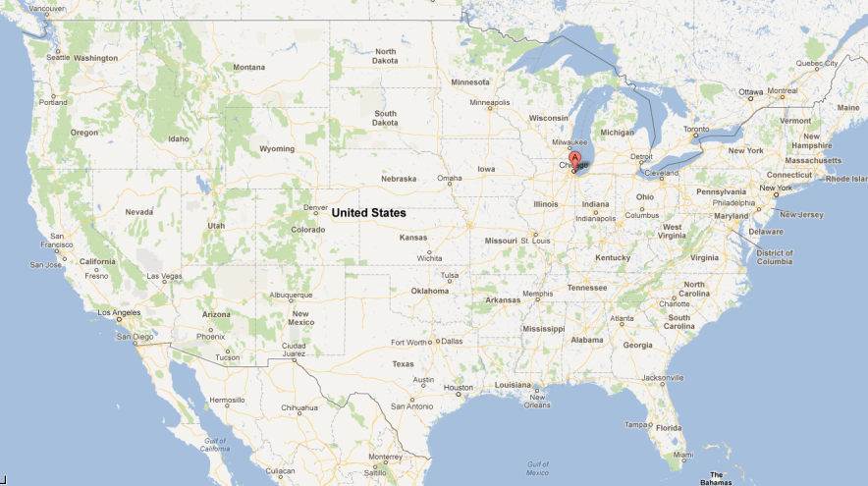
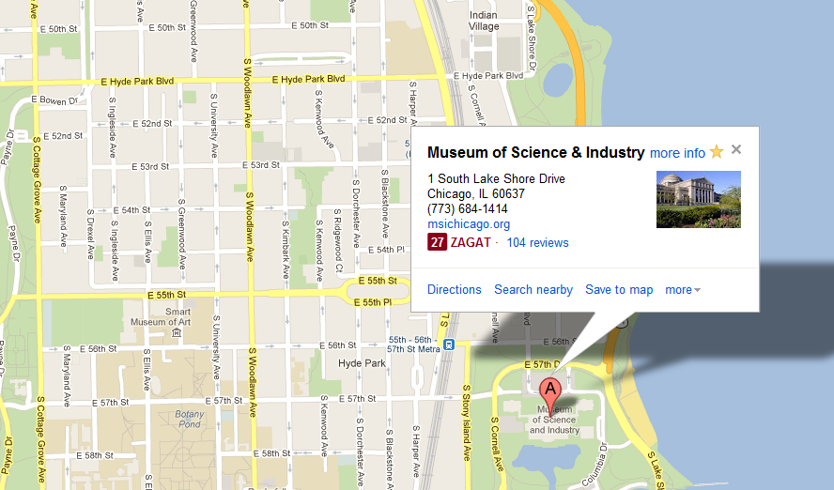
Obama’s
House
Notes:
Geographic Location
10 Blocks from Obama’s House

Slide 3
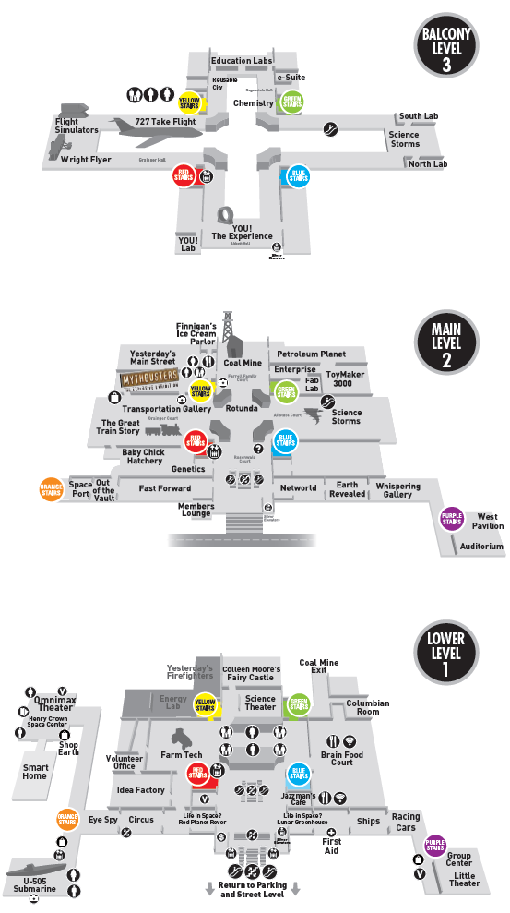
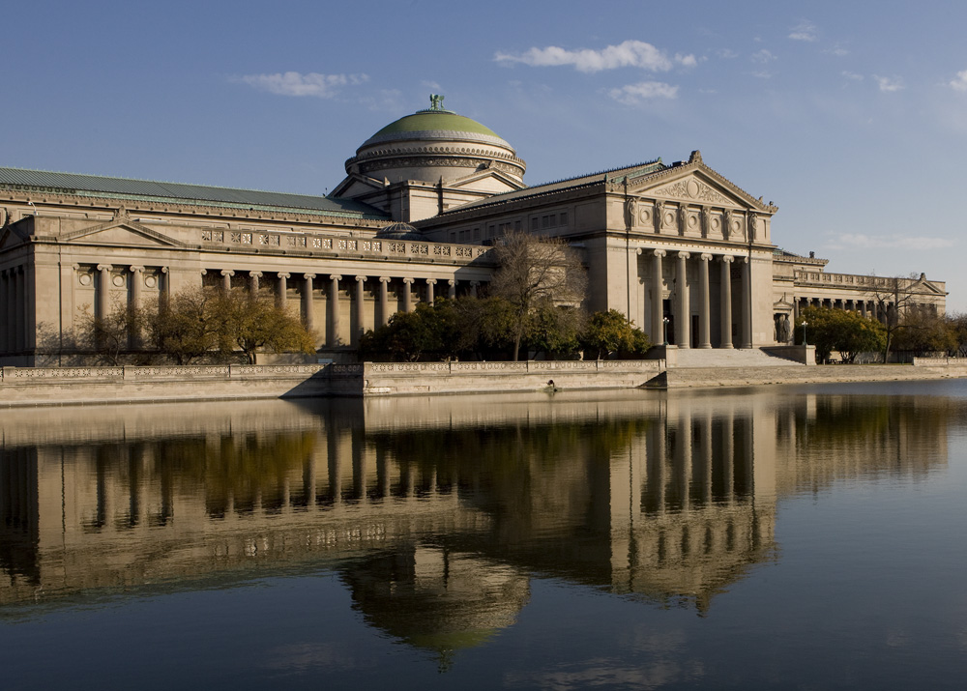
Fab Lab
Notes:
Largest Science Center in the Western Hemisphere
~14 acres of exhibits (CHECK STAT)
~1.35 Million Visitors Each Year
Built in 1893 for World’s Fair – Palace of the fine arts in The Devil in the White (book, possibly movie?)
Maybe something about Mission/Vision?
Fab Lab only a small part of the entire machine

Slide 4
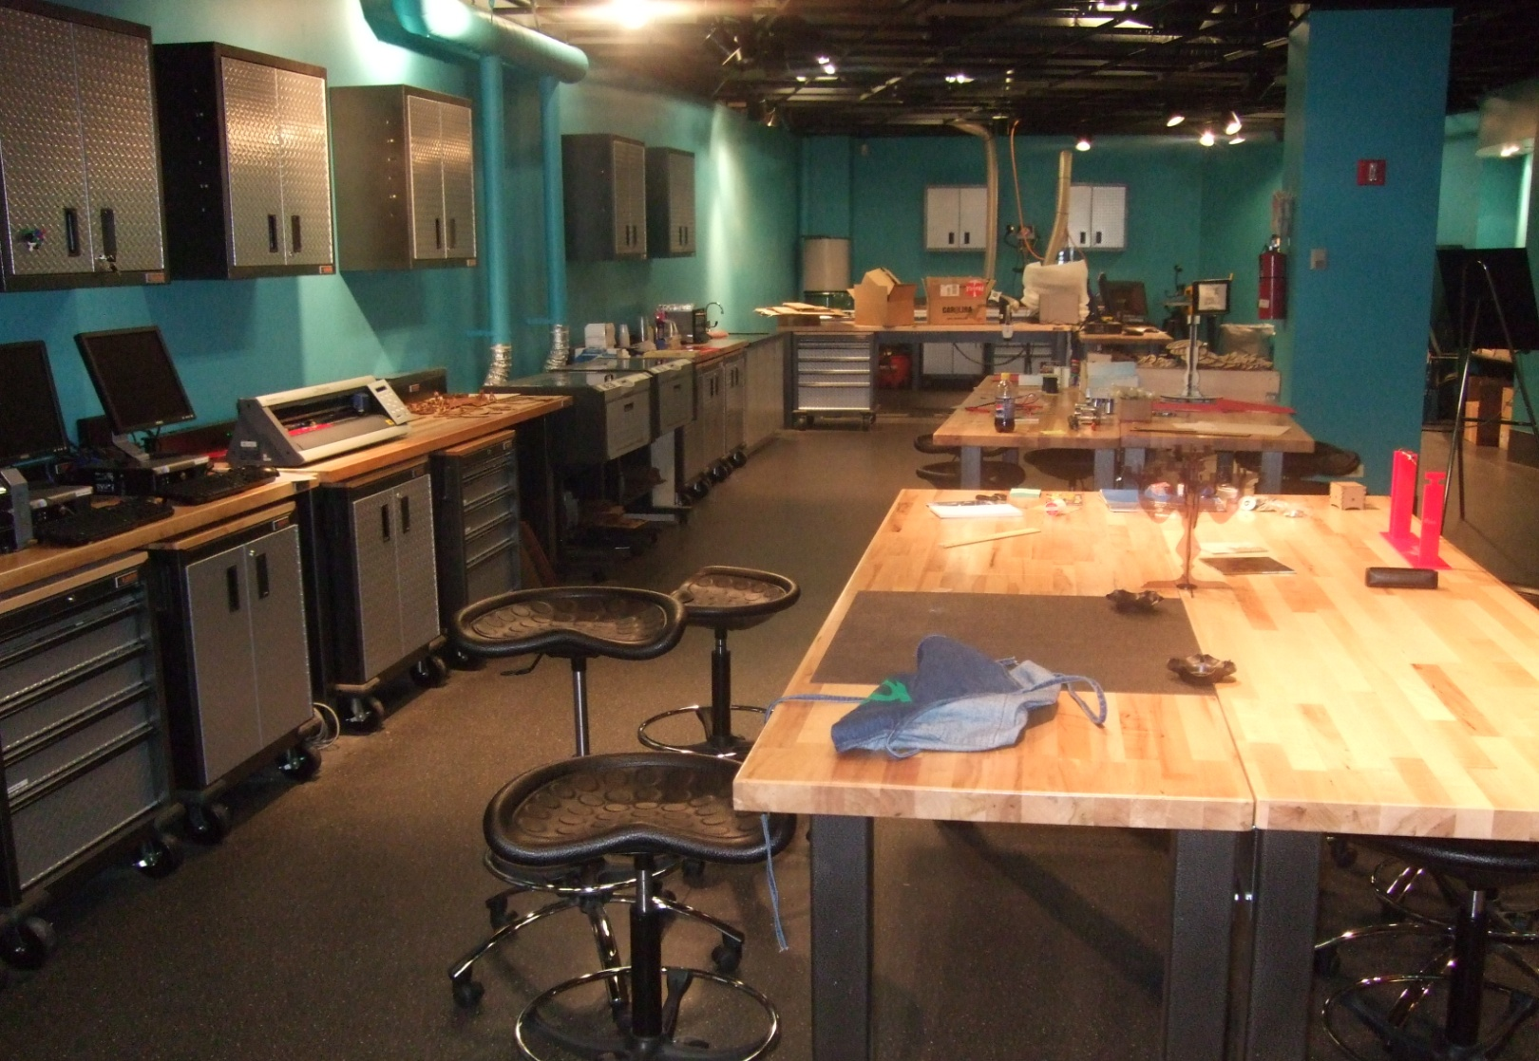
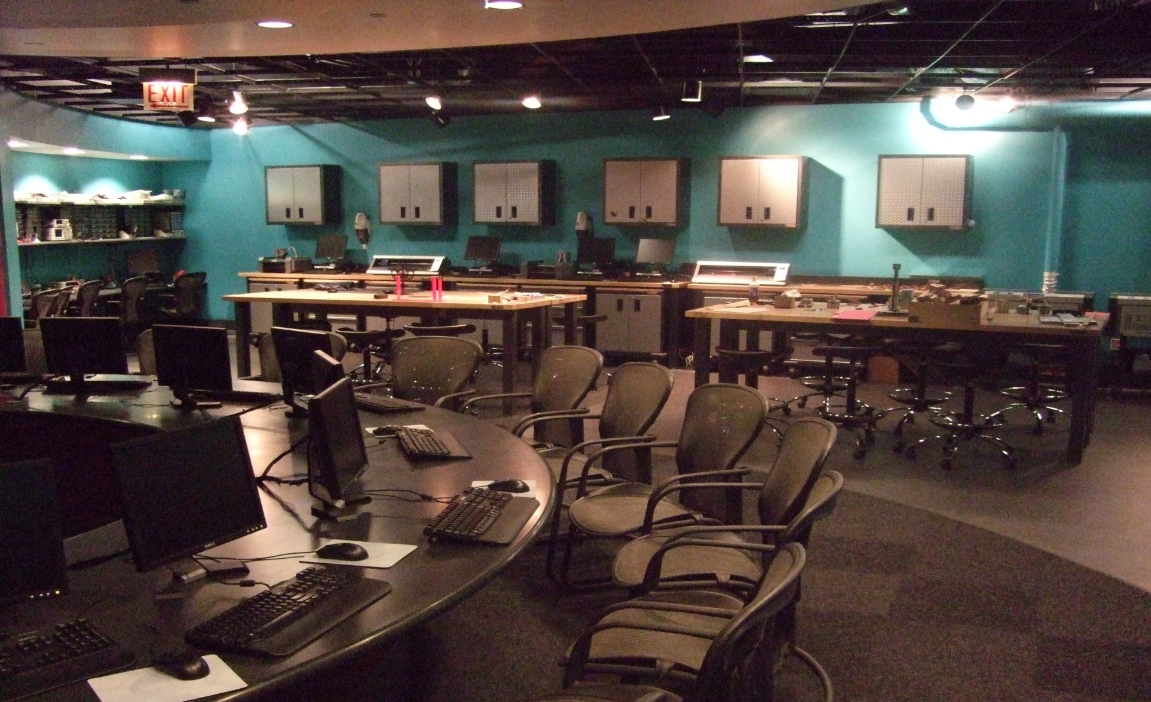
Notes:
Info about the lab?
Founded in 2007
Not sure how detailed to go here, do we assume they know our equipment? List new equipment? Stuff since last conference– Up! 3D printer, Stratasys Uprint Plus, NextEngine, Kinect, Wacoms
Possibly pictures of machines?
Famously underutilized in the past, in a phase of dramatic growth.

Slide 5
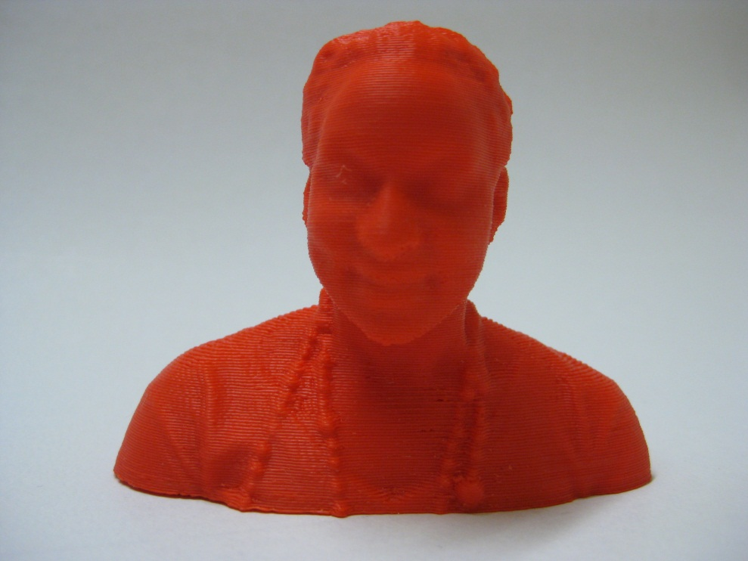
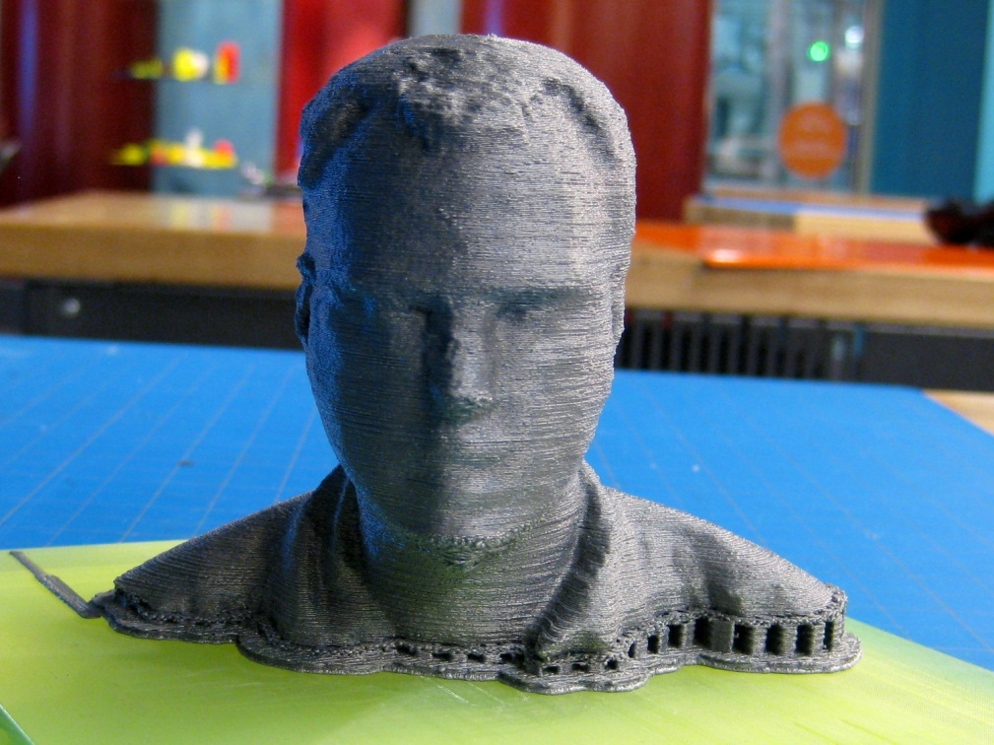
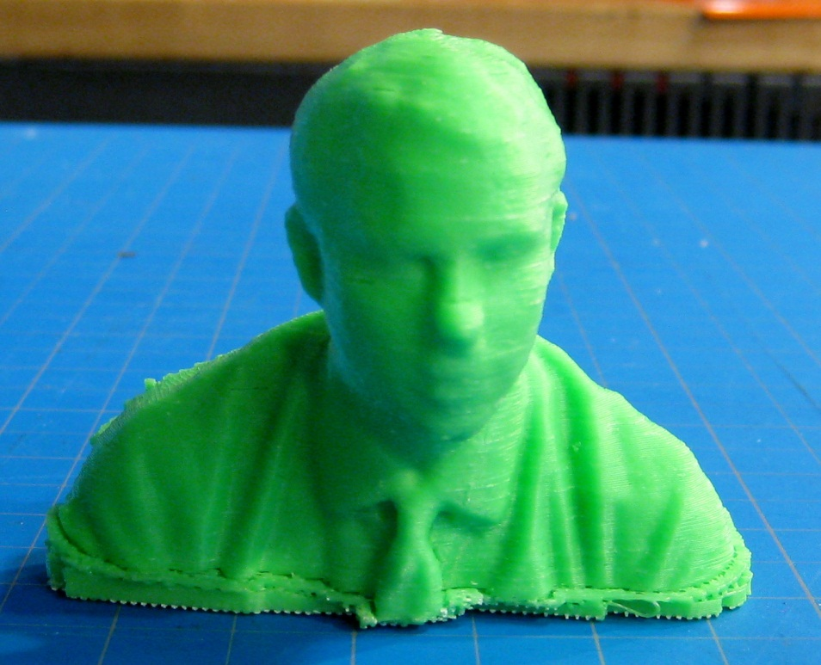
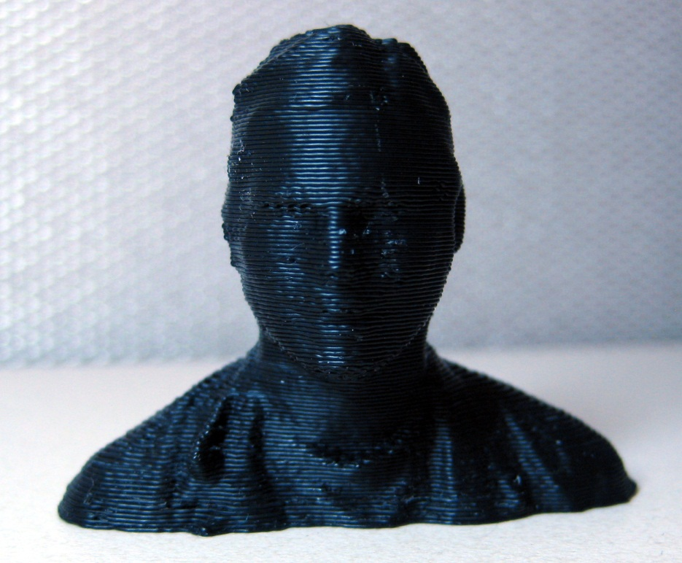
RABIAH
DAN
CHRISTIAN
MATT
Notes:
Rabiah
Dan
Matt
Christian
New Facilitators/Volunteers

Slide 6
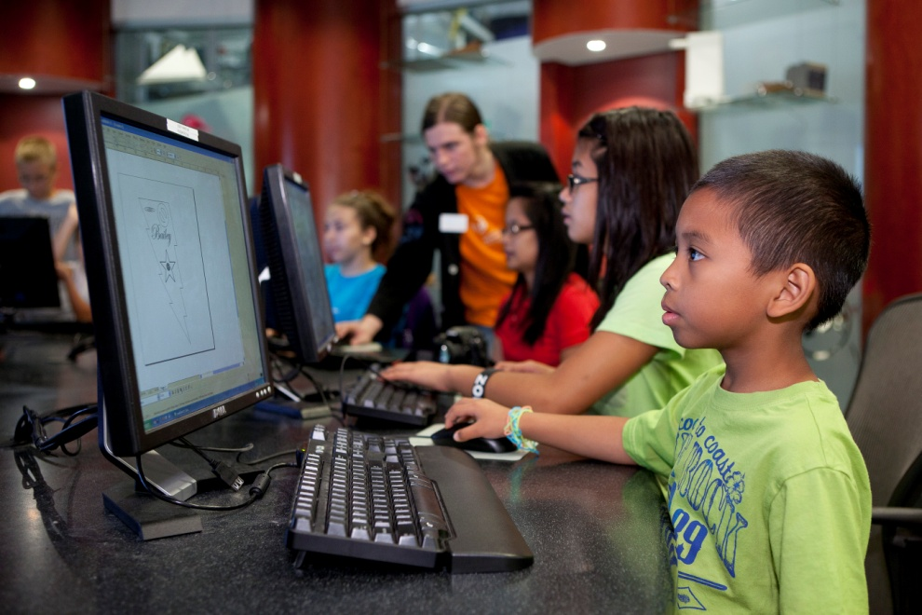
Notes:
New hires
Expanded programming
From October 26, 2011 to August 15, 2012 1179 guests ages 8 and up have participated in Fab Lab open workshops
Currently offer 2 workshops a week, shortly to increase to at least 10 a week, more than 500 a year.

Slide 7
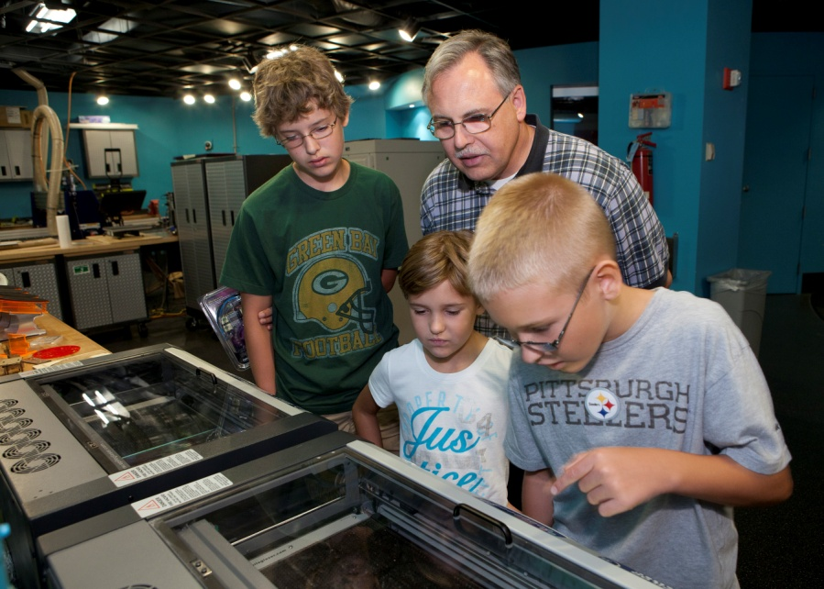
Notes:
Principle workshop is Dream It! Design It! Fab It!
Guests learn basic functionality of Inkscape, design their own keychains (or other small acrylic objects,) then we cut them out on the laser cutters, all within an hour
Sometimes have guests who have never used a mouse

Slide 8
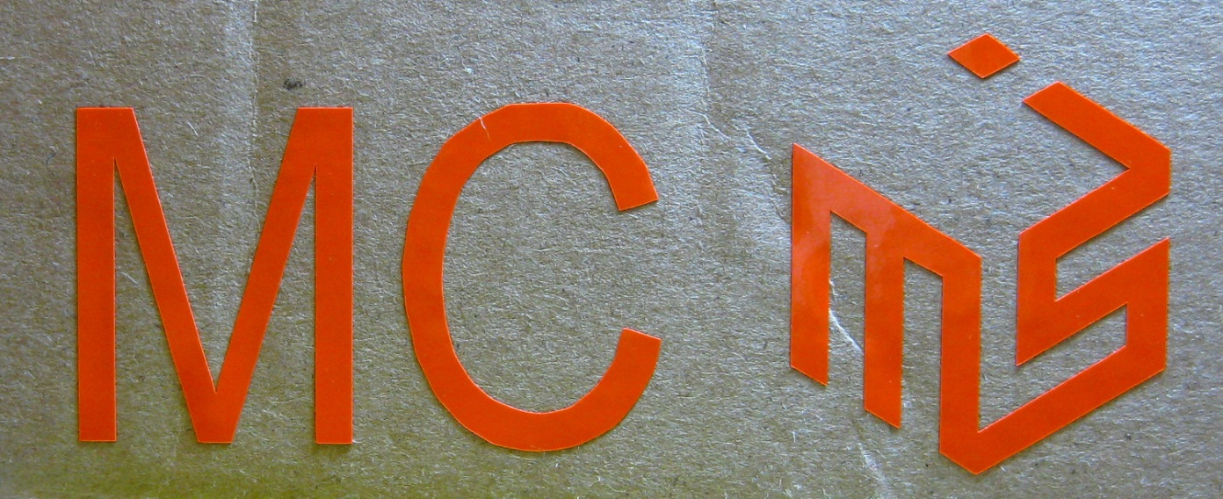
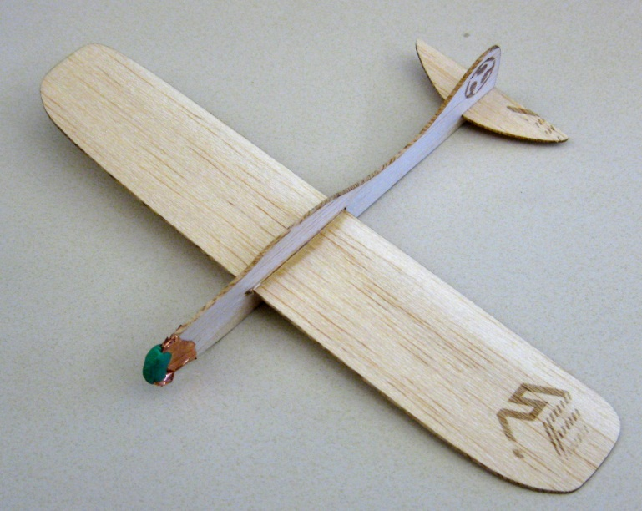
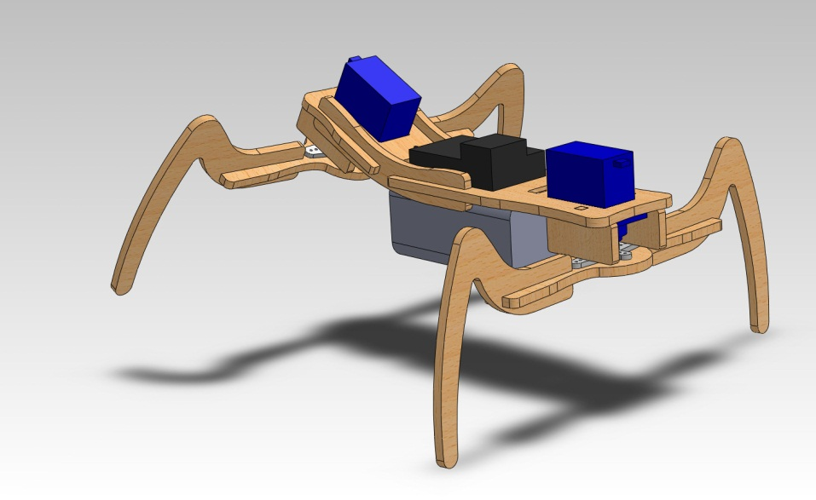
Notes:
Future Guest Workshops
Three models
Brief, <20 minute encounters that focus on one machine or simply intro space without a heavy design element, either heavily templated or no design at all (extended tours with physical takeaway), free
~ 1 Hour workshops, single machine use, focused creation, keychain workshop, 3D scanning and printing, remain free
Extended multi hour workshops, multi machine, register in advance, paid

Slide 9
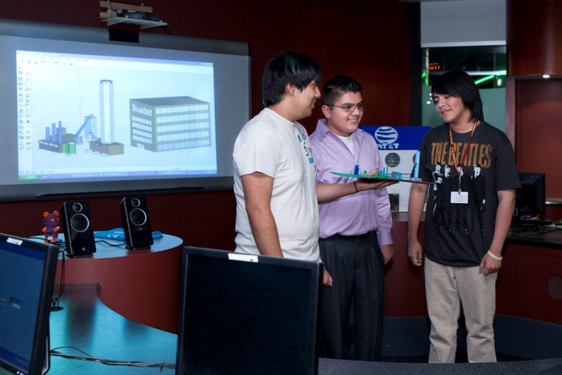
Notes:
Extended Engagement Programs
Innovation Clubs
Science Achievers
High School (age 14-18) students, 10 to 15 return trips to the Fab Lab, out of school time (afternoons, weekends)
Project based instruction model, everyone working on a single topic/theme, often on a single large scale object
Partnership with local schools
Alternate visits between school and MSI
Most design happens at the School, most making happens in the lab

Slide 10
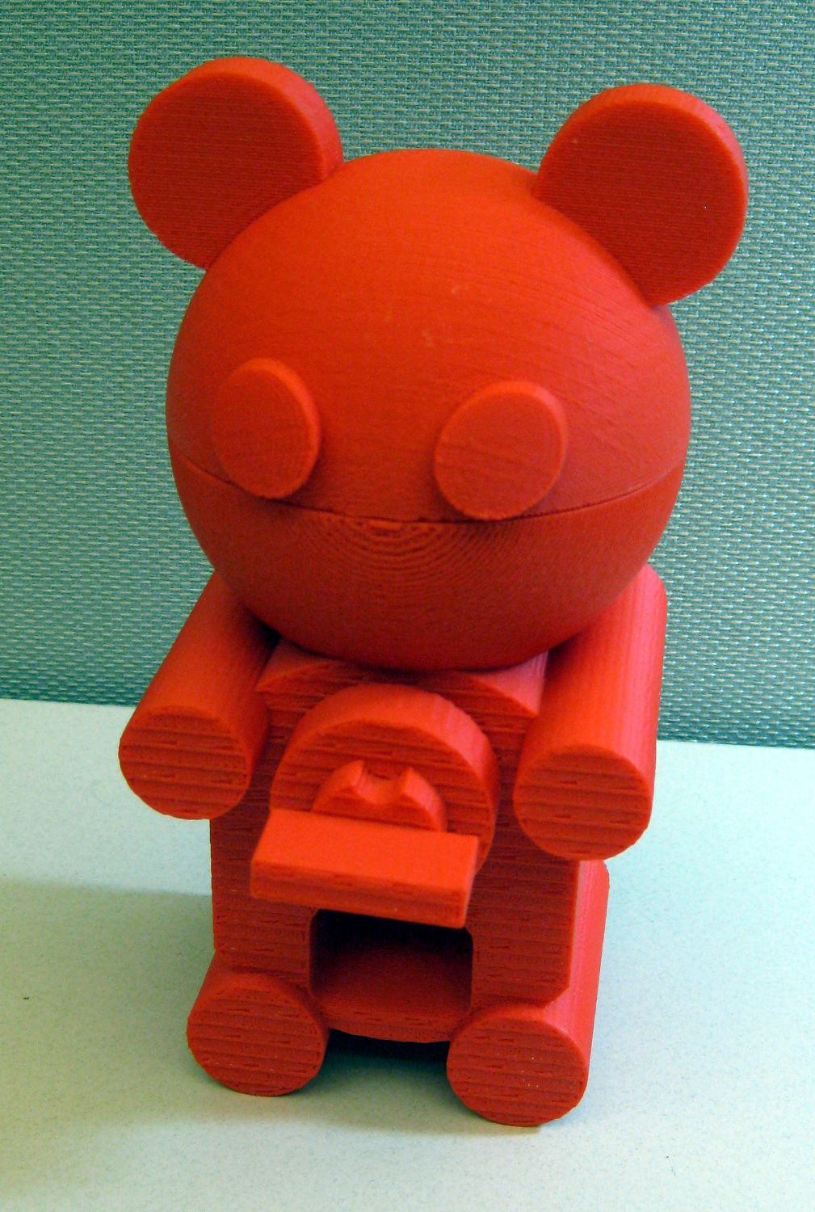
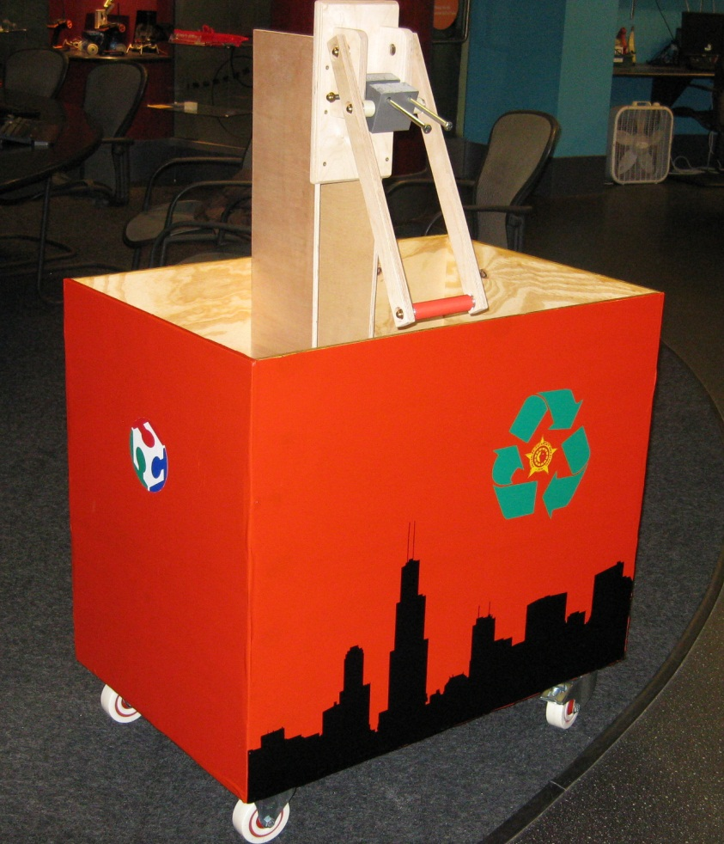
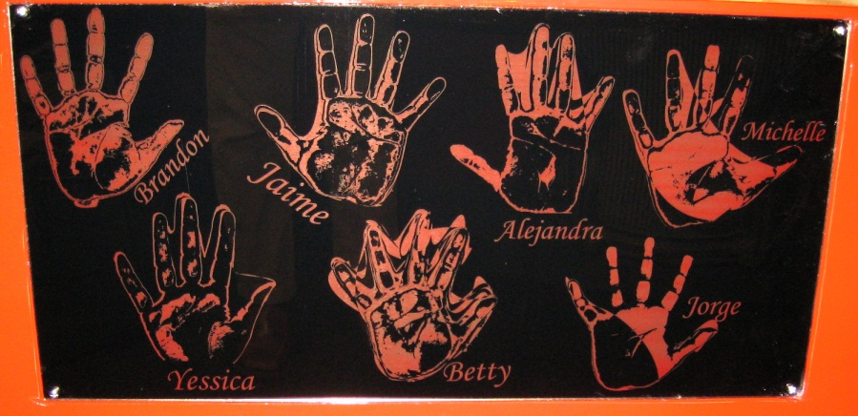
Notes:
Innovation club projects
Gummy Bear Dispenser
Designed in sketchup
3D printed on the Prodigy Plus
Recycling cart
Can Crusher, cart – shop bot
Various Vinyl Stickers
Laser etched hand scans

Slide 11
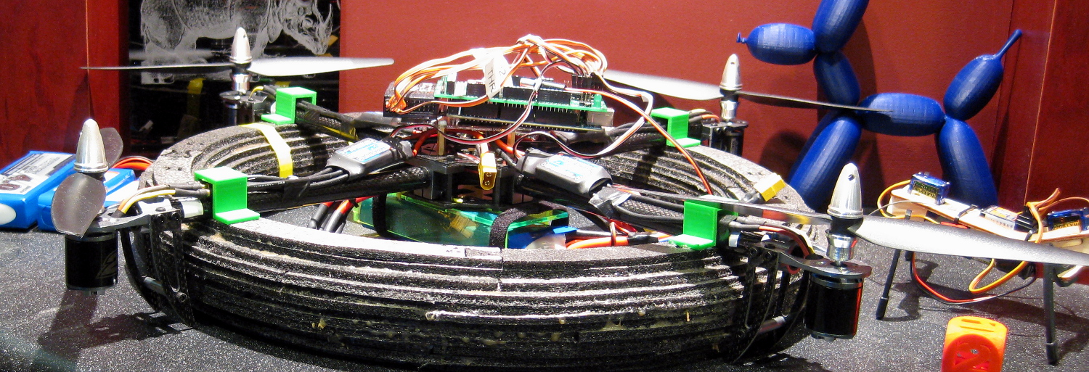
Notes:
Achievers Summary
High school volunteer club housed at MSI
Visit every Saturday, 10 week cycles
Majority returning kids, they go into project groups with a focus
New kids go through a boot camp process, learning one process and machine every week
Quadcopter
Arduino mega powered
Aeroquad software
Custom foam ring for floating on lake (not yet fully waterproof)

Slide 12
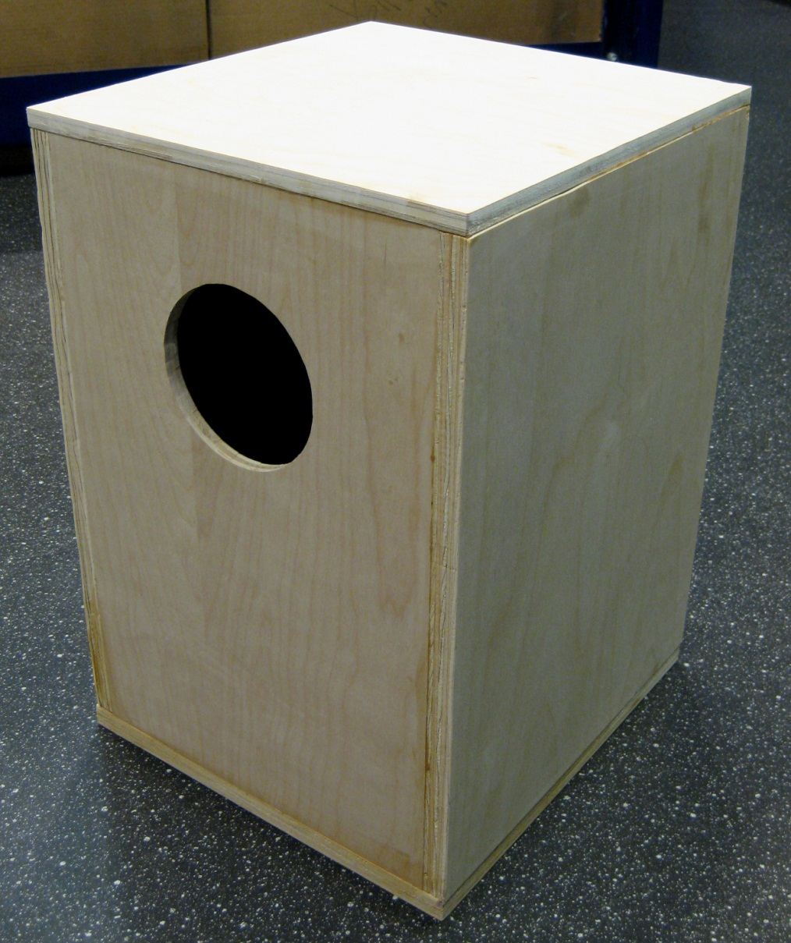
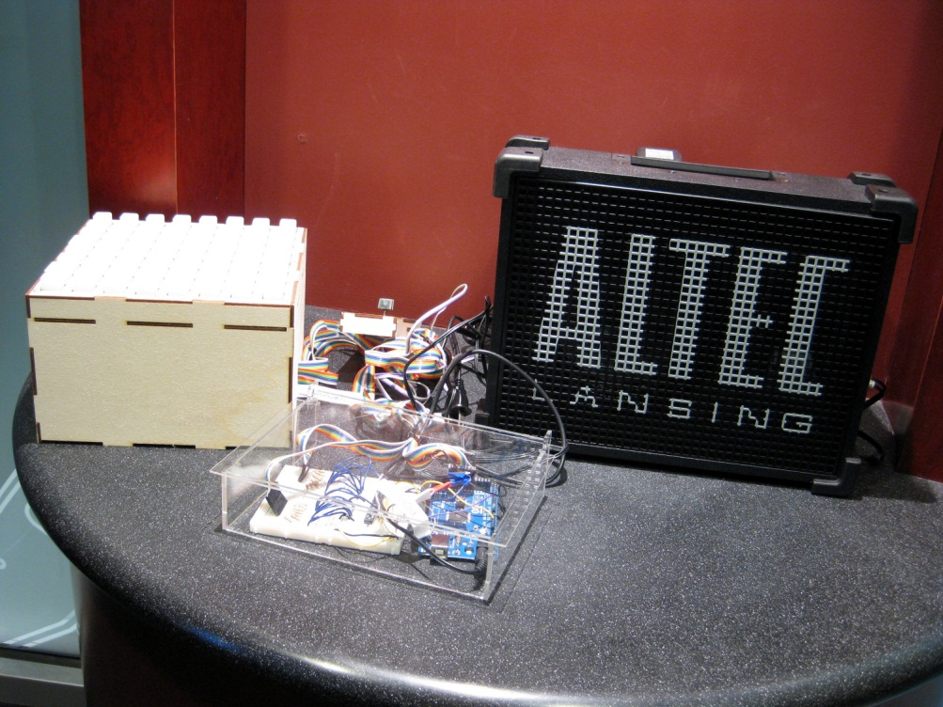
Notes:
Music
Cajon
Shop bot (prototypes on the laser cutter)
Monome
Digital sequencer, laser cut box
Arduino mega programing

Slide 13
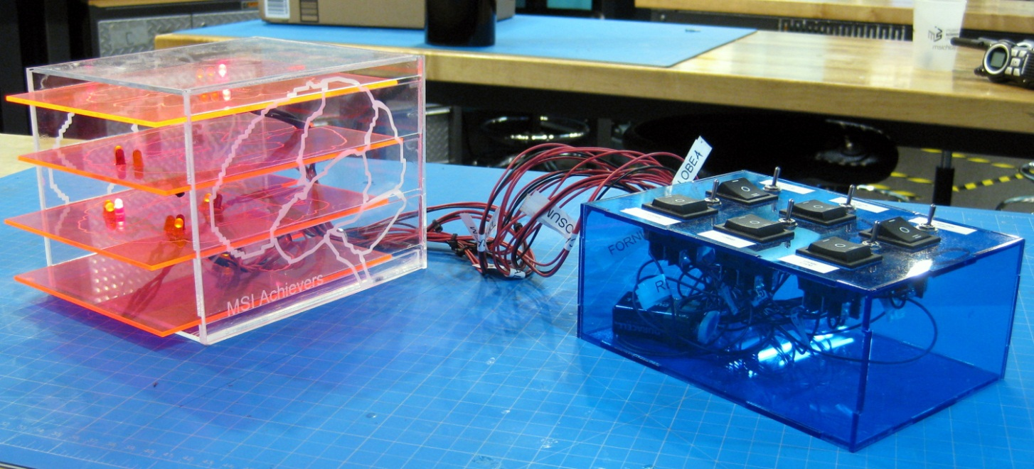
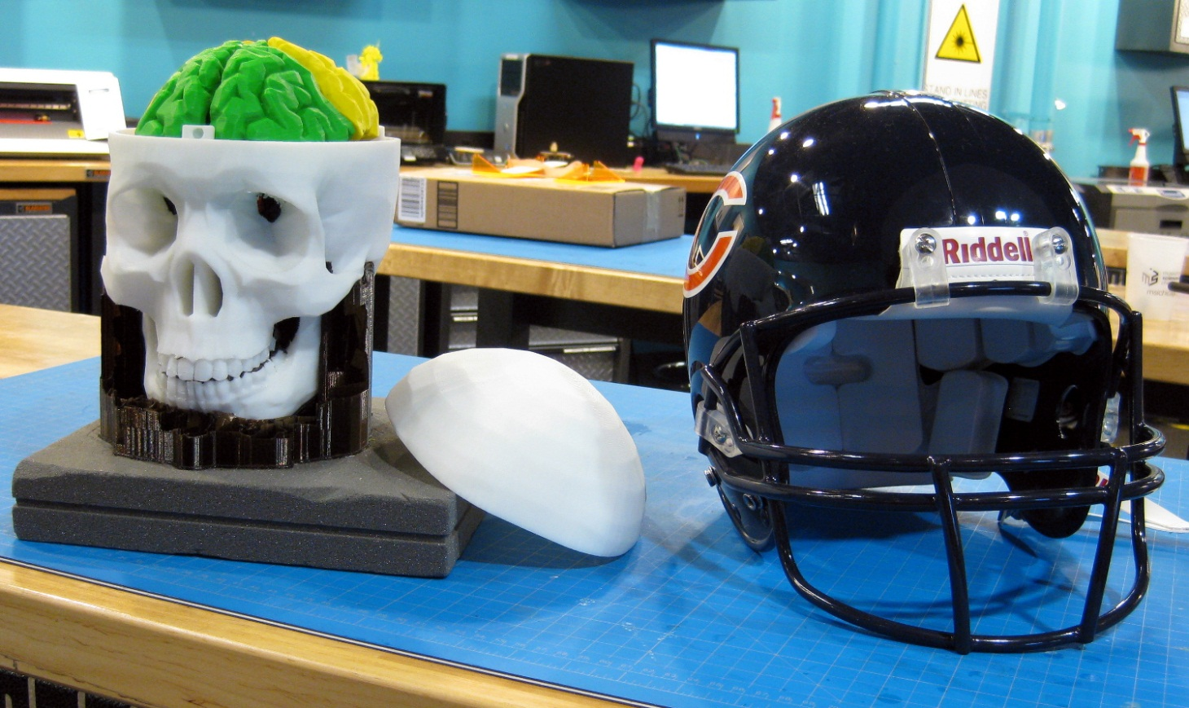
Notes:
Brain Awareness
Slices
Embedded LED’s highlight common concussion injury areas in laser cut box
3D printed skull and brain
Disassemblable (maybe a word?) to show internal anatomy of the brain
Scaled to fit inside professional football helmet

Slide 14
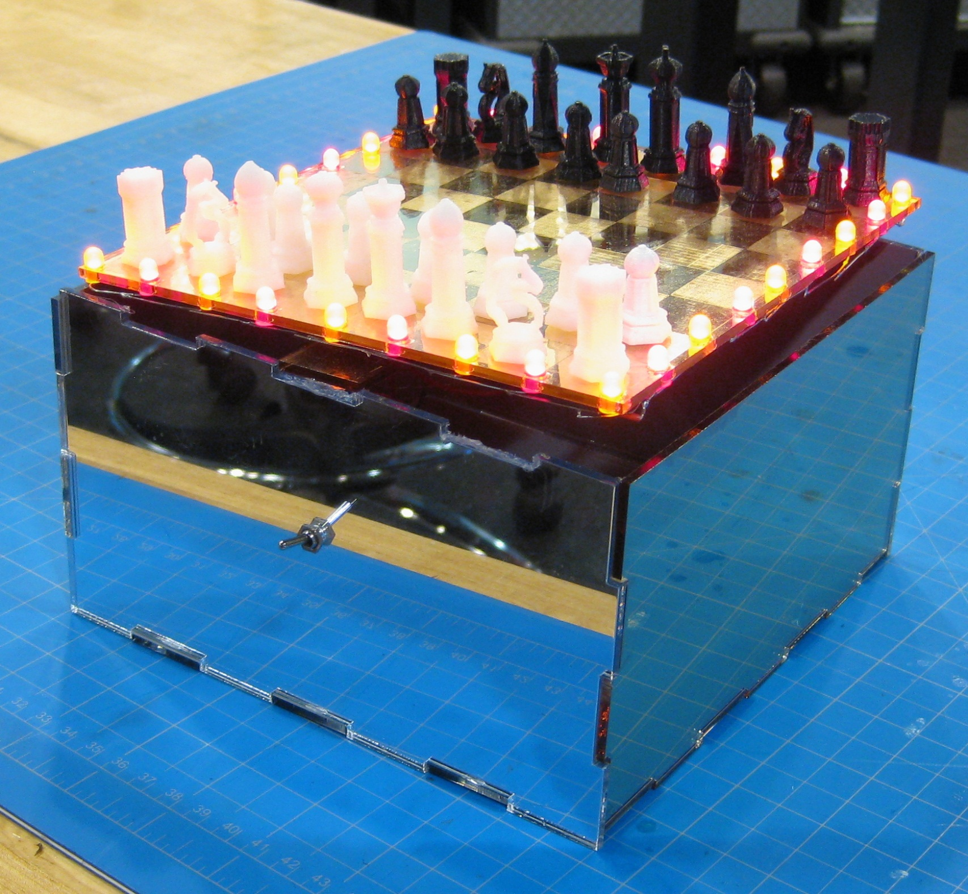
Notes:
Bootcamp
New achievers, have never been in the lab before
In general no design experience
One machine a week, up to the Shop Bot
Last 2 weeks they have to make something cool with partners to display to guests on the floor (this session’s theme was “entertainment”) using multiple fab processes
Laser cut chess board/housing
Soldered LED’s
3D printed chess pieces

Slide 15
Coming Soon!
FabOnline (learn more on Friday afternoon)
Corporate innovation partnerships
Chicago fab/make/tinker/hacker community-building
Lots of program development
Evaluation and research (Need help! Need help?)

