Slide 1
Fab9
Hiro Tanaka,
a director of Social Fabrication Center,
Keio University
Youka Watanabe
a manager of FabLab Kamakura

Slide 2
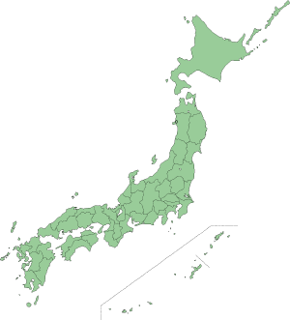
FabLab Tsukuba
FabLab Shibuya
+ FabCafe
FabLab Kamakura

Slide 3
FabLab Kamakura

Slide 4
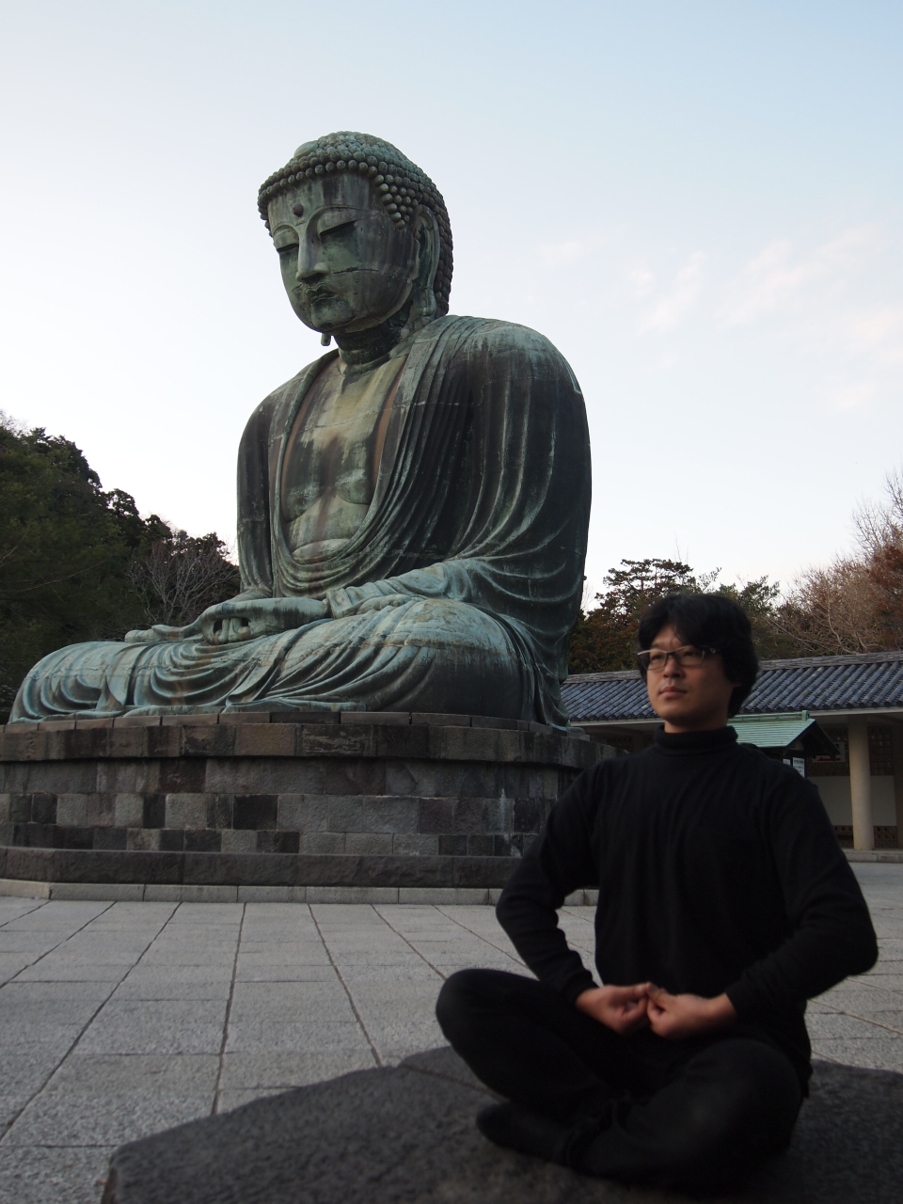
Notes:
Let me move on to what is fablab japan?

Slide 5
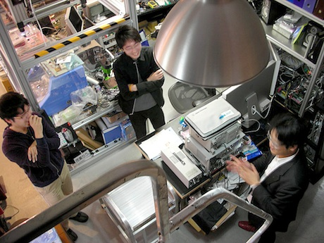
FabLab Tsukuba

Slide 6
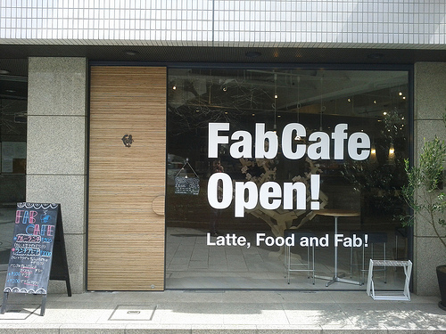
Fab Cafe in Shibuya (the central Tokyo)

Slide 7
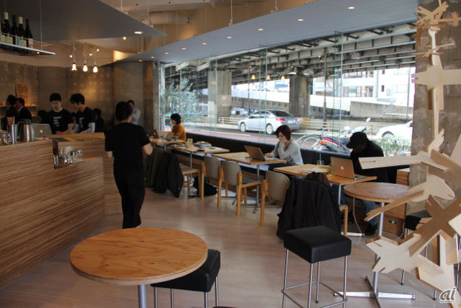

Slide 8
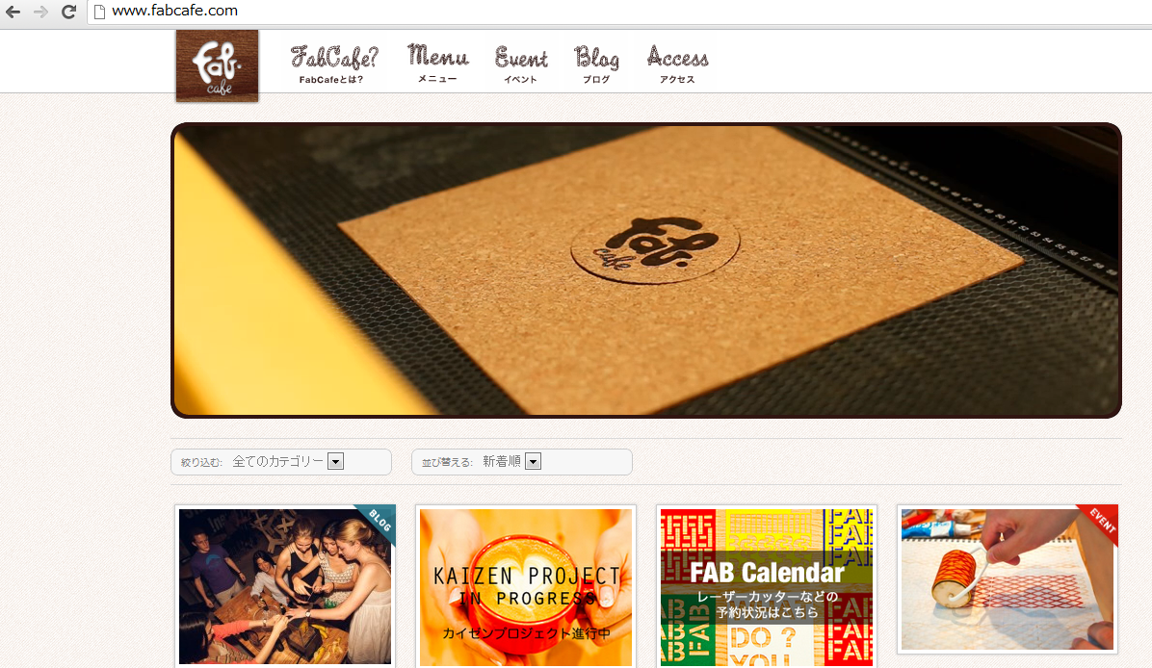

Slide 9
FabLab Sapporo
Keio University
Social Fabrication Center
FabLab Tsukuba
FabLab Kansai
FabLab Shibuya
+ FabCafe
FabLab Kamakura
f.Lab/ FabLab Ogaki

Slide 10
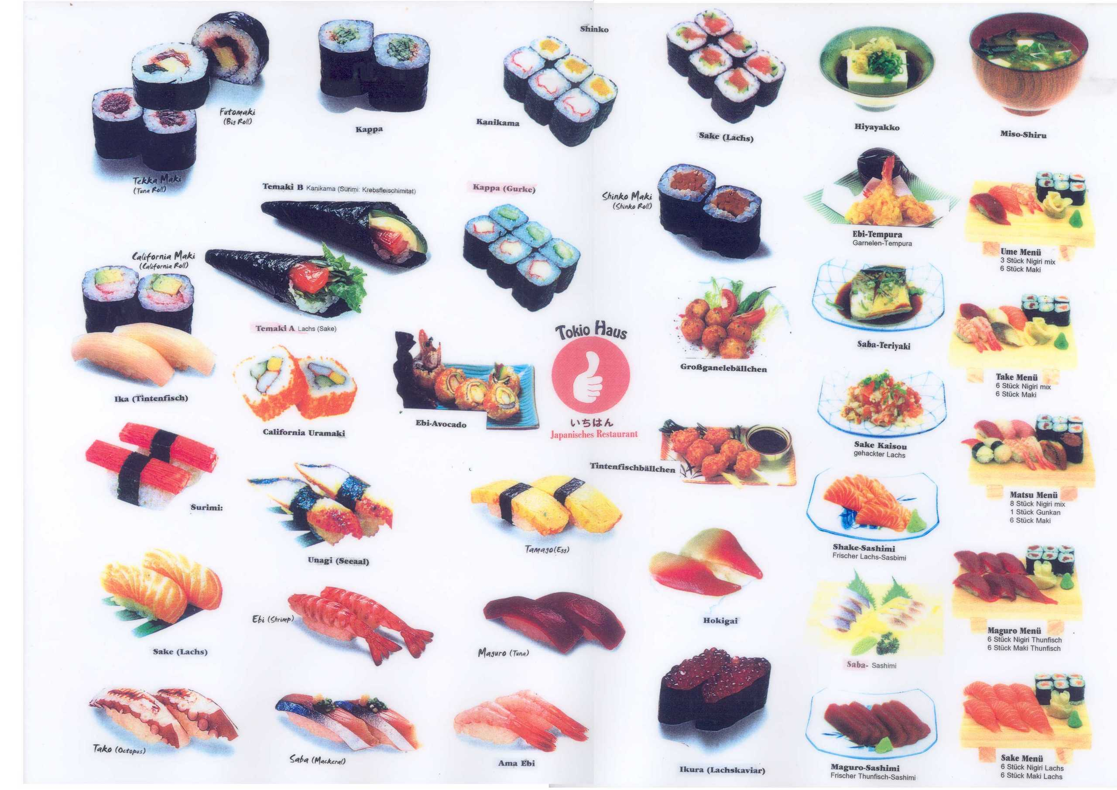
Modular Design!

Slide 11
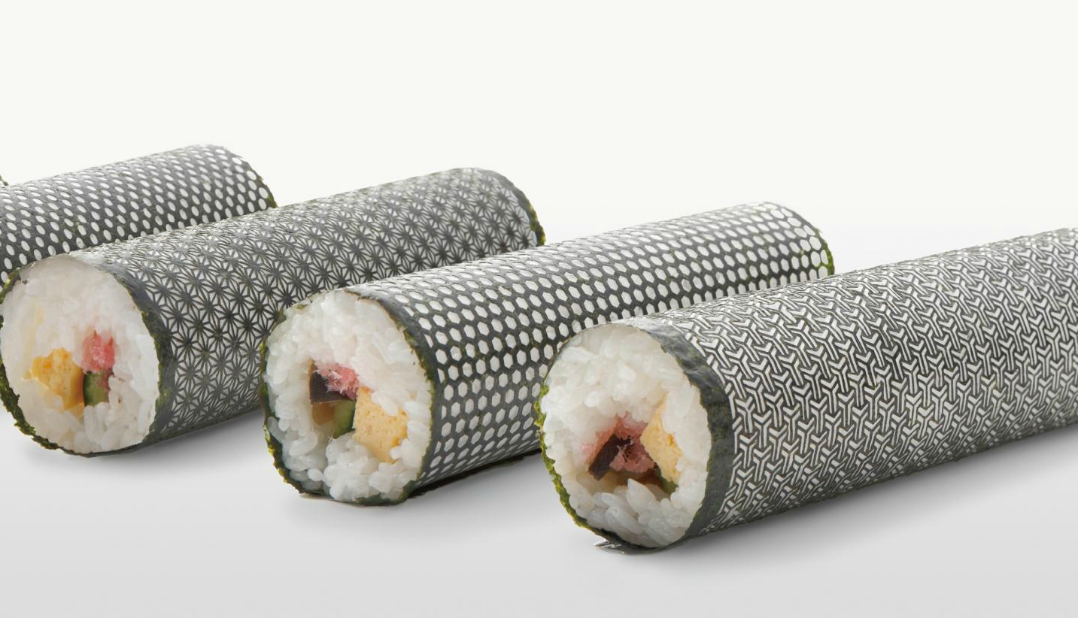
https://treeofmamre.files.wordpress.com/2012/04/screen-shot-2012-04-13-at-11-32-00-am.png
Personal Customization!

Slide 12
++ Cultural Activities
Fabbercize 2.0
Fab Cinema
Fab Music
Fab Food
Fab Sports
Fab Fashion
Fab Karaoke
……………..

Slide 13
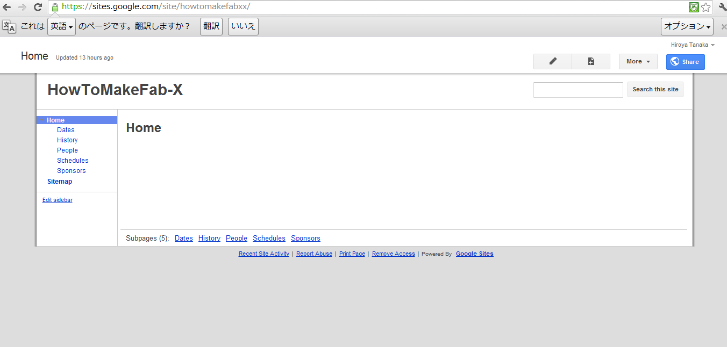
https://sites.google.com/site/howtomakefabxx/

Slide 14
Date?

Slide 15
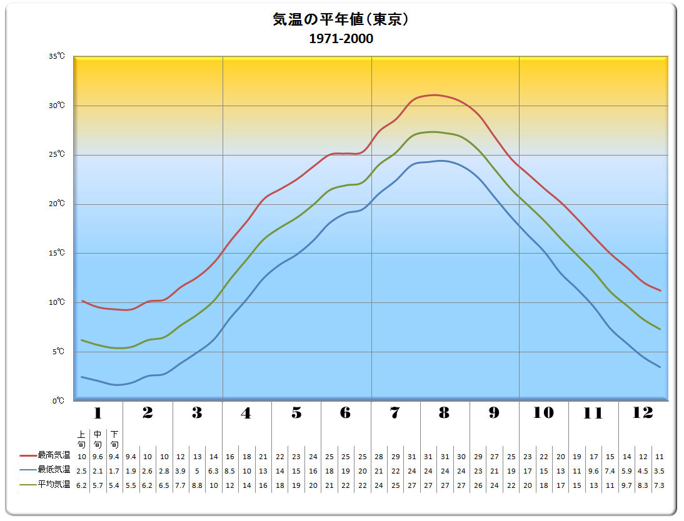
Tempereture
Notes:
セルシウス

Slide 16
8/21 (wed)- 8/27(Tue)

Slide 17
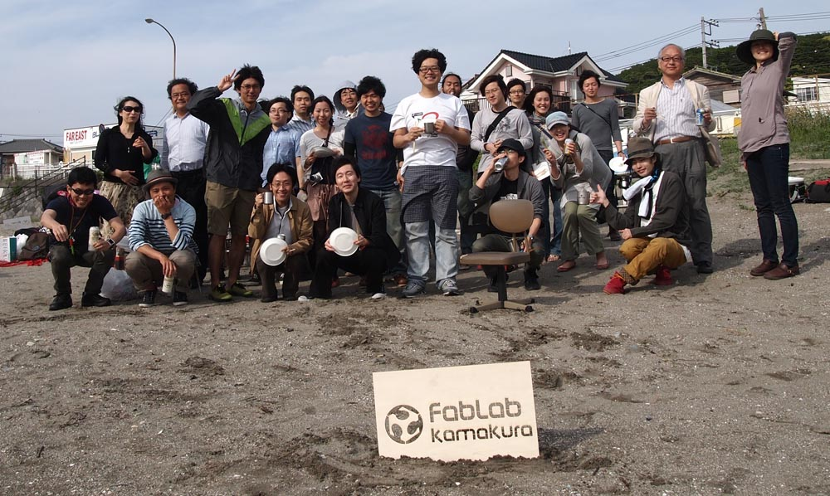
See you in Japan next year!

