Slide 1


Synthetic biology: from parts to modules to systems
Ron Weiss
Department of Biological Engineering
Department of Electrical Engineering and Computer Science
MIT
Department of
Biological Engineering
FAB6, August 2010

Slide 2
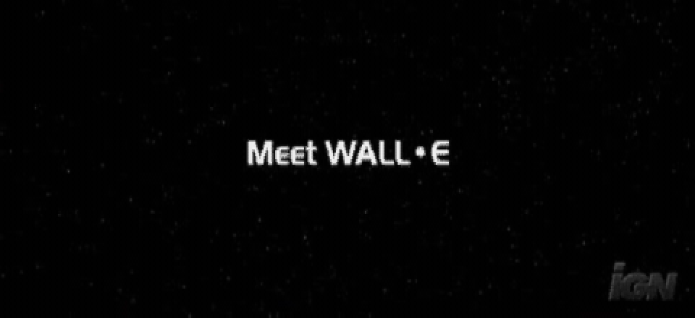
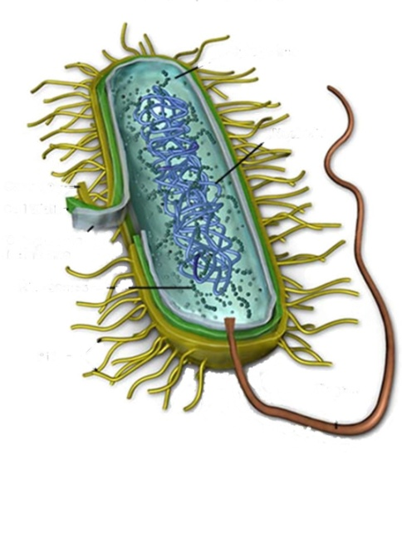
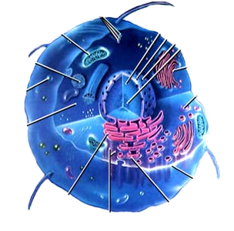
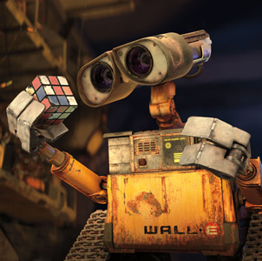
Synthetic biology analogy: bio-bots

Slide 3
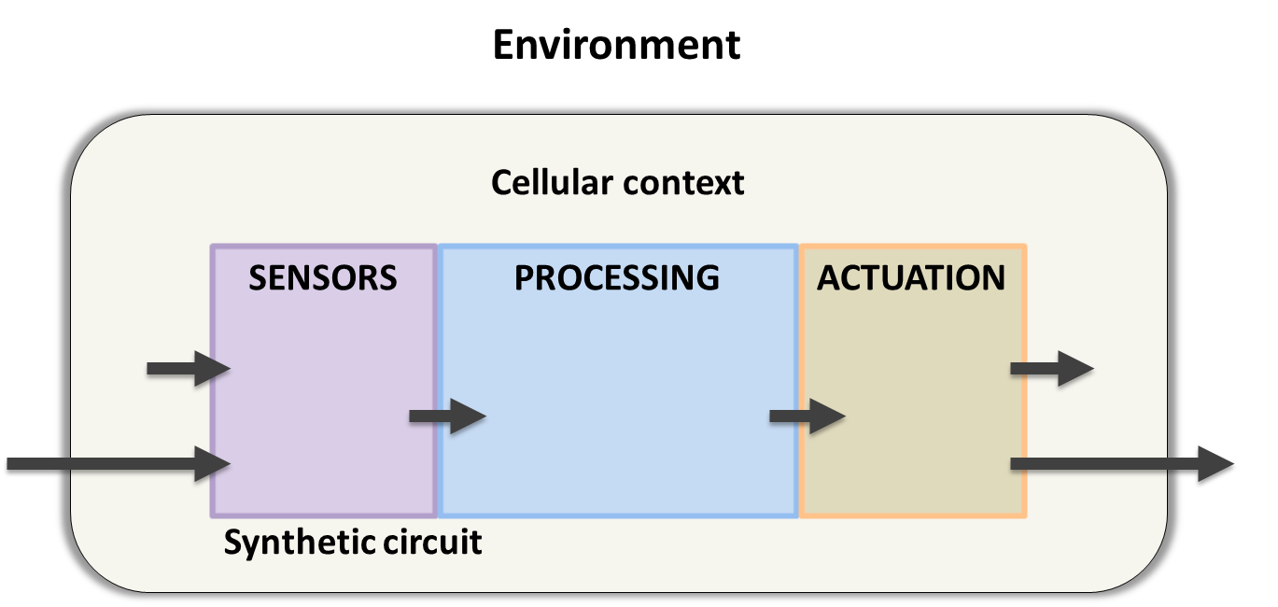
Synthetic biology analogy: bio-bots

Slide 4
Overview
Basic modules
  Digital, analog, multicellular
Applications / Larger scale systems
  Logic circuits for cancer therapy
  Artificial tissue homeostasis for β cells

Slide 5

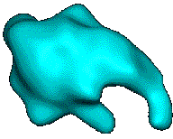
Genetic Building Block – Digital Inverter
0
1
input protein
(repressor)
output protein
Transcription /
Translation
P
CDS

Slide 6
Genetic Building Block – Digital Inverter
1
0
input protein
(repressor)
output protein
Transcription /
Translation
P
CDS

Slide 7

Modules implemented in Weiss lab
digital
comm.
Inverter
Send/Receive
Toggle switch
Yeast QS
Cascades
Consensus
Pop Ctrl
1:2 MUX
Pulse Gen
Band detect
Amplifier
analog

Slide 8
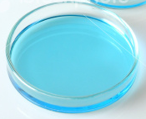
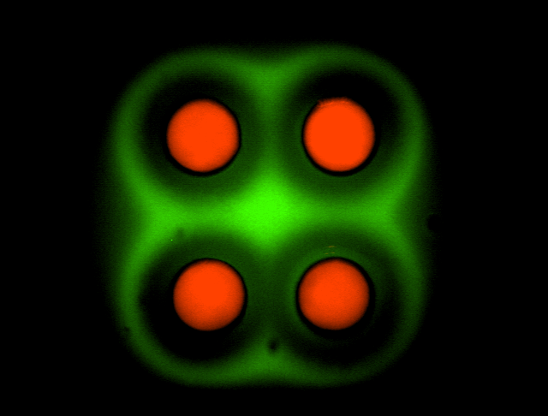

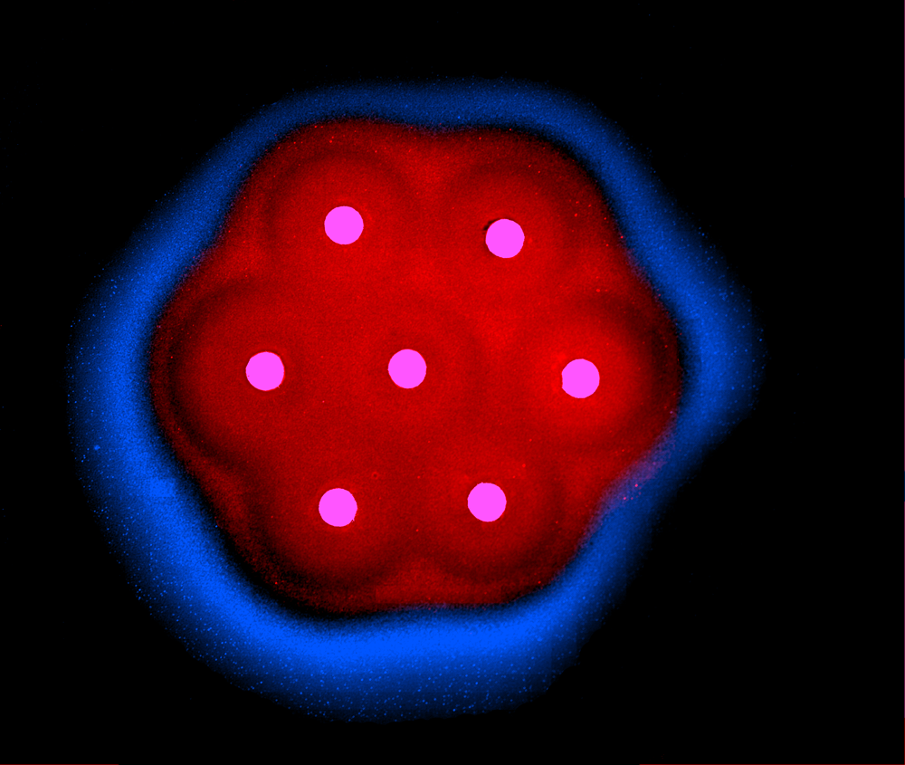
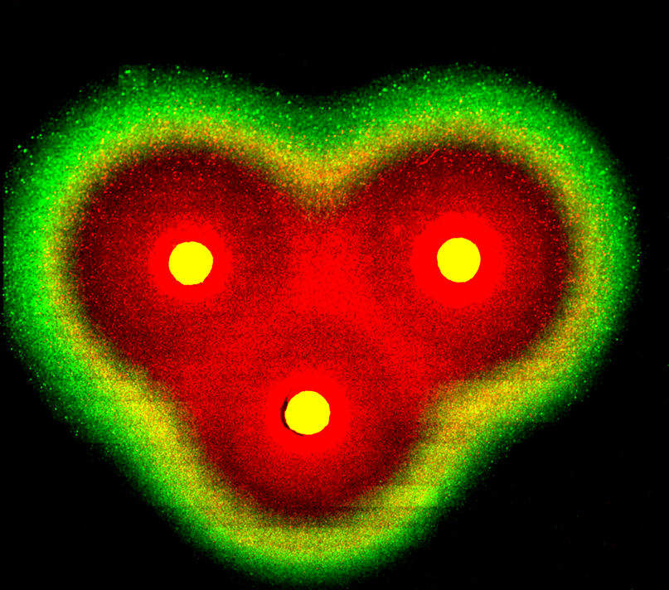
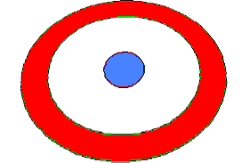
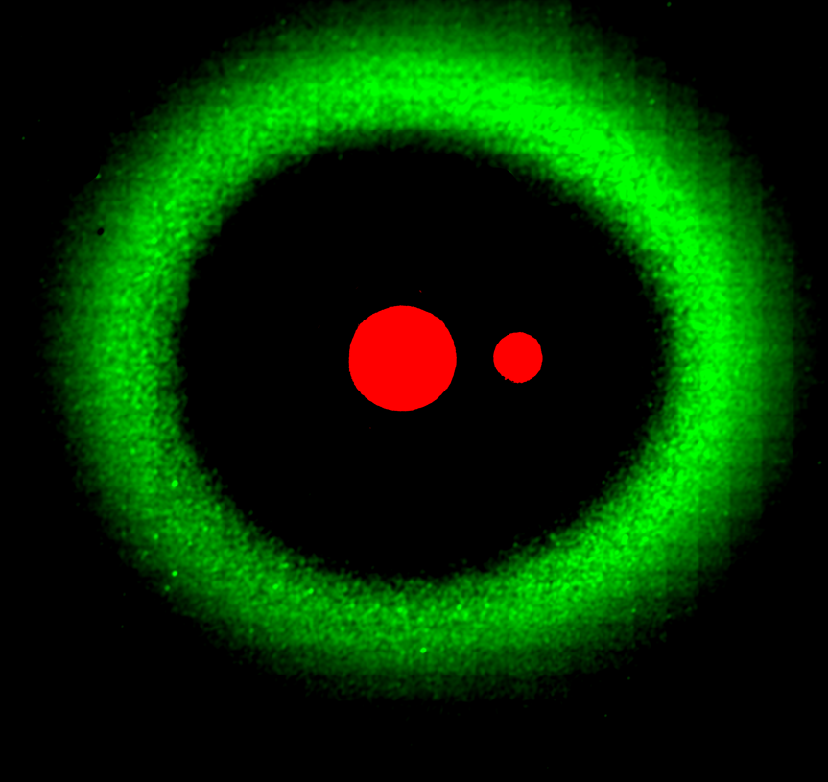
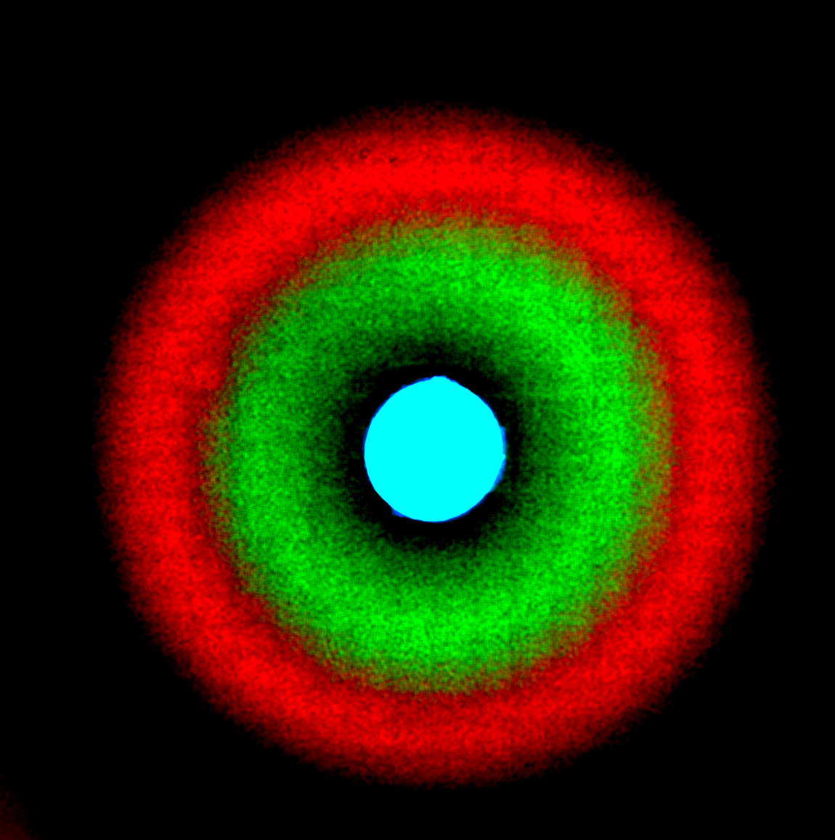
Modules implemented in Weiss lab
Ultrasensitive
Switch
EYFP = NOT(NOT(aTc)
Ring-like spatial patterns
Sender: send(AHL)
Receiver:
If (AHL = medium) then express (RFP)
aTc
CI
AHL
LuxR
LuxR
LuxR
tetR
lacI
cI
eyfp
CI
CI
LacI
GFP
GFP
Sender
Band detector
Band detector
Band detector
Pulse Generator
Sender: send(AHL)
Receiver: Transient GFP expression
aTc
AHL
tetR
luxI
luxR
cI
gfp

Slide 9
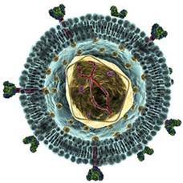
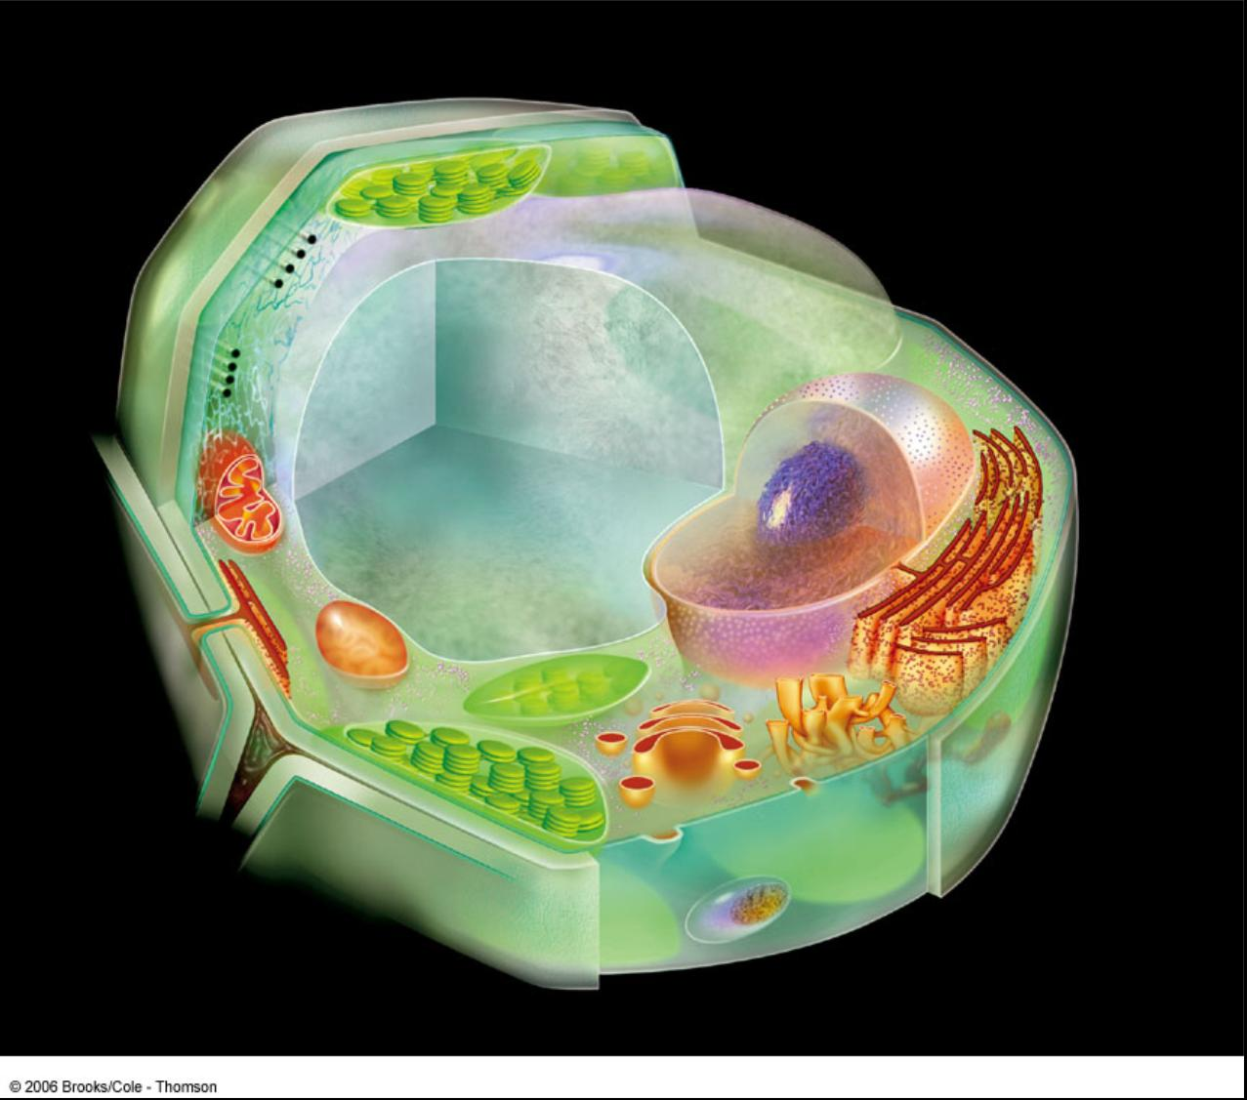
Cancer therapy: decipher the transcriptome
Problem: Most existing cancer therapies are not specific enough and result in significant collateral damage.
Goal: Develop an adaptable, effective and highly specific cancer therapy that evaluates internal cell state using combinatorial logic
Approach:
(1) a “smart virus” infects a cell,
(2) computes whether the transcriptome
is indicative of cancer, and if so,
(3) decides to destroy the cell
Main novelty: A therapeutic agent that carries an RNAi based logic circuit that can respond to a target gene expression profile
Note: Also, non-clinical applications
http://content.hccfl.edu/facultyinfo/ckasper/humanreproduction.html

Slide 10
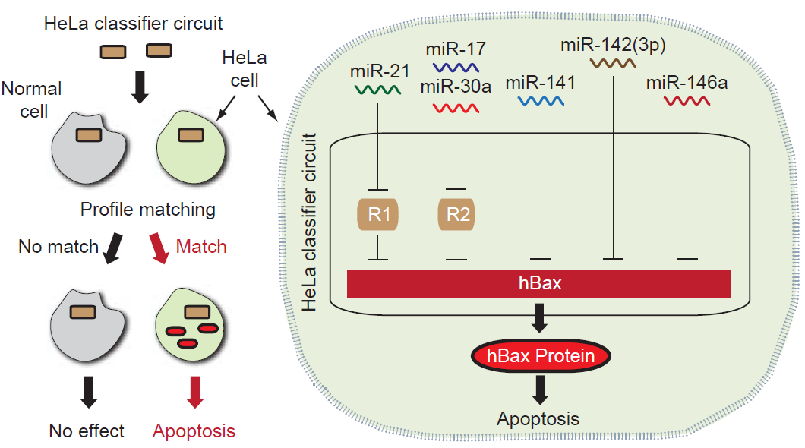
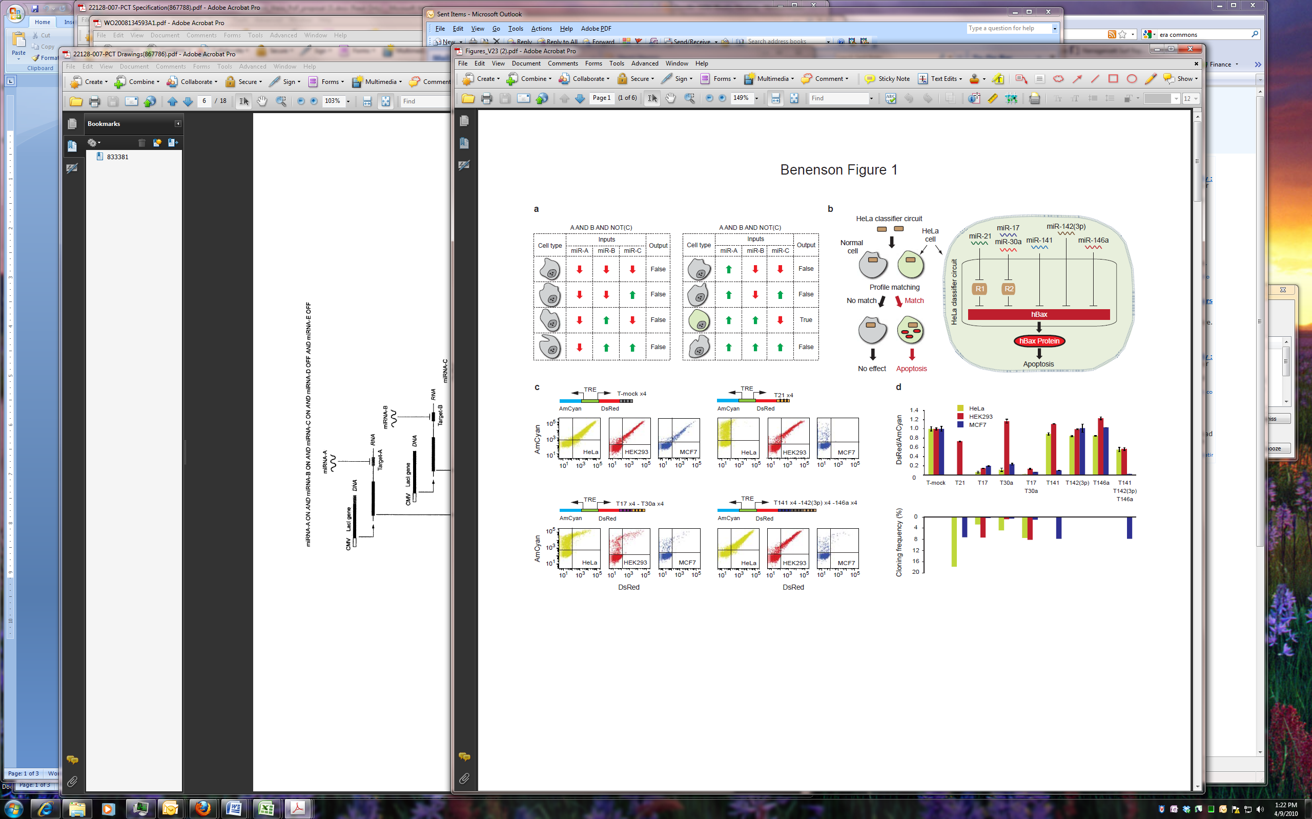
Using microRNA profiles (with Benenson lab)
miR-2H
miR-5L
miR-1H
miR-4L
miR-6L
miR-1A
miR-3H
Logic function: miR-1H ᴧ (miR-2H + miR-3H) ᴧ miR-4L ᴧ miR-5L ᴧ miR-6L

Slide 11
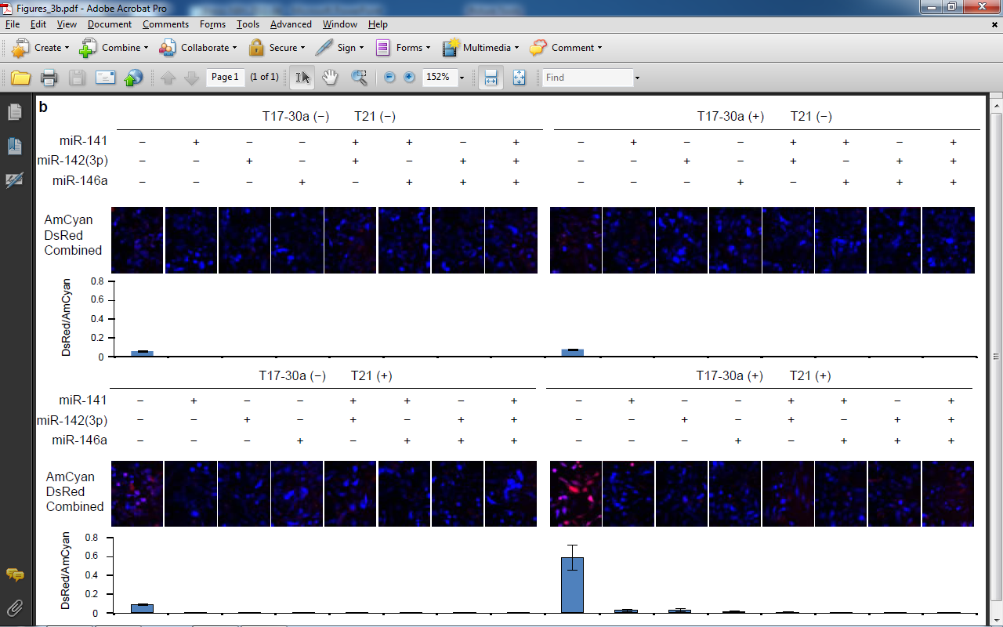
Verifying all 32 input combinations
2H/3H
1H
2H/3H
1H
4L
5L
6L
2H/3H
1H
2H/3H
1H
4L
5L
6L
Used HeLa cells
Transfected 4L/5L/6L to emulate indicated levels
Disrupted microRNA sites for 1H/2H/3H as indicated in the four panels

Slide 12
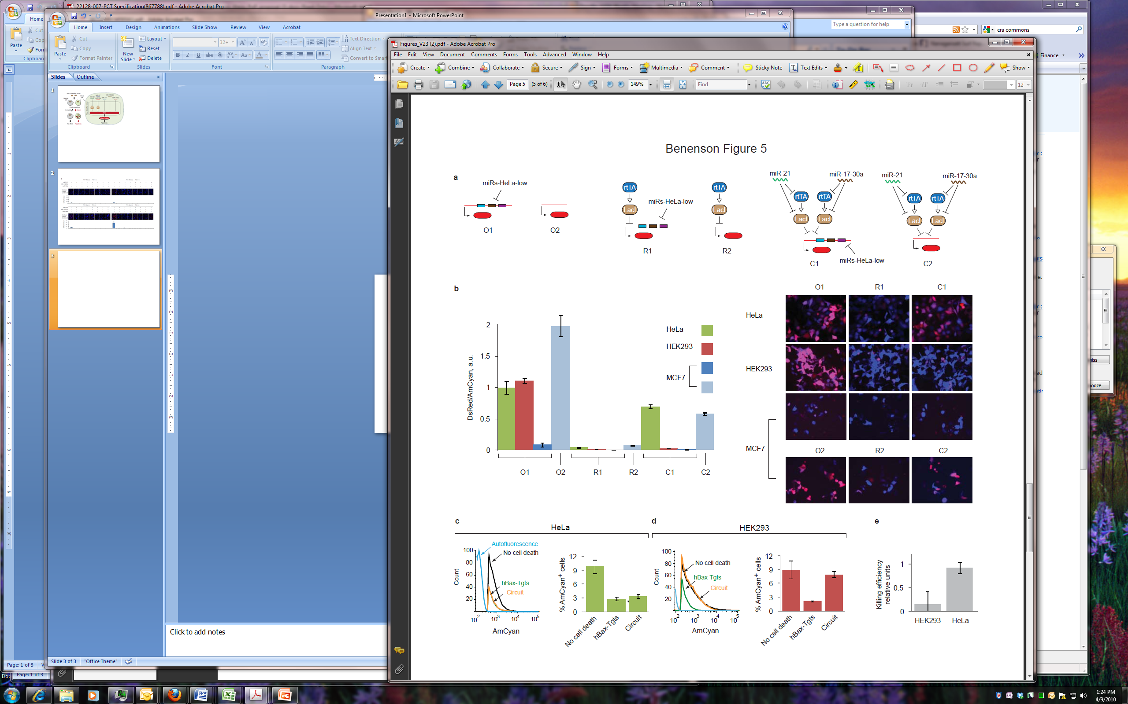
Fluorescence output in 3 cell lines
Experimental legend
O1: Just low targets
O2: No targets
R1: Low targets + transcriptional repression
R2: Just transcriptional repression
C1: Full circuit
C2: Just high targets

Slide 13
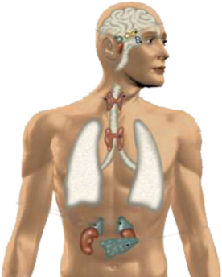
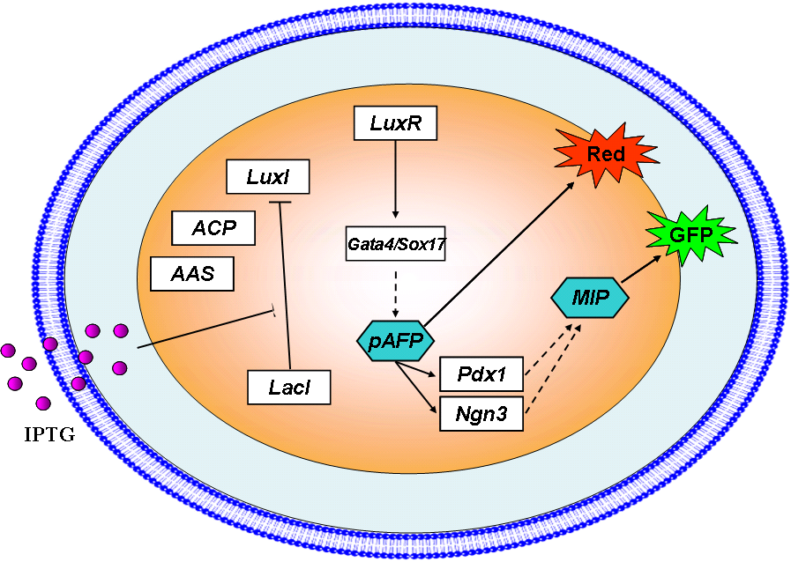
Artificial tissue homeostasis for β cells
7.8% of the US population has diabetes
In Diabetes Type I (10% of diabetics), auto-immune response (slowly) kills insulin-producing pancreatic β cells.
Goal:
Maintain population level of β-like cells using
auto-regulated differentiation of ES cells
that counter-balances auto-immune attacks.
ES cell
proliferation
ES cell
population?
high
ES cell
growth arrest
low
high
ES → β cell
differentiation
β cell
population?
low
Complex system with 22 components
Design with ‘known’ modules (from bacteria, yeast, mammalian cells)
Notes:
13
13
13
Motivation: Glandular organs
Approach: Implement artificial quorum sensing for programmed differentiation
MIP: Mouse Insulin Promoter
ACP and AAS as previously explained
Luxr activates Gata4 or Sox17, drives cell to an endoderm stage,
Once endoderm is formed, alpha-fetoprotein is expressed. Alphafetoprotein simultaneously activates three genes: dsred, so we know we have endoderm, and Pdx1 and Ngn3
Alpha-fetoprotein (AFP) controls expression of Pdx1 and Ngn3 -> beta cell differentiation
Type 1: autoimmune diease, body attacks beta cells and renders them dead or nonfunctional
Type II: get later in life, linked to obesity and other things. Helpful where insulin is mutated, insulin receptors are mutated, or insulin not produced in enough quantity.
Working on a more complex system, which will allow for control and constant production of beta cells,
Also, using ES cells Possible that the immune system would not recognize and attack these cells
This system might be useful for helping with type 1 type 2 diabetes, where the human immune response kills off the beta cells, thus can't produce insulin anymore
Thus, this system would allow us to transplant embryonic stem cells, let them proliferate to be able to produce beta cells, reach a critical density, and then differentiate into beta cells to remedy / compensate for the natural deficiency

Slide 14
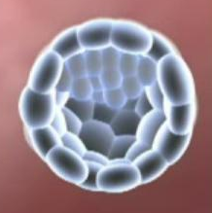
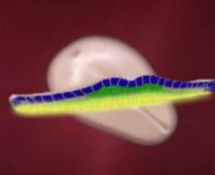
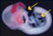
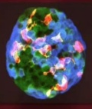
A self-timed genetic program for β cell differentiation
High level behavior:
“Self-timed, multi-step
β cell differentiation”
Bio-program:
input: DOX
if (DOX)
ICM
Ectoderm
Mesoderm
Endoderm
express(Endo-CFR)
if (Endoderm)
express(Islet-CFR)
if (Islet)
express(GFP)
lungs
stomach
liver
pancreas
exocrine
endocrine
Nervous system;
Skin;
Muscles;
Bones;
Blood;
PP
alpha
gamma
beta
Notes:
14
14
14
Motivation: Glandular organs
Approach: Implement artificial quorum sensing for programmed differentiation
MIP: Mouse Insulin Promoter
ACP and AAS as previously explained
Luxr activates Gata4 or Sox17, drives cell to an endoderm stage,
Once endoderm is formed, alpha-fetoprotein is expressed. Alphafetoprotein simultaneously activates three genes: dsred, so we know we have endoderm, and Pdx1 and Ngn3
Alpha-fetoprotein (AFP) controls expression of Pdx1 and Ngn3 -> beta cell differentiation
Type 1: autoimmune diease, body attacks beta cells and renders them dead or nonfunctional
Type II: get later in life, linked to obesity and other things. Helpful where insulin is mutated, insulin receptors are mutated, or insulin not produced in enough quantity.
Working on a more complex system, which will allow for control and constant production of beta cells,
Also, using ES cells Possible that the immune system would not recognize and attack these cells
This system might be useful for helping with type 1 type 2 diabetes, where the human immune response kills off the beta cells, thus can't produce insulin anymore
Thus, this system would allow us to transplant embryonic stem cells, let them proliferate to be able to produce beta cells, reach a critical density, and then differentiate into beta cells to remedy / compensate for the natural deficiency

Slide 15
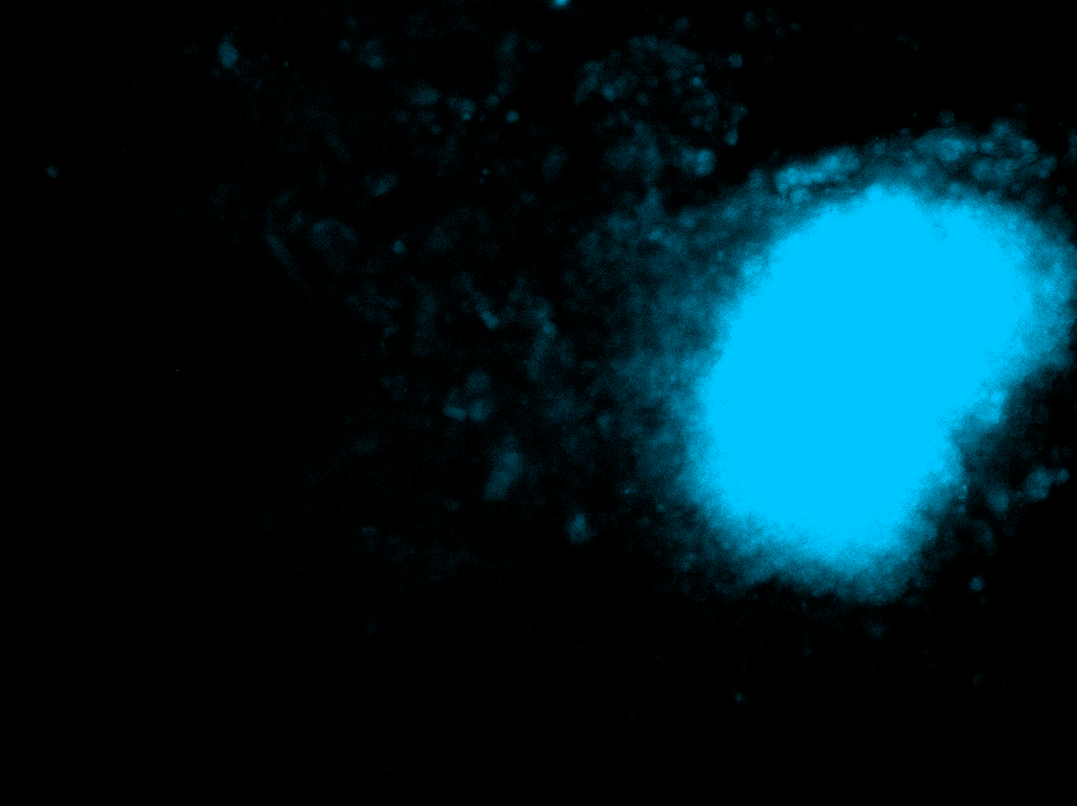
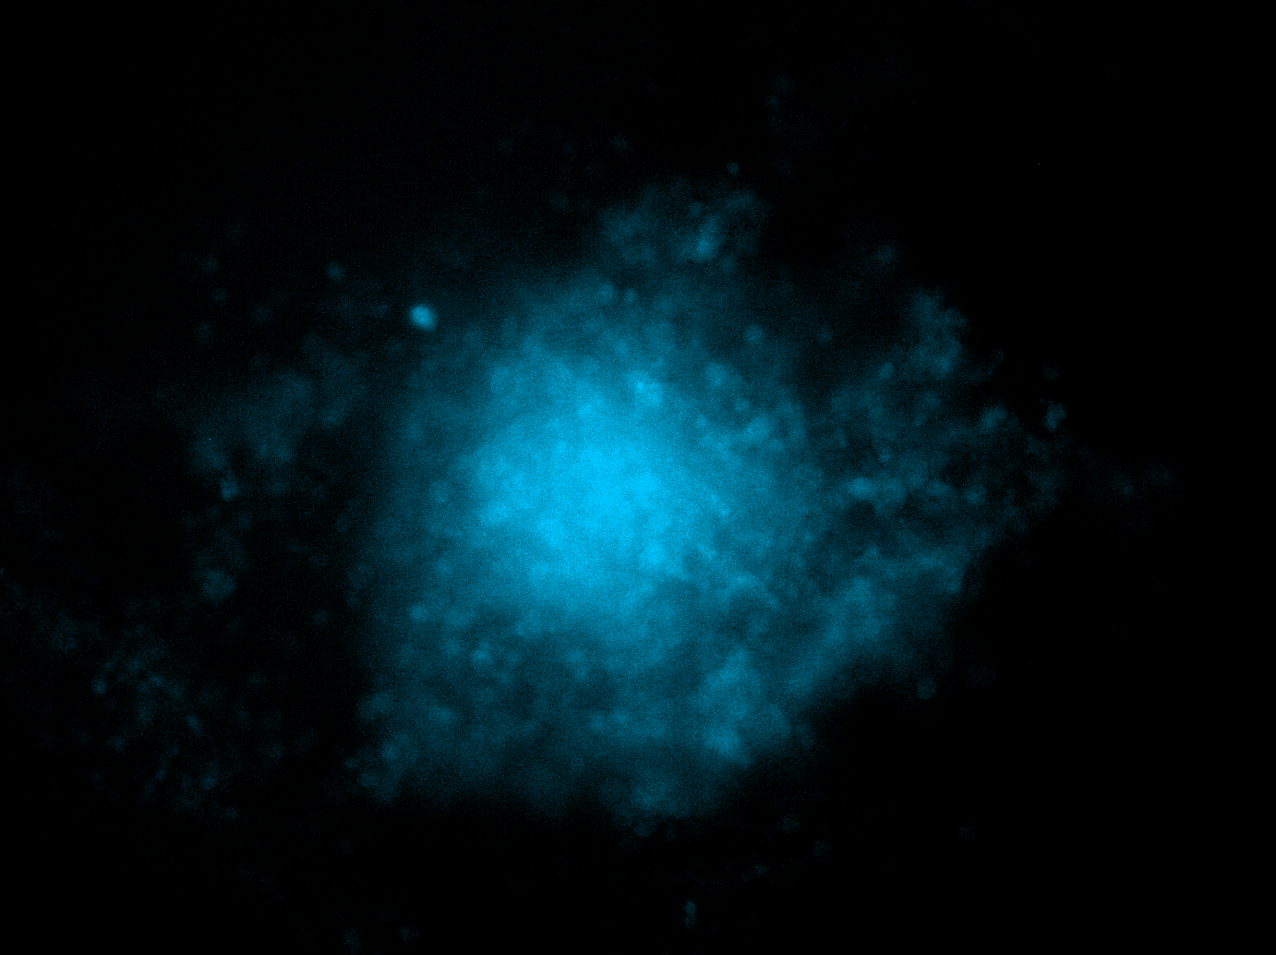
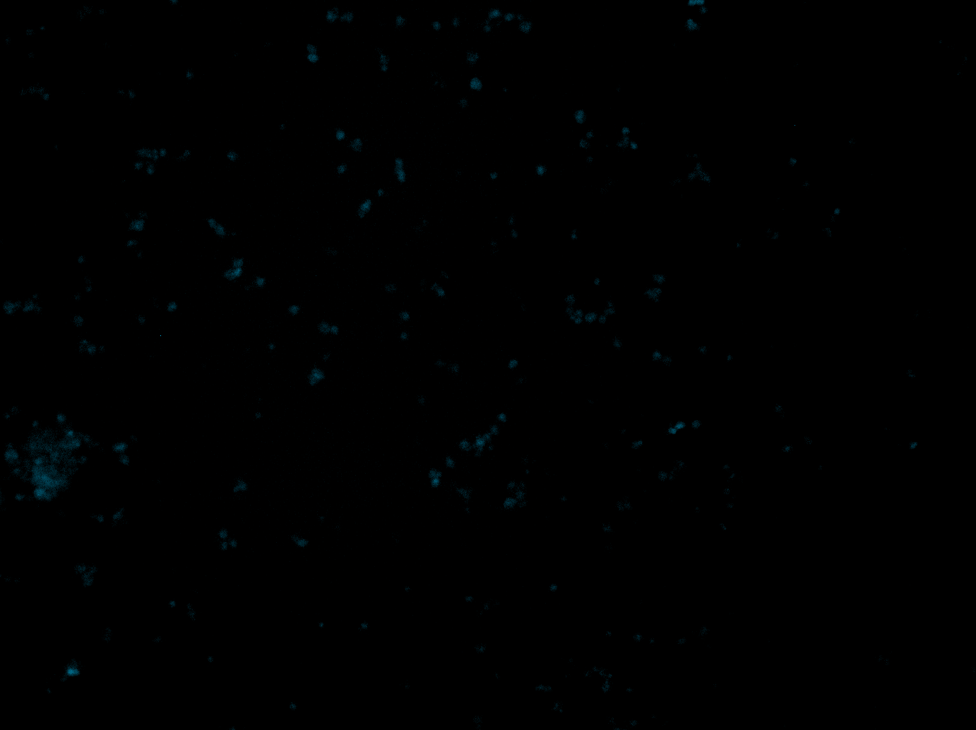
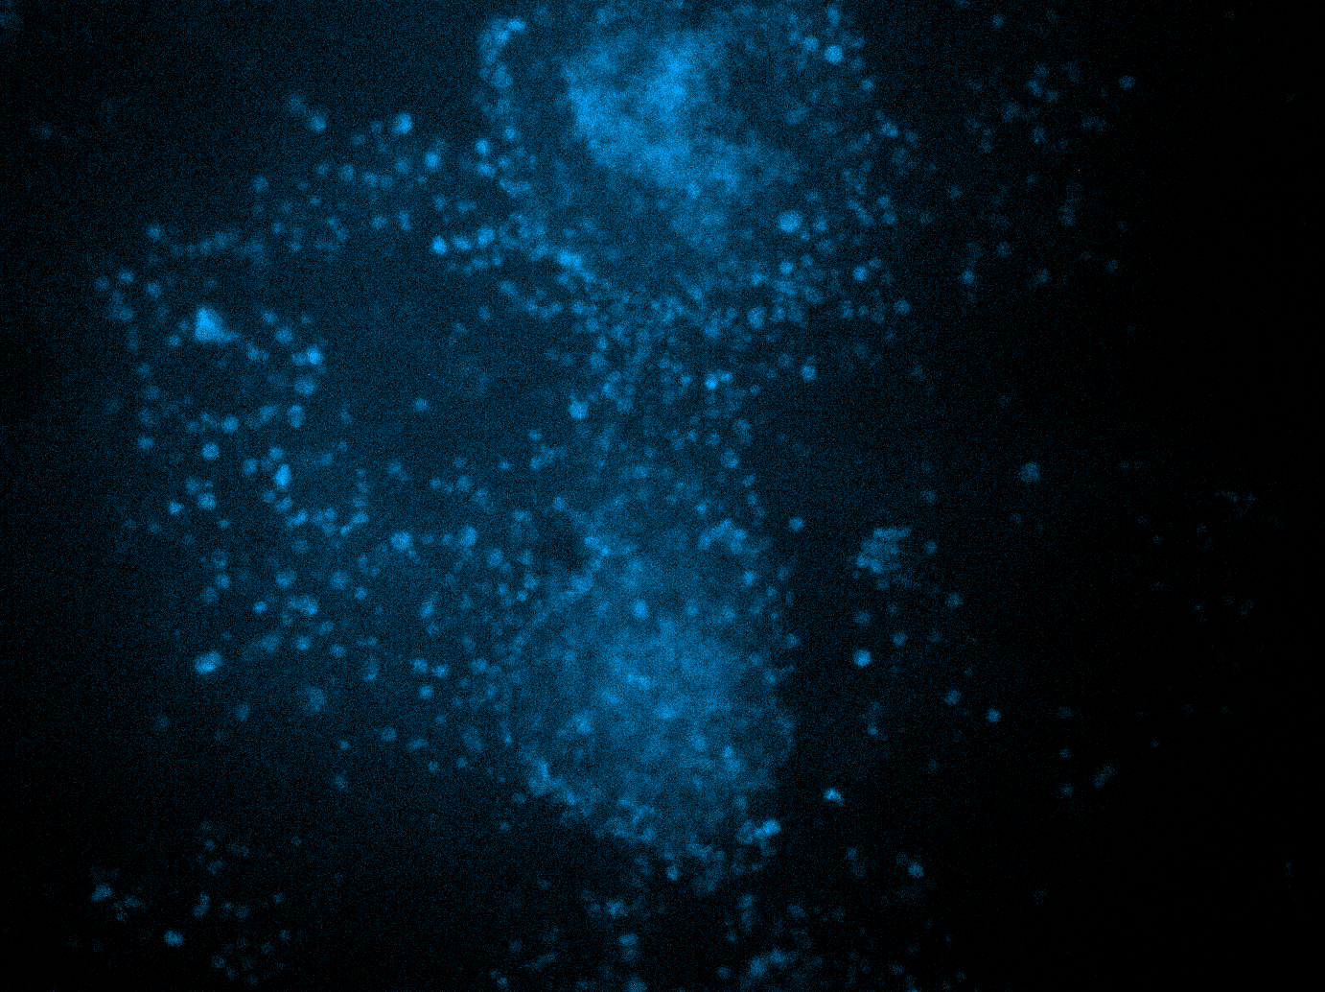
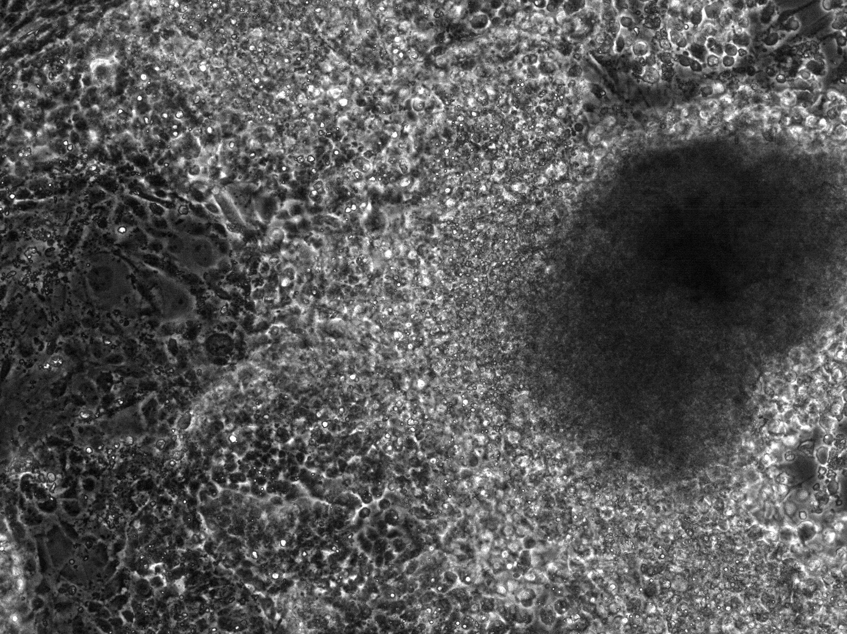
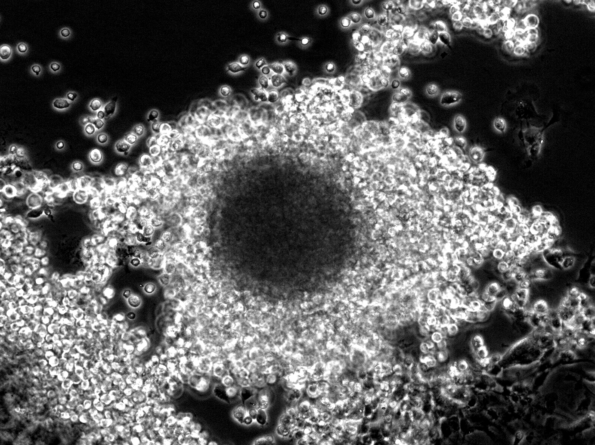
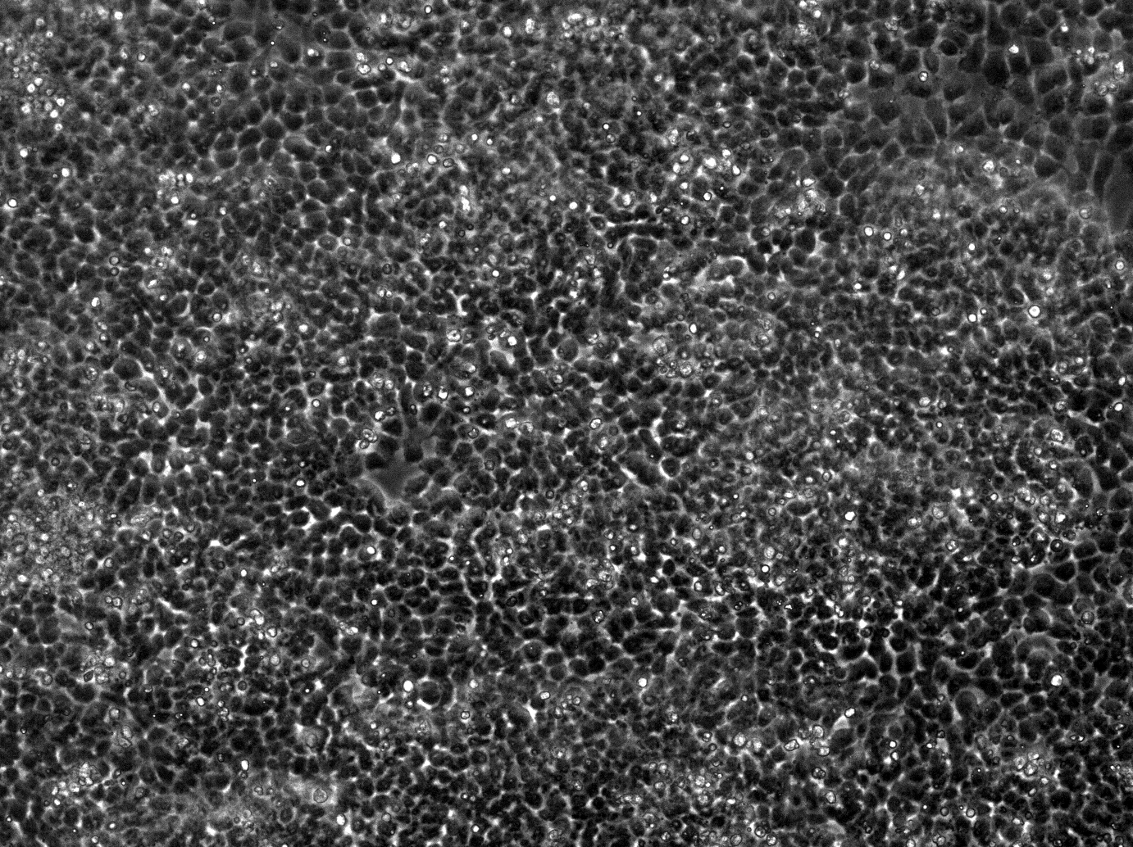
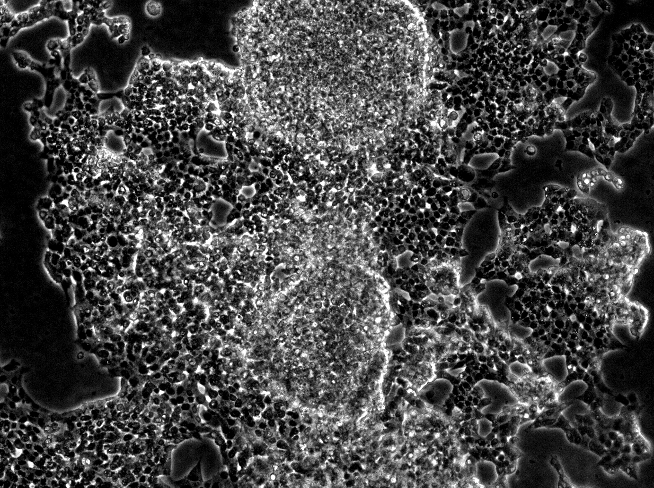
Insulin-production assay with C-peptide antibodies
Program 1
Program 2
Neg. ctrl
Pos. ctrl
GATA4
Ngn3
Dox
GATA4
Ngn3
Pdx1
Dox/aTc
CCE
Beta TC6

Slide 16

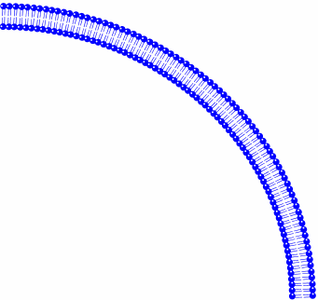
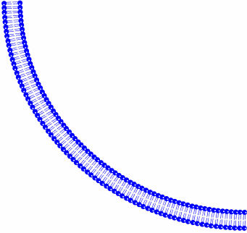
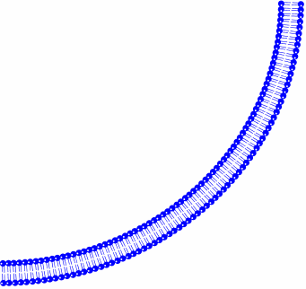
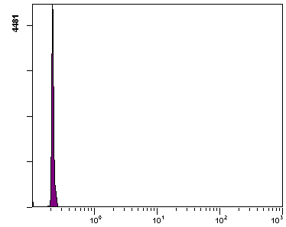
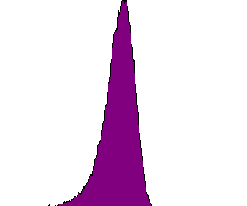
Engineered mammalian cell-cell communication
Mammalian
Sender
AHL Dosage Response
ACP
GFP FLR (A.U.)
P_{HEF1α}
LuxI
LuxI
P_{HEF1α}
ACP
P_{HEF1α}
Citx
LuxI
AHL
LuxI
exogenous AHL
Citx
Mammalian
Receiver
neg.
ctrl
LuxIm +
ACPm +
Citxm
LuxR
P_{lux}
GFP
Events
P_{HEF1α}
LuxR
DsRed
Fluorescence (A.U.)

Slide 17
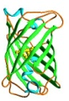
Information processing: toggle switch
aTc
aTc
LacI
TetR
LacI
IPTG
TetR
IPTG
aTc
IPTG
IPTG
aTc
Notes:
17

Slide 18
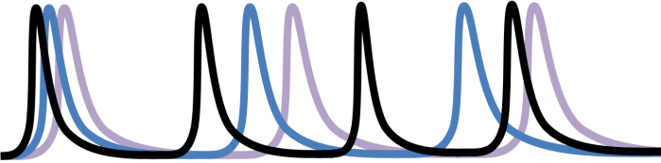
Logic to regulate differentiation
Uncommitted
population control
high?
No commitment
+
Self-renewal
f(x)
UPD
“0”
Oscillator
AND
high?
Toggle . switch
NOT
“1”
Committed population
Commitment
+
Differentiation
f(x)
high?
CPD
Features:
Decouple commitment from differentiation
Oscillator breaks symmetry
Exploit biological noise in design
Notes:
Put the collapse model in place of the oscillator at first then make disappear and bring in oscillator

Slide 19
Artificial tissue homeostasis (version 0.2)
I1
AI 1
Rec1
GAF
Uncommitted Pop.
A2
Toggle Switch
Oscillator
A1
R2
R4
R6
R7
R3
R1
R5
Committed Population
Rec2
Differentiation
Ngn3
Gata4
AI 2
I2
Pdx1
AFP

Slide 20
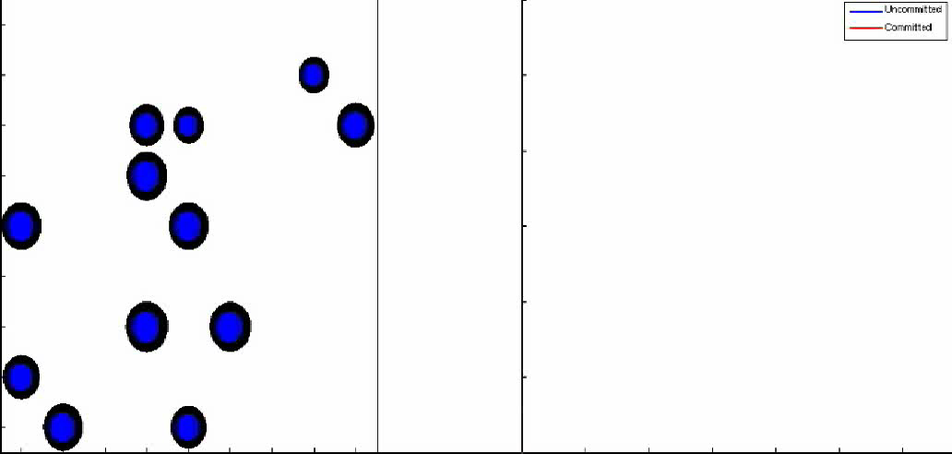
Simulation of artificial tissue homeostasis
Blue = uncommitted
Red = committed

Slide 21
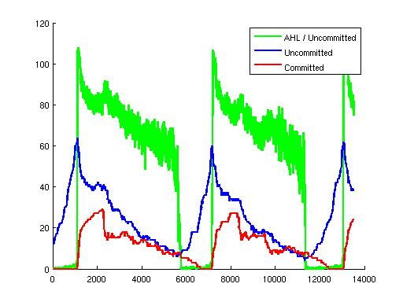
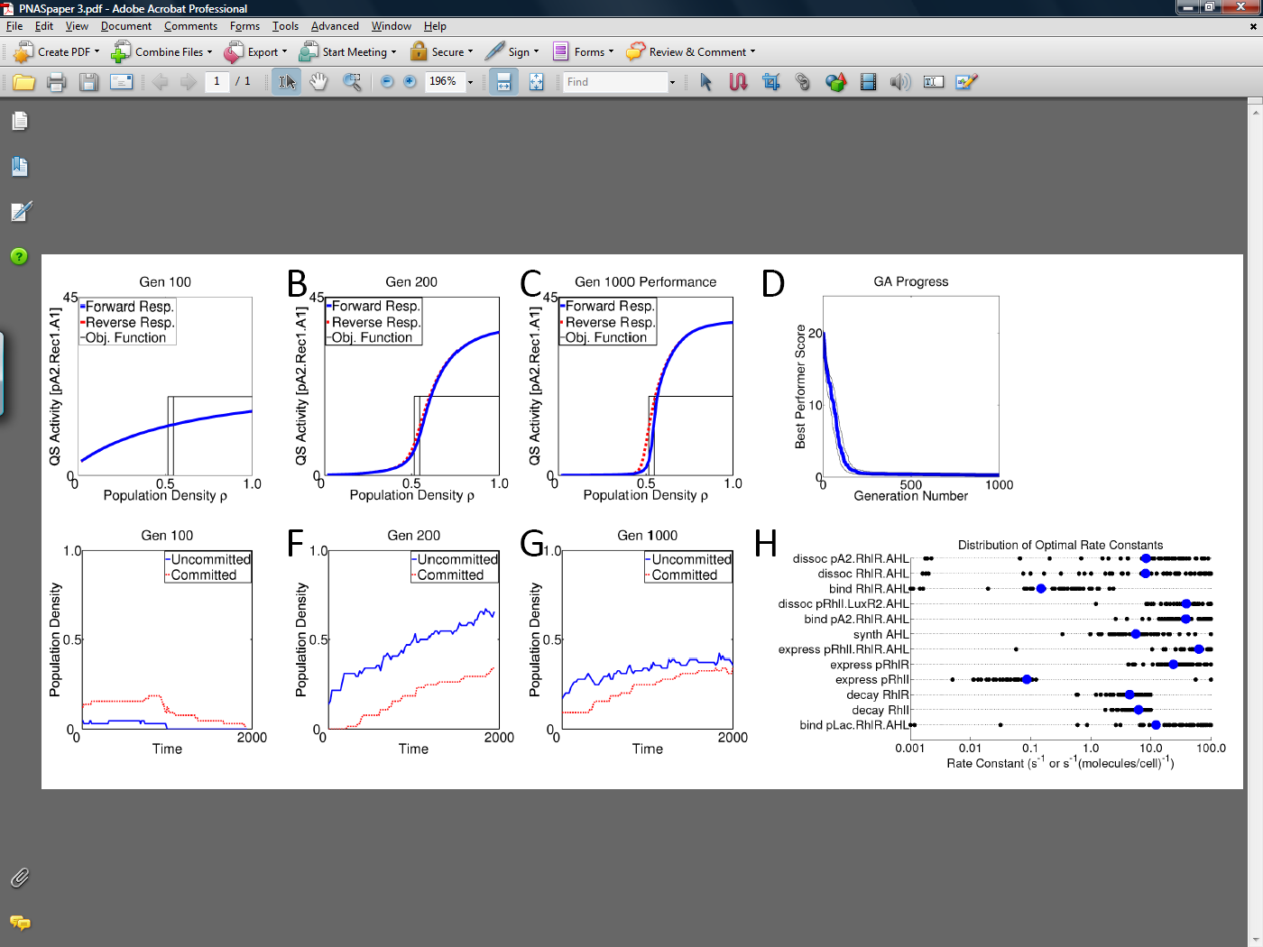
System optimization
Issue:
quorum sensing hysteresis results in
non-optimal commitment
Approach:
Use sensitivity analysis to identify important
parameters and genetic algorithms to optimize
parameter set and remove hysteresis
Notes:
21

Slide 22
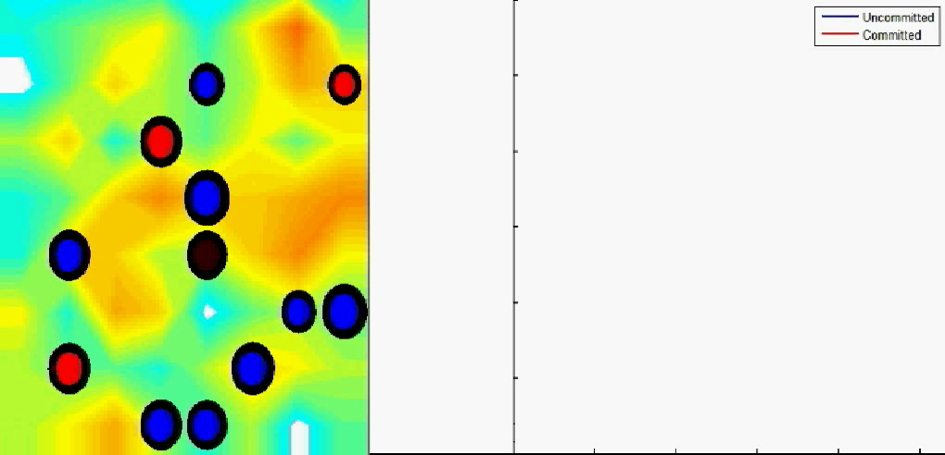
Simulation of artificial tissue homeostasis
Blue = uncommitted
Red = committed
Notes:
22

Slide 23
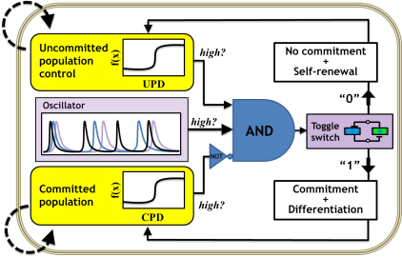
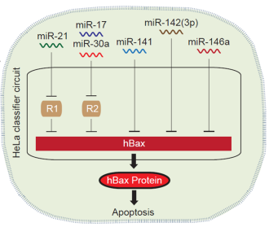

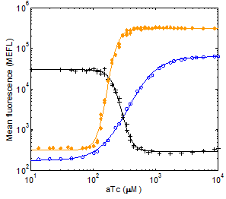
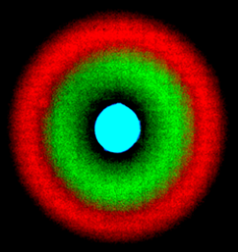
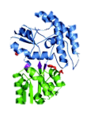
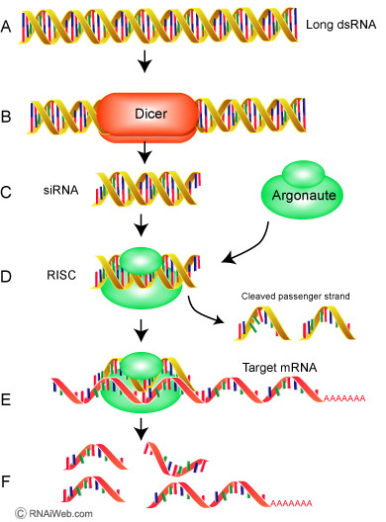
Summary
Applications
System integration
Modules
Genetic parts

Slide 24
(Simplified) Lessons
Goal: create an engineering discipline for biology
Be inspired by Biology / CS / EE / MechEng / CivilEng / …
then
Design it your way
but
Don’t underestimate biological complexity!

Slide 25

Acknowledgments
MIT (current):
  Jon Babb
  Noah Davidsohn
  Steve Firsing
  Saurabh Gupta
  Patrick Guye
  Yinqing Li
  Ting Lu
  Cil Purnick
  Jingjing Sun
  Liiliana Wroblewska
Princeton (former):
  Ernesto Andrianantoandro
  Subhayu Basu
  Ming-Tang Chen
  David Coleman
  Caroline DeHart
  Yoram Gerchman
  Abigail Kalmbach
  David Karig
  Jerome Ku
  Sara Hooshangi
  Rishabh Mehreja
  Thomas Mason
  Miles Miller
  Ilka Netravali
  Tom Peterson
  Allegra Petti
  Sairam Subramanian
  Stephan Thiberge
Princeton:
  Craig Arnold
  Ken Steiglitz
  Hersch Rabitz
Mt. Sinai:
  Ihor Lemischka
Caltech:
  Frances Arnold
  Jared Leadbetter
  Yohei Yokobayashi
  Cynthia Collins
Duke:
  Lingchong You
Harvard
  Kobi Benenson
MIT:
  Tom Knight
  Gerald J. Sussman
  Hal Abelson
  Radhika Nagpal
  Dylan Hirsch-Shell
Funding:
DARPA BIOS
NSF QuBIC
NSF EMT
NSF Career
DOE
Princeton
NJ Spinal Cord

Slide 26

Questions?

Slide 27
Thank you!

